Slide 1
Constructive Computer Architecture
Arvind
Computer Science & Artificial Intelligence Lab
Massachusetts Institute of Technology
6.175: L01 – September 9, 2015

Slide 2
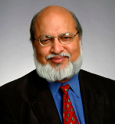
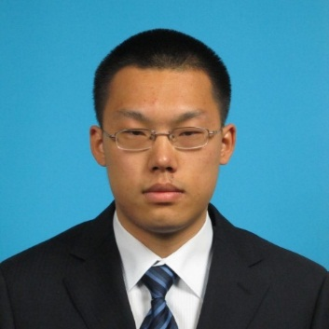
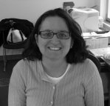
6.175
Course Staff
Instructor
Arvind
arvind@csail.mit.edu
Teaching Assistant
Adminis-tration
Sizhuo Zhang
szzhang@mit.edu
Sally Lee
sally@csail.mit.edu
For most up-to-date information and handouts please consult the course website: http://csg.csail.mit.edu/6.175

Slide 3
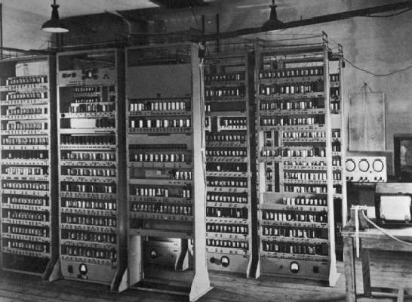
Computing Devices Then…
EDSAC, University of Cambridge, UK, 1949
Notes:
Fishbowl computing. Dramatic changes since then.

Slide 4




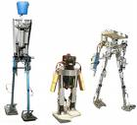
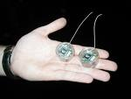
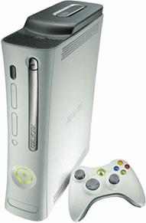


Computing Devices Now
Dramatic progress in terms of size, speed, cost, reliability

Slide 5
Computer architecture is about designing machines to meet some power, performance, cost and size constraints

Slide 6
Studying Computer Architecture
A method of constructing machines: Machine descriptions which can be simulated in software and synthesized into hardware
This course is about “construction”
Quantitative evaluation: To what extent designs meet various design criteria
Testing and verification: Does the machine do what it is supposed to do

Slide 7
Constructing and Deconstructing
A venerable method of studying any class of artifacts
an example from the art world...

Slide 8
Las Meninas (The Maids of Honour) Diego Velázquez 1656
Pictures removed for copyright protection. Please visit the following link to view the pictures:
http://en.wikipedia.org/wiki/Diego_Velazquez
Portrait of Infanta Margarita, the daughter of King Philip IV, in Royal Alcazar, Madrid

Slide 9
Different lighting
Pictures removed for copyright protection. Please visit the links to view pictures:
http://en.wikipedia.org/wiki/Diego_Velazquez
Also just type “velasquez maids of honor pictures” in google

Slide 10
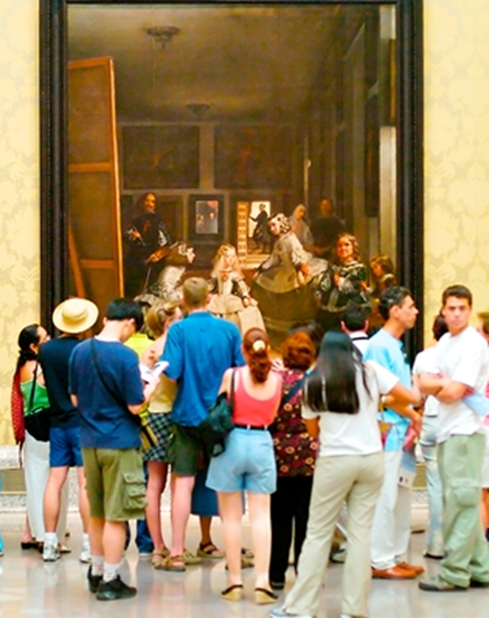
It is big!
Museo del Prado, Madrid

Slide 11
Engages the viewer
Pictures removed for copyright protection. Please visit the links to view pictures:
http://en.wikipedia.org/wiki/Diego_Velazquez
Also just type “velasquez maids of honor pictures” in google
The most important painting in Western art history

Slide 12
Spanish tradition
Diego
Velasquez
1599-1660
El Greco
1541–1614
Francisco
de Goya
1746–1828
Pablo
Picasso
1881-1973
Pictures removed for copyright protection. Please visit the links to view pictures:
http://en.wikipedia.org/wiki/Diego_Velazquez
http://en.wikipedia.org/wiki/El_Greco
http://en.wikipedia.org/wiki/Goya
http://en.wikipedia.org/wiki/Picasso

Slide 13
Picasso
In fine arts one is encouraged to copy masters as a way of learning
In 1956, at the 300th anniversary of Diego Velázquez’s Las Meninas, Picasso revisited Madrid to see the painting
The story goes he came back and locked himself in his studio for three months and painted 58 versions of it – deconstructing and constructing – not copying
  All can be seen at Museu Picasso in Barcelona
Why? Picasso was 75 and very aware of his Spanish heritage. Was he trying to improve upon the master’s work?

Slide 14
Deconstructing & Constructing: Las Meninas
Just type “maids of honor Picasso” in google
All of Picasso’s copies of Las Meninas are the Picasso Museum in Barcelona

Slide 15
Infanta Margarita
Just type “maids of honor Picasso” in google
All of Picasso’s copies of Las Meninas are the Picasso Museum in Barcelona
Perplexed? Distracted by sun light?

Slide 16
Deconstructing & Constructing: Las Meninas – Infanta Margarita
Just type “maids of honor Picasso” in google
All of Picasso’s copies of Las Meninas are the Picasso Museum in Barcelona

Slide 17
Deconstructing & Constructing: Las Meninas
Just type “maids of honor Picasso” in google
All of Picasso’s copies of Las Meninas are the Picasso Museum in Barcelona

Slide 18
Deconstructing & Constructing: Las Meninas
Just type “maids of honor Picasso” in google
All of Picasso’s copies of Las Meninas are the Picasso Museum in Barcelona

Slide 19
Deconstructing & Constructing: Las Meninas
Just type “maids of honor Picasso” in google
All of Picasso’s copies of Las Meninas are the Picasso Museum in Barcelona

Slide 20
Picasso reportedly said “I cannot improve it but these are my Meninas”

Slide 21
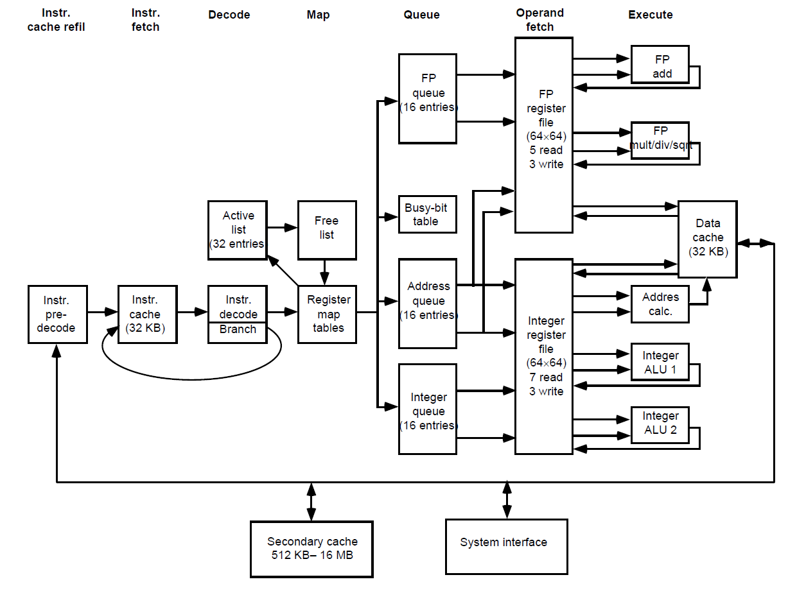
Deconstructing Microprocesors:
MIPS R10K
Modern processors are complex:
ALUs, pipelining, caches and cache coherence, branch predictors, virtual memory, ...
Designs must be balanced and meet some design constraints
Deconstruct R10K to construct our Las Maninases

Slide 22
Our Meninas:
Various RISC V Processors
A new open instruction set out of Berkeley
Non-Pipelined: 1 Cycle, 2 Cycle, 4 Cycle
Pipelined: 2-stage with and without data hazards; pipelines with up to 6 stages
Pipelines with multiple Branch Predictors
Pipelines with Branch Predictors and Caches
Pipelines with Exceptions
Pipelines with TLBs and Virtual Memory
Non-blocking caches
Multi-core Processors with coherent shared memory
All these are evaluated quantitatively using C benchmarks run in simulation and on real hardware

Slide 23
The goals of this subject
Study computer architecture by constructing many different machines
Learn a new method of describing architectures where there is less emphasis on figures/diagrams and more emphasis on executable descriptions
  Each architecture and each part of it would be defined as executable code in BSV
  Learning BSV is about learning a model of parallel programming (all hardware is parallel)
Learn about test benches, including designing your own
Learn about quantitative evaluation of designs

Slide 24
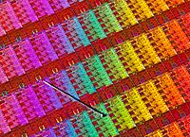
BSV Design Flow
BSV source
Bluespec Compiler
Verilog RTL
Bluespec Simulator
Cycle
Accurate
Xilinx Vivado
Simulator
Xilinx Vivado
Synthesis
Design Compiler/ Encounter
VCD output
Power Analysis
Gates
ASIC

Slide 25
All the designs you do in this course can be implemented as ASICs without any changes in the source code. Time will not permit the class to explore ASICs but we will show sample synthesis results

Slide 26
Course information
The class will meet three times a week (MWF 3pm to 4pm), accept for a few holidays
  Typically two classes every week are lectures while the third one is a tutorial
Eight lab assignments; to be done individually
A project/competition in the last two weeks to produce the fastest implementation or to try out a new cool architecture idea
Labs + project constitute 10 grade units
  A = >75% on all 10 grade units;
  B = >75% on 7 grade units
  C = >50% on 7 grade units
No Quizzes

Slide 27
Resources
“Computer Architecture: A Constructive Approach”, Arvind, Rishiyur Nikhil, Joel Emer and Murali Vijayaraghavan
BSV Reference manual
For most up-to-date information and handouts please consult the course website: http://csg.csail.mit.edu/6.175

Slide 28
Contributors to the course material
Current: Arvind, Rishiyur S. Nikhil, Muralidaran Vijayaraghavan, Andrew Wright, Sizhuo Zhang
Past:
  Staff and students in 6.S078 (12 Spring), 6.S195 (12 Fall, 13 Fall), 6.375 (13 Spring), 6.175 (14 Fall)
    Joel Emer, Asif Khan, Richard Uhler, Sang Woo Jun, Abhinav Agarwal, Myron King, Kermin Fleming, Ming Liu, Li-Shiuan Peh
  External
    Prof Amey Karkare & students at IIT Kanpur
    Prof Jihong Kim & students at Seoul Nation University
    Prof Derek Chiou, University of Texas at Austin
    Prof Yoav Etsion & students at Technion
    Prof James Hoe CMU

