Slide 1
Constructive Computer Architecture Tutorial 4 Debugging
Sizhuo Zhang
6.175 TA

Slide 2
BSV Debug -- $display
See a bug, not sure what causes it
Add $display statements
Recompile
Run
Still see bug, but you have narrowed it down to a smaller portion of code
Repeat with more display statements…
Find bug, fix bug, and remove display statements

Slide 3
BSV Display Statements
The $display() command is an action that prints statements to the simulation console
Examples:
$display(“Hello World!”);
$display(“The value of x is %d”, x);
$display(“The value of y is “, fshow(y));

Slide 4
Ways to Display Values Format Specifiers
%d – decimal
%b – binary
%o – octal
%h – hexadecimal
%0d, %0b, %0o, %0h
Show value without extra whitespace padding

Slide 5
Ways to Display Values fshow
fshow is a function in the FShow typeclass
It can be derived for enumerations and structures
Example:
typedef emun {Red, Blue} Colors deriving(FShow);
Color c = Red;
$display(“c is “, fshow(c));
Prints “c is Red”

Slide 6
BSV Debugging Waveform Viewer
Simulation executables can dump VCD waveforms
./bsim_dut –V test.vcd
Produces test.vcd containing the values of all the signals used in the simulator
Not the same as normal BSV signals
VCD files can be viewed by a waveform viewer
Such as gtkwave
The signal names and values in test.vcd can be hard to understand
Especially for structures and enumerations

Slide 7
Bluespec GUI Example
We use Bluespec GUI + gtkwave to view waveform of VCD files
gtkwave Installed in vlsifarm matchines
SSH with -X
ssh –X username@vlsifarm-03.mit.edu
Windows may need some tools
Cygwin/X
Use onecycle processor in lab5 as Example

Slide 8
Bluespec project
We have set SceMi to generate it when building the project
project.bld: workstation-project-file
$ cd scemi/sim
$ build –v onecycle
onecycle.bspec is the project file

Slide 9
Simulation: generate VCD file
$ cp ../../programs/build/assembly/vmh/simple.riscv.vmh
mem.vmh
$ ./bsim_dut –V out.vcd > log.txt &
$ ./tb

Slide 10
Open Bluespec GUI
$ bluespec onecycle.bspec

Slide 11
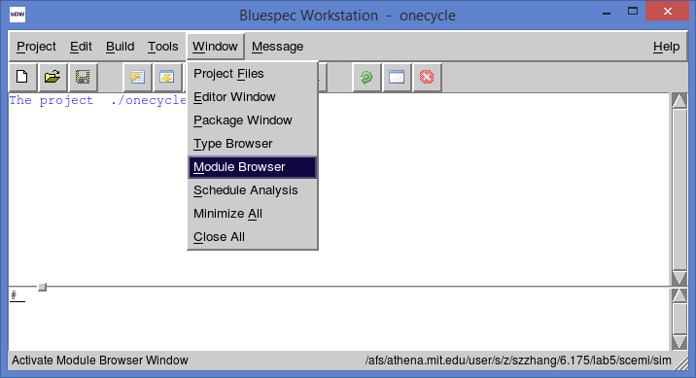
Open Module Browser
Window → Module Browser

Slide 12
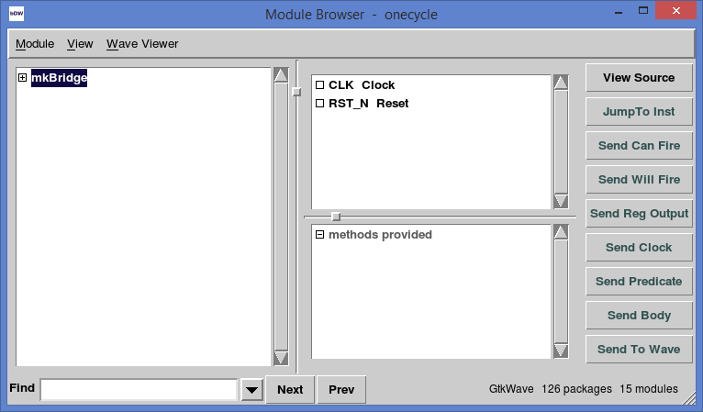
Module Browser
Top level module
Signals
Module Hierarchy
Methods

Slide 13
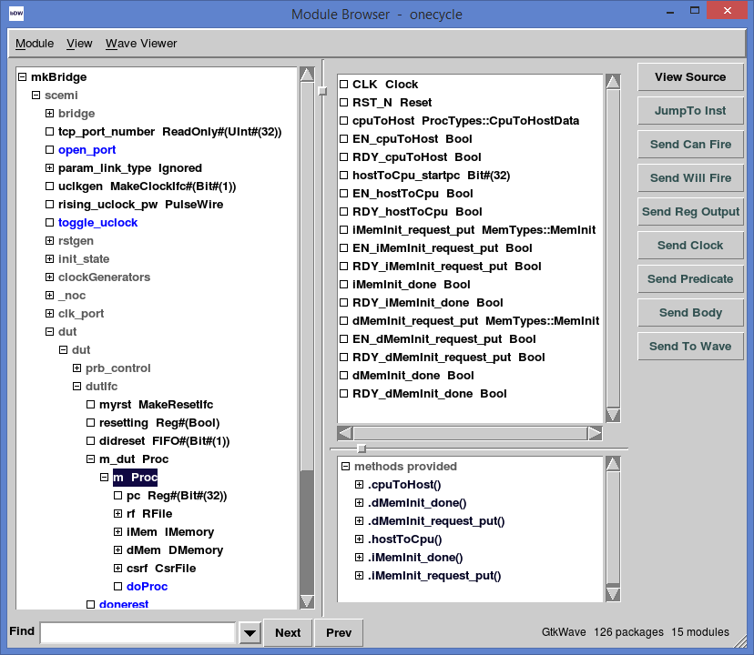

Slide 14
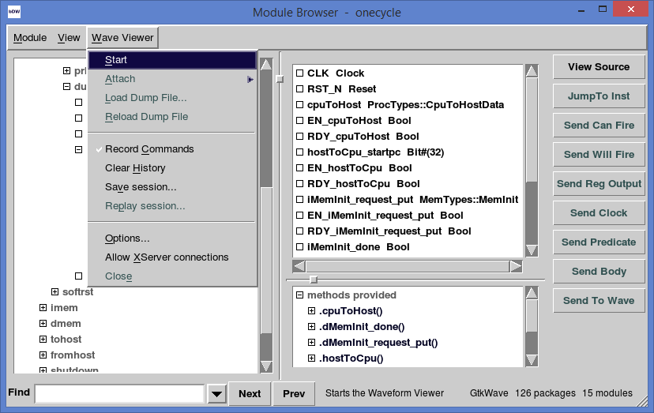
Open Waveform Viewer

Slide 15
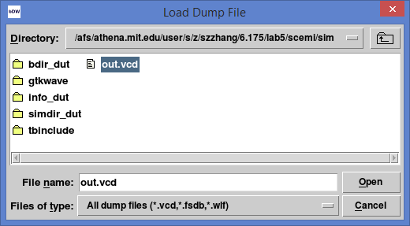
Load VCD

Slide 16
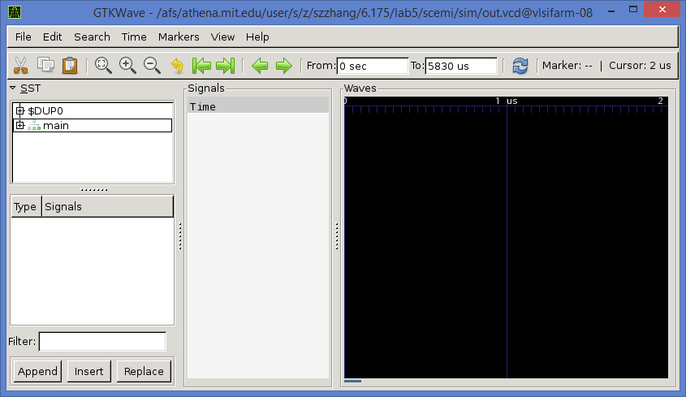
Waveform Viewer
Signal
names
Waveform

Slide 17
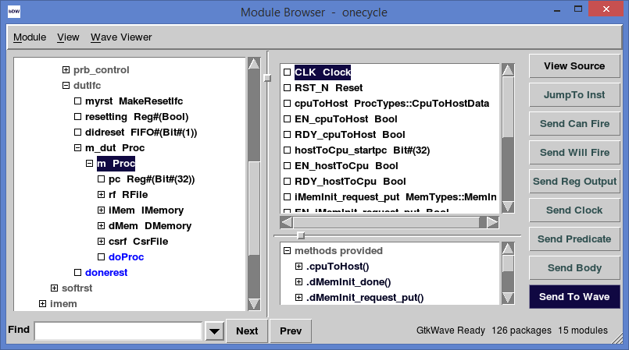
Add Signals to View
Add clock

Slide 18
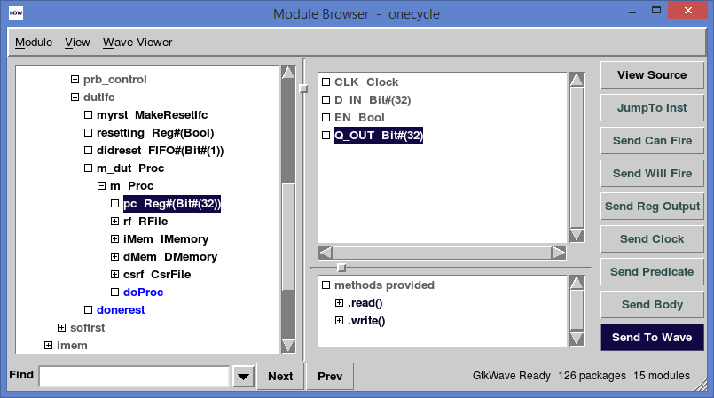
Add Signals to View
Add PC

Slide 19
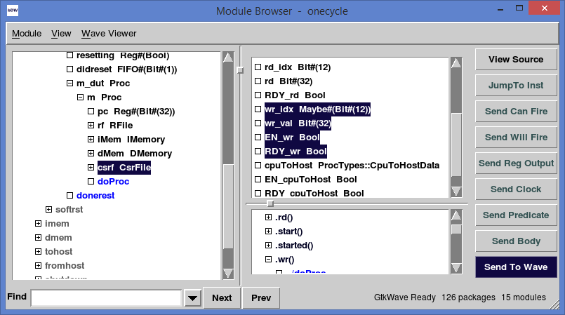
Add Signals to View
Add csrf.wr method

Slide 20
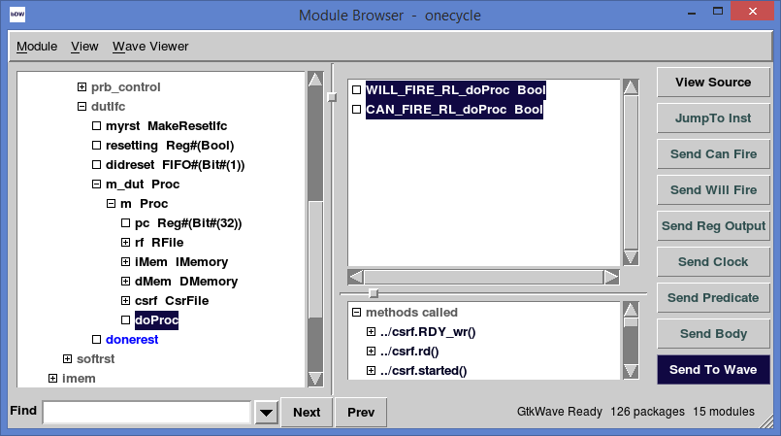
Add Signals to View
Add can_fire, will_filre for rule doProc

Slide 21
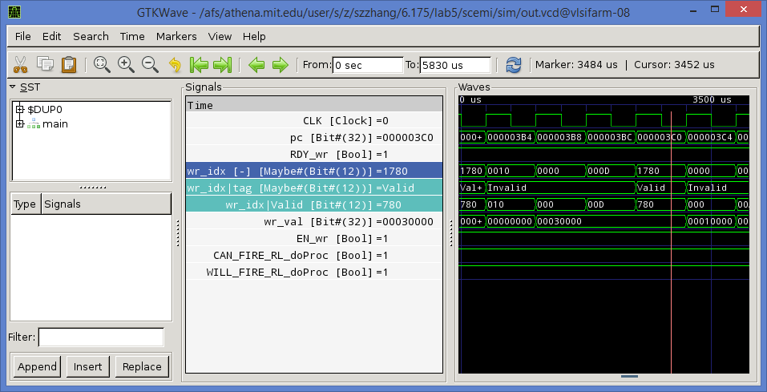
Waveforms
Readable value

Slide 22
Problem
No internal signals
Optimized away during compilation
But I want to see them for dubuggin
For example: dInst

Slide 23
Solution -- Probe
interface Probe#(type t);
method Action _write(t x);
endinterface
module mkProbe(Probe#(t)) provisos(
Bits#(t, sz));
Write to mkProbe will be recorded in VCD file
Instantiate mkProbe for each signal that we want to record

Slide 24
Probe Example
import Probe::*;
...
module mkProc(Proc);
mkProbe#(DecodedInst) dInstProbe <- mkProbe;
...
rule doProc;
...
let dInst = decode(inst);
dInstProbe <= dInst;
...
endrule
...
endmodule

Slide 25
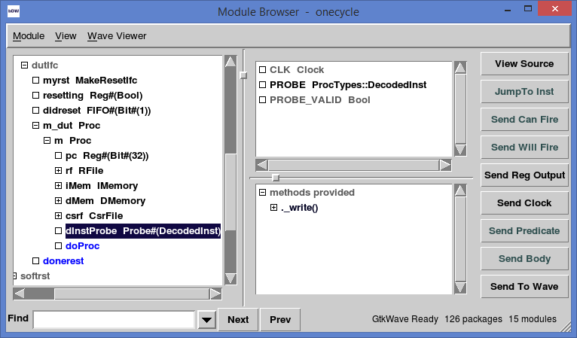
After Adding Probe

Slide 26
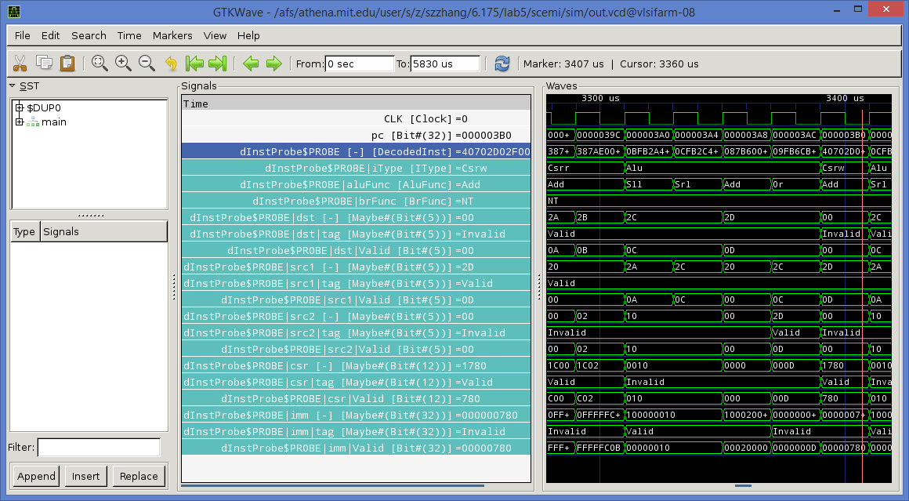

Slide 27
Combine with Assembly
Assembly code of compiled tests are in
programs/build/*/dump
Refer to the assembly code in debugging

Slide 28
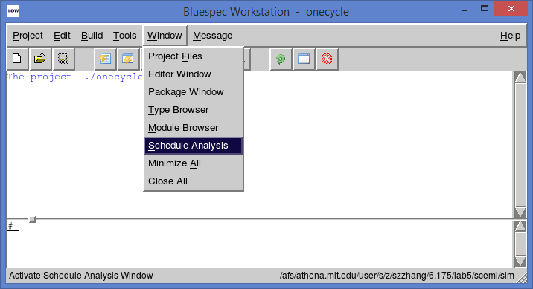
Debugging Scheduling
GUI: schedule Analysis
The same as “-show-shedule” BSC flag

Slide 29
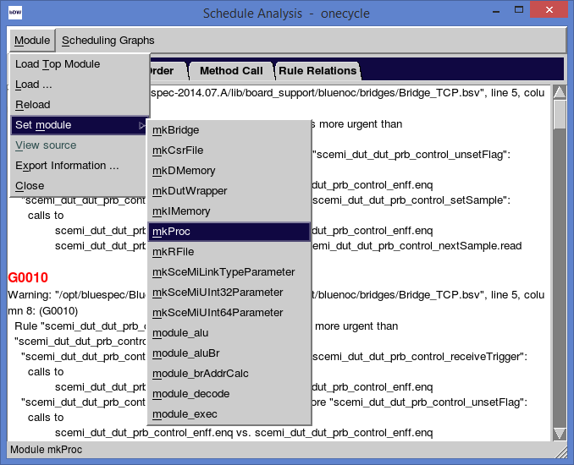
Select mkProc

Slide 30
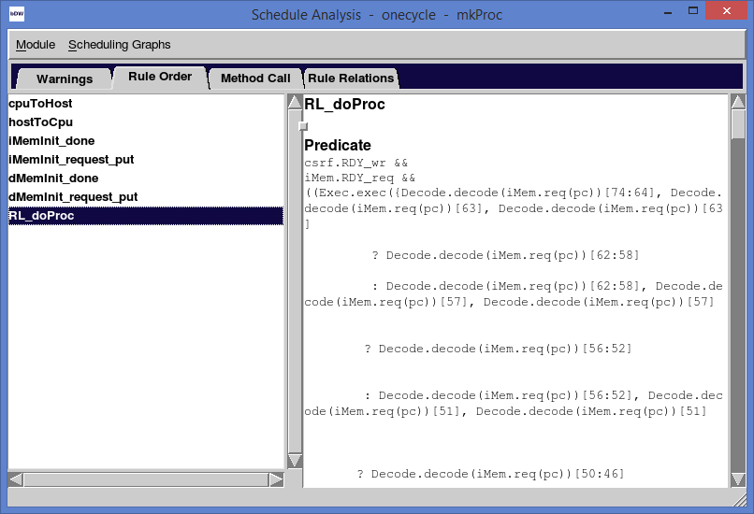
Output of Schedule Analysis
Rule order: execution order of rules and methods
From top to bottom

Slide 31
Alternative for Schedule Analysis
Add –show-schedule to project.bld
Generate info_dir/*.sched
Contain same information as GUI outputs

Slide 32
General Debugging Advice
Debugging is to guess what goes wrong
Check warnings in compiler outputs
Scheduling warnings
Understand all warnings in mkProc
Stare at your code – prove its correctness
Add $display – convenient & very useful
Look at assembly code, locate position
Dump VCD file and see waveform

Slide 33
Note
Codes on the slide is a little different from our labs
Read src/includes to be familiar with out lab setup.

