Slide 1
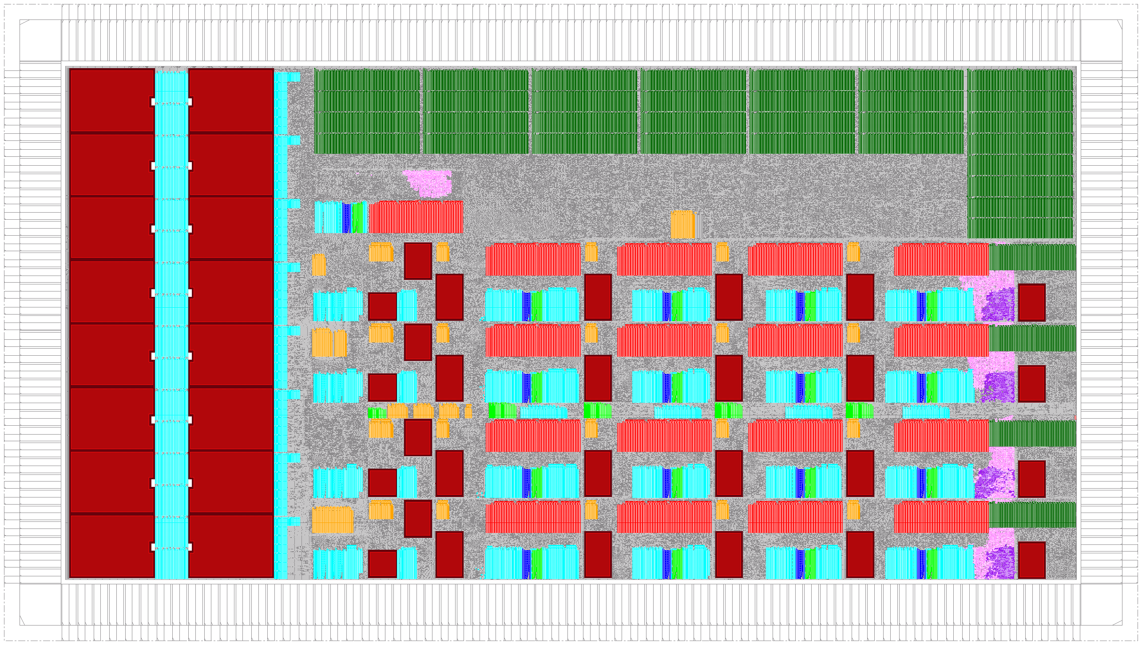
6.375: Complex Digital Systems
Lecturer: Arvind
TA: Richard S. Uhler
Administration: Sally Lee

Slide 2
Why take 6.375
Something new and exciting as well as useful
Fun: Design systems that you never thought you could design in a course
  made possible by large FPGAs and Bluespec
You will also discover that is possible to design complex digital systems with little knowledge of circuits

Slide 3
New, exciting and useful …

Slide 4
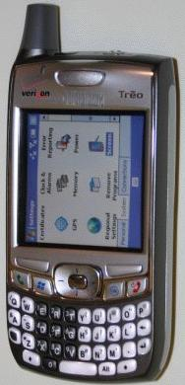

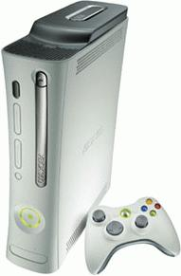





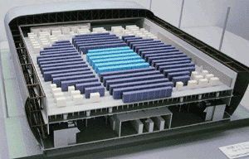

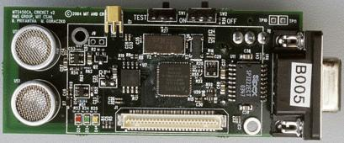
Wide Variety of Products Rely on ASICs
ASIC = Application-Specific Integrated Circuit

Slide 5
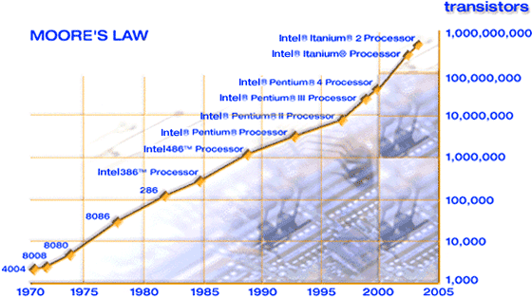
What’s required?
ICs with dramatically higher performance,
optimized for applications
and at a
size and power to deliver mobility
cost to address mass consumer markets
Source: http://www.intel.com/technology/silicon/mooreslaw/index.htm

Slide 6
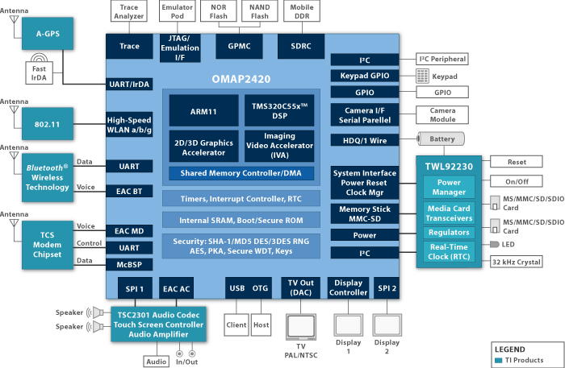
Current Cellphone Architecture
Two chips, each with an ARM general-purpose processor (GPP) and a DSP (TI OMAP 2420)
WLAN RF
WLAN RF
WCDMA/GSM RF
WLAN RF
Application Processing
Comms. Processing
Complex, High Performance
but must not dissipate more than 3 watts
Many specialized complex blocks
Notes:
6

Slide 7
Server microprocessors also need specialized blocks
compression/decompression
encryption/decryption
intrusion detection and other security related solutions
Dealing with spam
Self diagnosing errors and masking them
…
Notes:
7

Slide 8
Real power saving implies specialized hardware
H.264 video decoder implementations in software vs. hardware
  the power/energy savings could be 100 to 1000 fold
but our mind set is that hardware design is:
  Difficult, risky
    Increases time-to-market
  Inflexible, brittle, error prone, ...
    Difficult to deal with changing standards, …
New design flows and tools can change this mind set
Notes:
8

Slide 9
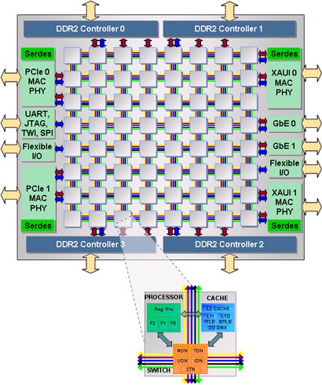
Will multicores reduce the need for new hardware?
Unlikely – because of power and performance
64-core Tilera
Notes:
9

Slide 10
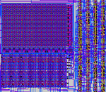
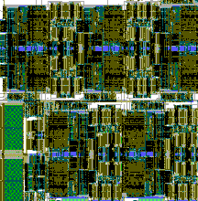
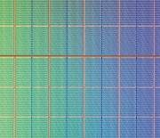
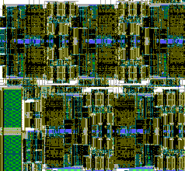
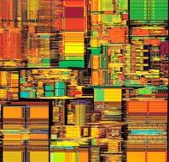
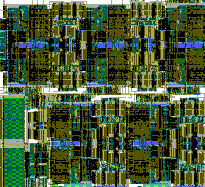
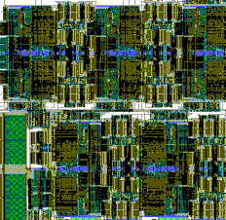
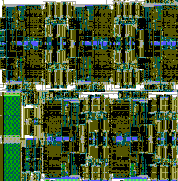
SoC & Multicore Convergence: more application specific blocks
Application-specific processing units
On-chip memory banks
General-purpose processors
Structured on-chip networks
Notes:
10

Slide 11
To reduce the design cost of SoCs we need …
“Intellectual Property”
Extreme IP reuse
  Multiple instantiations of a block for different performance and application requirements
  Packaging of IP so that the blocks can be assembled easily to build a large system (black box model)
Architectural exploration to understand cost, power and performance tradeoffs
Full system simulations for validation and verification
Notes:
11

Slide 12
Hardware design today is like programming was in the fifties, i.e., before the invention of high-level languages
Notes:
12

Slide 13
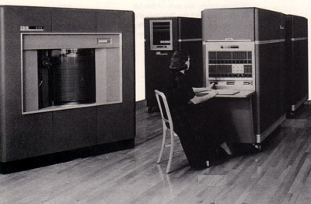
Programmers had to know many detail of their computer
IBM 650
(1954)
An IBM 650 Instruction: 60 1234 1009
  “Load the contents of location 1234 into the distribution; put it also into the upper accumulator; set lower accumulator to zero; and then go to location 1009 for the next instruction.”
Can you program a computer without knowing , for example, how many registers it has?
1950s reaction
Fortran changed this mind set (1956)
Notes:
13

Slide 14
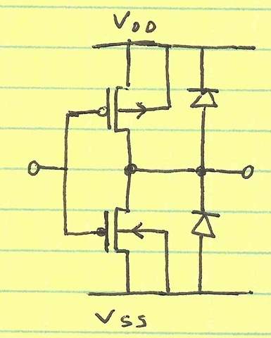
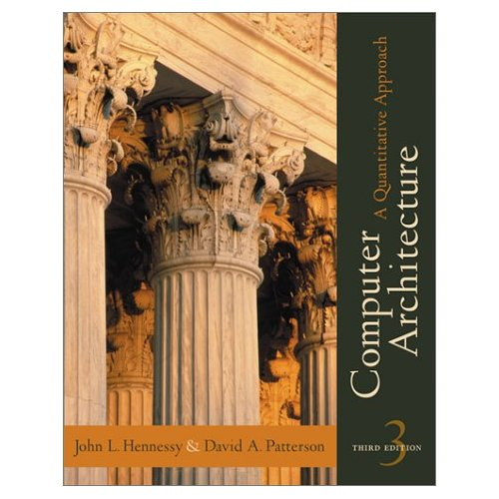



For designing complex SoCs deep circuits knowledge is secondary
Using modern high-level hardware synthesis tools like Bluespec requires computer science training in programming and architecture rather than circuit design
Notes:
14

Slide 15
Bluespec A new way of expressing behavior
Bluespec
A formal method of composing modules with parallel interfaces (ports)
  Compiler manages muxing of ports and associated control
Powerful and zero-cost parameterization of modules
  Encapsulation of C and Verilog codes using Bluespec wrappers
  Helps Transaction Level modeling
Smaller, simpler, clearer, more correct code
not just simulation, synthesis as well
Notes:
15

Slide 16
IP Reuse via parameterized modules
Example OFDM based protocols
WiFi: 64pt @ 0.25MHz
WiMAX: 256pt @ 0.03MHz
TX
Controller
Scrambler
FEC
Encoder
Interleaver
Mapper
Pilot &
Guard
Insertion
IFFT
CP
Insertion
MAC
D/A
WUSB: 128pt 8MHz
RX
Controller
De-
Scrambler
FEC
Decoder
De-
Interleaver
De-
Mapper
Channel
Estimater
FFT
S/P
Synchronizer
MAC
A/D
standard specific
WiFi:x⁷+x⁴+1
Convolutional
potential reuse
  Reusable algorithm with different parameter settings
WiMAX:x¹⁵+x¹⁴+1
Reed-Solomon
85% reusable code between WiFi and WiMAX
From WiFi to WiMAX in 4 weeks
  Different throughput requirements
WUSB:x¹⁵+x¹⁴+1
Turbo
  Different algorithms
(Alfred) Man Cheuk Ng, …

Slide 17
High-level Synthesis from Bluespec
Bluespec SystemVerilog source
First simulate
Second run on FPGAs
Bluespec Compiler
We won’t explore the chip design path
C
Verilog 95 RTL
Bluesim
Cycle
Accurate
Verilog sim
RTL synthesis
VCD output
gates
Power estimation tool
Debussy
Visualization
Place &
Route
FPGA
Physical
Tapeout

Slide 18
FPGAs: a new opportunity

Slide 19
Chip Design Styles
Custom and Semi-Custom
  Hand-drawn transistors (+ some standard cells)
  High volume, best possible performance: used for most advanced microprocessors
Standard-Cell-Based ASICs
  High volume, moderate performance: Graphics chips, network chips, cell-phone chips
Field-Programmable Gate Arrays
  Prototyping
  Low volume, low-moderate performance applications
Different design styles have vastly different costs

Slide 20
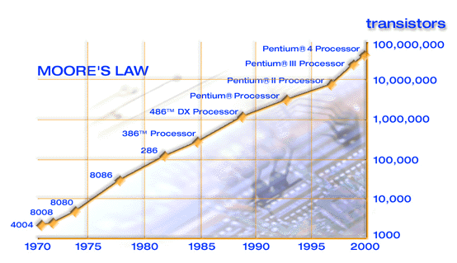
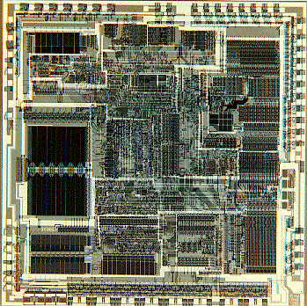
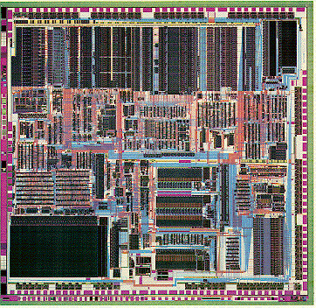
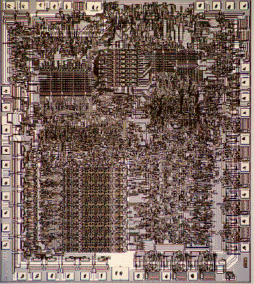
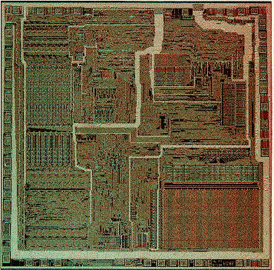
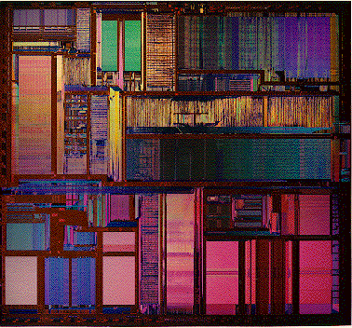
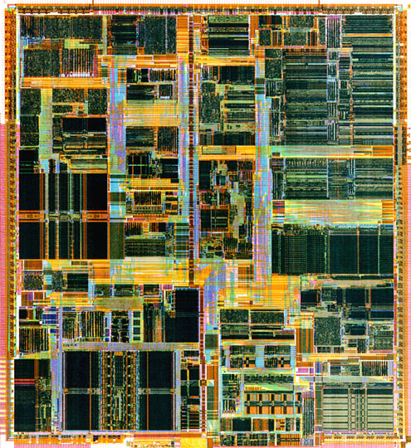
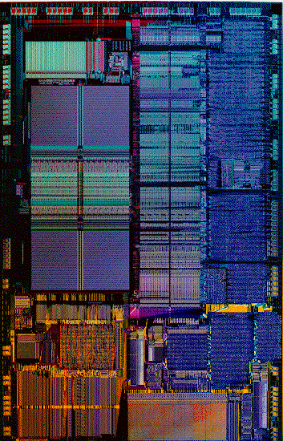
Exponential growth: Moore’s Law
Intel 8080A, 1974
3Mhz, 6K transistors, 6u
Intel 8086, 1978, 33mm²
10Mhz, 29K transistors, 3u
Intel 80286, 1982, 47mm²
12.5Mhz, 134K transistors, 1.5u
Intel 386DX, 1985, 43mm²
33Mhz, 275K transistors, 1u
Intel 486, 1989, 81mm²
50Mhz, 1.2M transistors, .8u
Intel Pentium, 1993/1994/1996, 295/147/90mm²
66Mhz, 3.1M transistors, .8u/.6u/.35u
Intel Pentium II, 1997, 203mm²/104mm²
300/333Mhz, 7.5M transistors, .35u/.25u
Shown with approximate relative sizes
http://www.intel.com/intel/intelis/museum/exhibit/hist_micro/hof/hof_main.htm

Slide 21
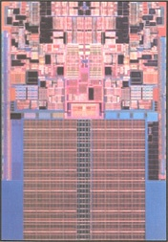
Intel Penryn (2007)
Dual core
Quad-issue out-of-order superscalar processors
6MB shared L2 cache
45nm technology
  Metal gate transistors
  High-K gate dielectric
410 Million transistors
3+? GHz clock frequency
Could fit over 500 486 processors on same size die.

Slide 22
But Design Effort is Growing
Nvidia Graphics Processing Units
Transistors (M)
Relative staffing on back-end
9x growth in back-end staff
Relative staffing on front-end
5x growth in front-end staff
Front-end is designing the logic (RTL)
Back-end is fitting all the gates and wires on the chip; meeting timing specifications; wiring up power, ground, and clock
Notes:
The primary limitation in chip capability is not process capability, but design capability. The theoretical improvements in chip performance from Moore’s Law scaling are not attained for most designs in practice due to the large and increasing effort required to complete a large design and tune its performance.
Nvidia graphics processing units (GPUs) are among the most complex logic chips in production and share many attributes with custom devices required for DoD applications (large quantities of customized digital signal processing with substantial memory bandwidth demands). Over the 9 years from 1993 to 2002, the staff years required per GPU design has grown by a factor of 5 for front-end logic design and verification, and by a factor of 9 for back-end physical design and verification. This growth has led design teams to be much more conservative and to give up performance in exchange for reduced design effort.
An approximate measure of the gap can be seen by comparing an aggressive full-custom design with a typical ASIC design. The Cell microprocessor was recently completed by a team from IBM-Toshiba-Sony with an estimated design cost of $400M, and achieved a clock rate of 4GHz in 90nm technology. This design effort is justified by the very high sales volume anticipated for this commercial part. Using cell-based automated tools, the typical design cost for a 90nm ASIC is around $20-40M, but the expected clock rate would be only approximately 400MHz. Even with the use of cell-based automated tools, the major part of the cost of a new chip is the staff years required for design and verification. Mask costs are only a small fraction of total costs.

Slide 23
Design Cost Impacts Chip Cost
An Altera study
Non-Recurring Engineering (NRE) costs for a 90nm ASIC is ~ $30M
  59% chip design (architecture, logic & I/O design, product & test engineering)
  30% software and applications development
  11% prototyping (masks, wafers, boards)
If we sell 100,000 units, NRE costs add
  $30M/100K = $300 per chip!
Hand-crafted IBM-Sony-Toshiba Cell microprocessor achieves 4GHz in 90nm, but at the development cost of >$400M
Alternative: Use FPGAs
Notes:
The primary limitation in chip capability is not process capability, but design capability. The theoretical improvements in chip performance from Moore’s Law scaling are not attained for most designs in practice due to the large and increasing effort required to complete a large design and tune its performance.
Nvidia graphics processing units (GPUs) are among the most complex logic chips in production and share many attributes with custom devices required for DoD applications (large quantities of customized digital signal processing with substantial memory bandwidth demands). Over the 9 years from 1993 to 2002, the staff years required per GPU design has grown by a factor of 5 for front-end logic design and verification, and by a factor of 9 for back-end physical design and verification. This growth has led design teams to be much more conservative and to give up performance in exchange for reduced design effort.
An approximate measure of the gap can be seen by comparing an aggressive full-custom design with a typical ASIC design. The Cell microprocessor was recently completed by a team from IBM-Toshiba-Sony with an estimated design cost of $400M, and achieved a clock rate of 4GHz in 90nm technology. This design effort is justified by the very high sales volume anticipated for this commercial part. Using cell-based automated tools, the typical design cost for a 90nm ASIC is around $20-40M, but the expected clock rate would be only approximately 400MHz. Even with the use of cell-based automated tools, the major part of the cost of a new chip is the staff years required for design and verification. Mask costs are only a small fraction of total costs.

Slide 24
Field-Programmable Gate Arrays (FPGAs)
Arrays mass-produced but programmed by customer after fabrication
  Can be programmed by loading SRAM bits, or loading FLASH memory
Each cell in array contains a programmable logic function
Array has programmable interconnect between logic functions
Overhead of programmability makes arrays expensive and slow as compared to ASICs
However, much cheaper than an ASIC for small volumes because NRE costs do not include chip development costs (only include programming)

Slide 25
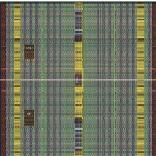
FPGA Pros and Cons
Advantages
  Dramatically reduce the cost of errors
  Little physical design work
  Remove the reticle costs from each design
Disadvantages (as compared to an ASIC)
[Kuon & Rose, FPGA2006]
  Switching power around ~12X worse
  Performance up 3-4X worse
  Area 20-40X greater
Still requires tremendous design effort at RTL level

Slide 26
The new opportunity
“Big” FPGAs have become widely available
  A multicore can be emulated on one FPGA
  but the programming model is RTL and not too many people design hardware
Enable the use of FPGAs via Bluespec

Slide 27
Fun: Design systems that you never thought you would design in a course

Slide 28
Some Bluespec/FPGA projects at MIT
Video decoder – H.264
AirBlue – A new platform to experiment with cross-layer wireless protocols
Cycle-accurate performance models
  Intel’s Hasim
  IBM’s PowerPC
Hardware software co-generation
Notes:
28

Slide 29
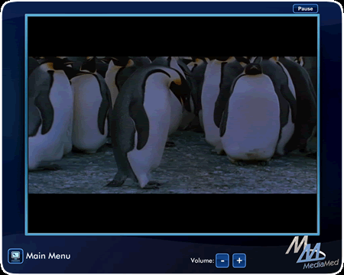
H.264 Video Decoder
Chun-Chieh Lin, K Elliott Fleming [MEMOCODE 2008]
Used everywhere - cell phones, DVDs, HD-DVDs
Initial Design
  Eight man-months
  8K lines of Bluespec
    in contrast to 80K lines of C standard
  Decoded 720p@32FPS
Major architectural explorations over 3 months
  High performance designs (4.2 mm sq in 180nm)
    720p@75FPS, 1080p@65FPS,
  Low cost designs
    QCIF@15FPS (2.2mm sq), 720p@30FPS (2.4mm sq)
Can be refined further to run 1080p@75FPS on FPGAs
Notes:
29

Slide 30
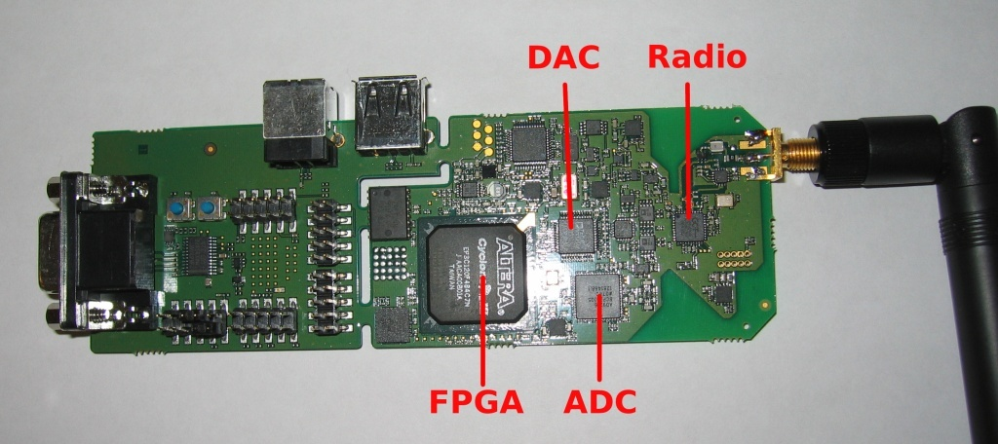
AirBlue: A platform for Cross-Layer Wireless Protocol development
Fits in Nokia N95 phones
Now building AirBlue2.0
  Cross-layer protocols (i.e., jointly optimizing PHY and MAC layers) are the hottest area of research in wireless
Several cross-layer experiments (e.g., SoftPhy) have already been conducted on full-speed 802.11a/g implementation
Each new protocol required less than 100 lines of code
With Prof Hari Balakrishanan
Notes:
30
A hardware platform with large FPGA and RF front-end was provided by Nokia.
It took approximately 5 months to develop a full speed 802.11a/g transceiver (8K lines of Bluespec) and another one month to write new cross-layer
protocols and conduct experiments.
The ease of writing new protocols has a lot to with Bluespec --- latency insensitive designs, correctness by construction of control circuitry, modular refinement, polymorphic type system, …

Slide 31
IBM: PowerPC Prototype
K. Ekanadham, Jessica Tseng (IBM)
Asif Khan, M. Vijayaraghavan (MIT)
Goal: Implement a multithreaded, multicore, in-order PowerPC on an FPGA platform and boot Linux on it in 12 months
Team:
  2(IBM) + 2(MIT) + Linux and FPGA help
The team accomplished the goal (Nov 2008)
  - Bluespec PowerPC boots Linux on FPGAs in 10min;
  - 100M instructions to reach “Hello World”;
  - 15K lines of Bluespec generated 90K lines of Verilog
IBM synthesized the generated Verilog using their tools in 40nm library
  – ran at 500MHz on the first try!
Notes:
31

Slide 32
Phase II: IBM/MIT Collaboration
March 2009 –
Goal: Produce a cycle-accurate and highly parameterized model of multithreaded, multicore PowerPC to run on FPGAs
  demonstrate 1000X speedup and flexibility by running the models on FPGAs
Use cheaper and widely available FPGA boards
  Xilinx 110 as opposed to 330
Target open source distribution
The model is currently able to boot 32-bit Linux on FPGAs and runs at 4.4 MIPS
Notes:
32

Slide 33
The Course Philosophy
Effective abstractions to reduce design effort
  High-level design language rather than logic gates
  Control specified with Guarded Atomic Actions rather than with finite state machines
  Guarded module interfaces automatically ensure correctness of composition of existing modules
Design discipline to avoid bad design points
  Decoupled units rather than tightly coupled state machines
Design space exploration to find good designs
  Architecture choice has largest impact on solution quality
We learn by doing actual designs

Slide 34
The course has no text book but …
Lecture slides (with animation)
  Make sure you sure you understand the lectures before exploring other materials
  http://csg.csail.mit.edu/6.375/handouts.html
Small Example suite (from Bluespec Inc)
  A series of small examples (currently over 70), focusing on one topic at a time. Good entry for learning the language by yourself
  http://sites.google.com/a/bluespec.com/learning-bluespec/Home/Small-Examples
  bluespec.com → Resources → Wiki → Small Examples
Bluespec System Verilog Reference manual
  It is a reference, not a tutorial
  http://www.bluespec.com/forum/download.php?id=96
  bluespec.com → Resources → Wiki → BSV Documentation → Reference Manual
Bluespec System Verilog Users guide
  How to use all the tools for developing BSV programs
  http://www.bluespec.com/forum/download.php?id=107
  bluespec.com → Resources → Wiki → BSV Documentation → User Guide

