Slide 1
Viterbi Decoder
6.375 Project
Arthur Chang
Omid Salehi-Abari
Sung Sik Woo
May 11, 2011

Slide 2
Background:
Error Control Techniques
Improving the reliability of digital communication
Inserting redundancy into the transmitted data
Detecting and correcting transmission errors
Example: Binary symmetric channel (BSC)
No error control
Pε = p
Triple- repetition code
Send each message bit three times, 0 → 000 , 1 → 111
More zeros are received than ones, assume the message bit was a zero
Pε = Pr{2 or 3 code bits are in error} = 3p²(1 − p) + p³ = 3p² − 2p³

Slide 3
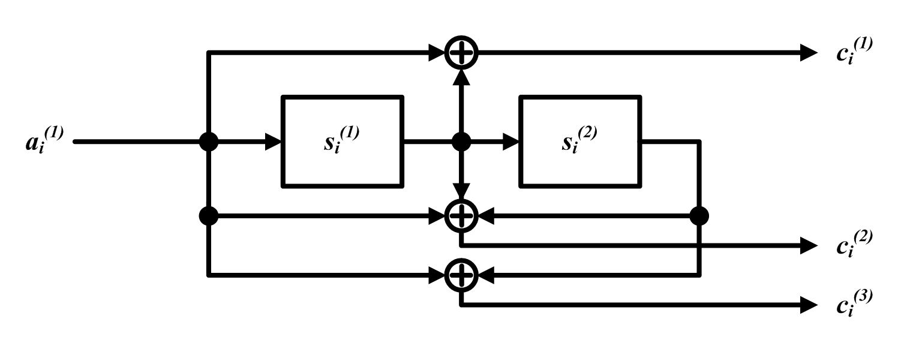
Background:
Convolutional Codes:
Linear codes
Operate on continuous streams of symbols
Can be generated by the convolution of the message sequence with a set of generator sequences
A (3,1,2) convolutional encoder, g₁=110, g₂=111 and g₃ =101
01
0/011
0/101
0
1
1/100
0/000
00
11
1/010
0/110
1/111
10
1/001

Slide 4
Background:
Some Definition:
Branch Metric: Hamming distance between the received codeword and all possible symbols (i.e. the number of bits in which received message differs from code sequence)
Path Metric: Sum of the Branch Metrics
Survivor Path: Path with the smallest Path Metric

Slide 5
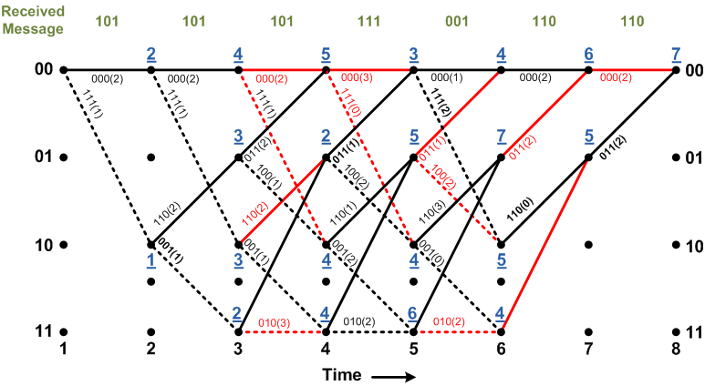
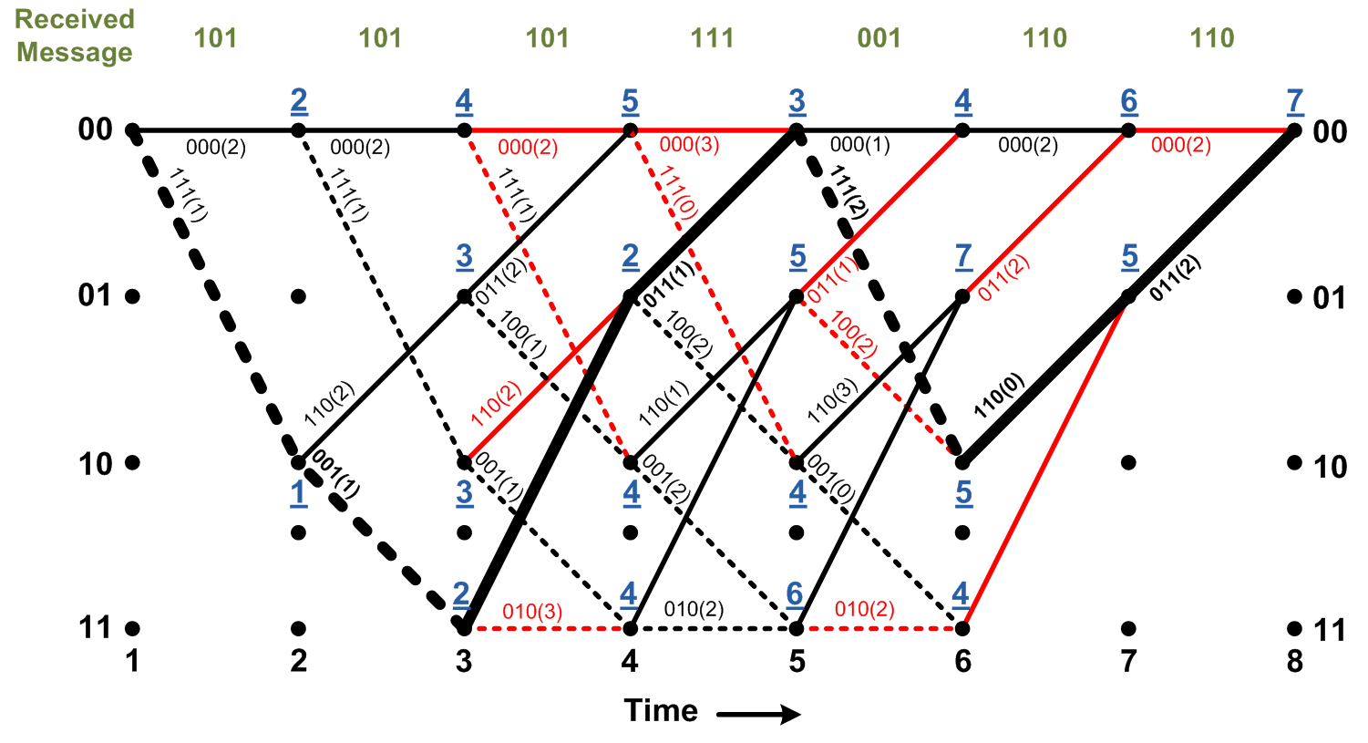
Background:
Viterbi Decoder:
Final decision on the maximum likelihood path is not made until the entire received sequence (i.e. long delay)
Practical solution: Sliding window with length of 5K

Slide 6
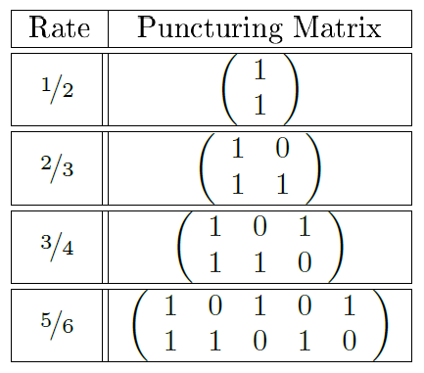
Specification
IEEE 802.16 WiMax Standards
K = 7
Rate =
29.1Mbps
Hardware is needed for the real-time decoding
FPGA is a good solution

Slide 7
System Block Diagram

Slide 8
Depuncture Unit

Slide 9
Branch Metric Unit (BMU)

Slide 10
Path Metric Unit (PMU)

Slide 11
Traceback Unit (TBU)
Traceback Length
= 5K = 35

Slide 12
Functional Testbench
Messages decoded by MATLAB and Bluespec are compared and shown to be identical across all rates and channel SNR.

Slide 13
Performance Benchmark
Decoder can maintain 1 bit/cycle output throughput with 88 cycles of latency.
Coded bits are generated on FPGA since Sce-Mi cannot supply bits as fast as the decoder can process them.
At 150MHz, we are 400x faster than the MATLAB implementation.

Slide 14
Synthesis Report
 | Decoder with 7-stage TBU | Decoder with 35-stage TBU
Number of Slice Registers | 28% | 38%
Number of Slice LUTs | 21% | 23%
Critical Path Module | TBU | MSU
Clock Frequency | 72.02MHz | 150.40MHz

Slide 15
Question?

