Slide 1
Hardware Implementation of Antenna Beamforming using Genetic Algorithm
Kevin Hsiue
Bryan Teague

Slide 2
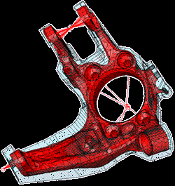
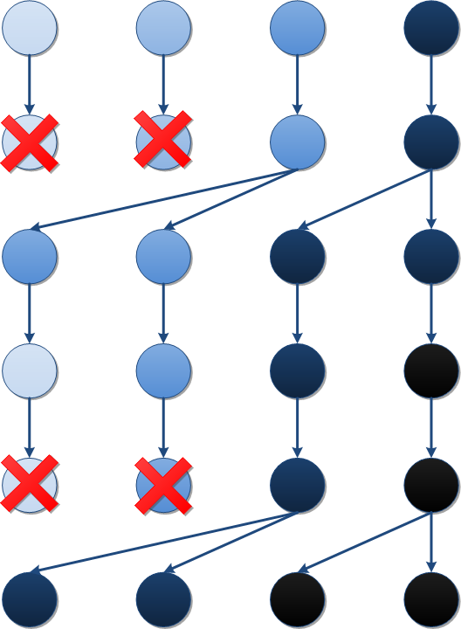
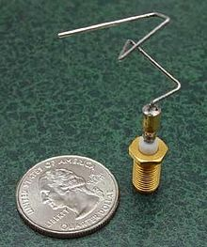
Genetic Algorithm Optimization
Initial Population
Selection for favorable traits
Reproduction of most favorable
Mutation adds variation
Selection prefers favorable mutation
Reproduction and repeat…

Slide 3
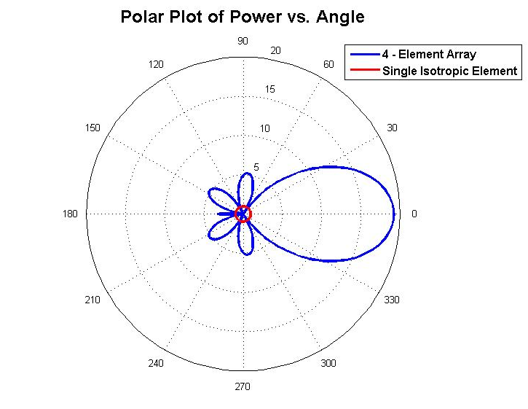
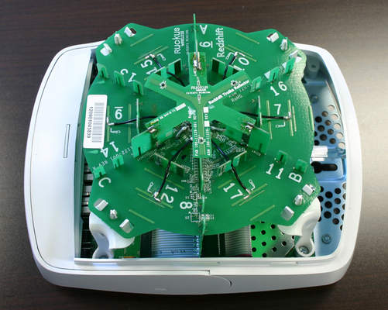
Antenna Beamforming
What is antenna beamforming?
Process of controlling relative phase of individual antennas to create a desired radiation pattern
Main beam position, sidelobe levels, and null position can be controlled
ANTENNAS
Ruckus ZoneFlex 7962 Wireless Router

Slide 4
Project Objectives
Goal: Implement genetic algorithm processor in hardware and demonstrate using antenna beamforming problem
Genetic algorithms and beamforming equations are each inherently parallelizable
Complex beamforming problems currently solved using genetic algorithms (GAs) in software
GAs have previously had mixed success in hardware

Slide 5
Project Objectives
Can hardware improve convergence rate of optimization?
Can flexibility be retained in hardware?
Can a hardware GA be scaled up to complicated beamforming problems?
Can hardware be used to solve GAs in “real-time”?

Slide 6
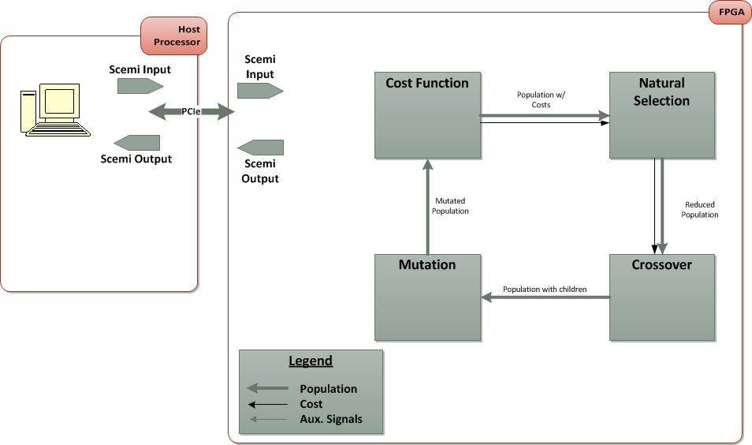
Implementation Block Diagram
Basic Genetic Algorithm Block Diagram

Slide 7
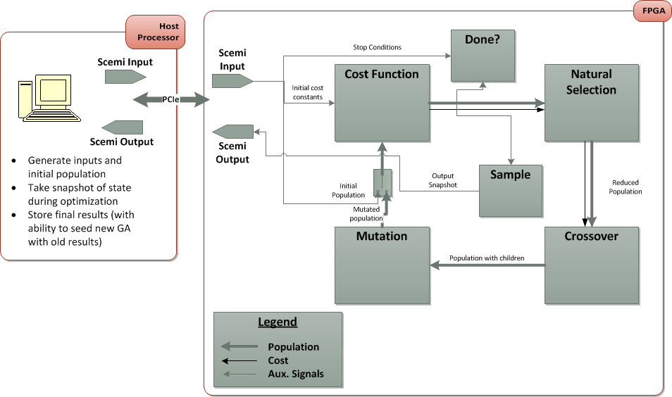
Implementation Block Diagram
Detailed Genetic Algorithm Block Diagram

Slide 8
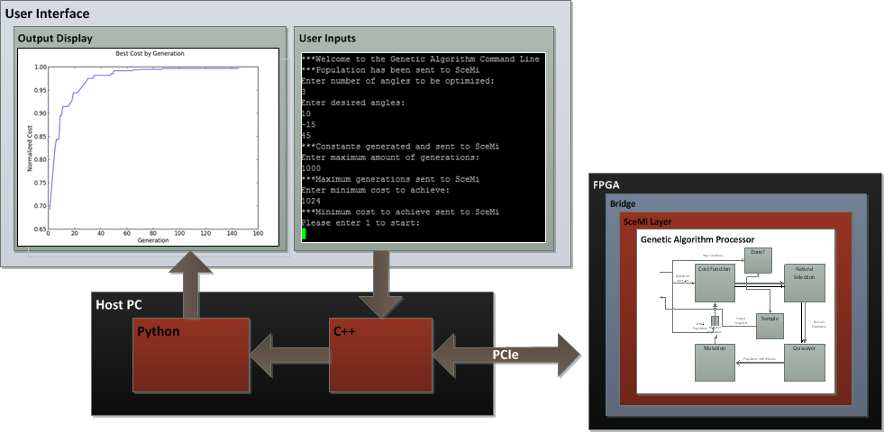
User Interface and Data Flow
System Data Flow

Slide 9
Microarchitectural Description
Population
Sequential Genetic Algorithm

Slide 10
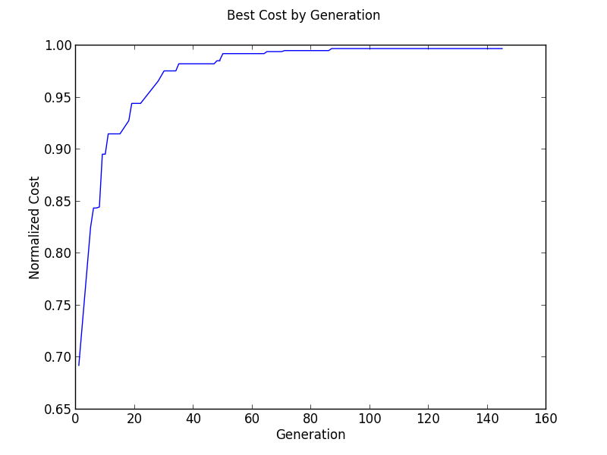
Video – Bluespec Simulation
Ideal curve generated from Python reference design
Solution generate with Bluespec simulation
Legend
Solution
Ideal

Slide 11
Implementation Evaluation
Performance Metric | Critical Path | Throughput | FPGA Utilization** (Slice/LUT/DSP) | Place-and-Route Successful?
Sequential GA Min/max | 43 ns (Natural Selection) | 690 kGen/s* | 48%/78%/100% | NO
Sequential GA Bubblesort | 45 ns (Natural Selection) | 690 kGen/s* | 49%/76%/100% | NO
Sequential GA Kill2 | 29 ns (Natural Selection) | 690 kGen/s* | 46%/73%/100% | NO
Sequential GA FIFO1 | 39 ns (Crossover) | 690 kGen/s* | 19%/40%/100% | YES (20 MHz)
* Assumes 20 MHz clock frequency
** Does not include SceMi interface

Slide 12
Microarchitectural Description 2
Population
Pipelined Genetic Algorithm

Slide 13
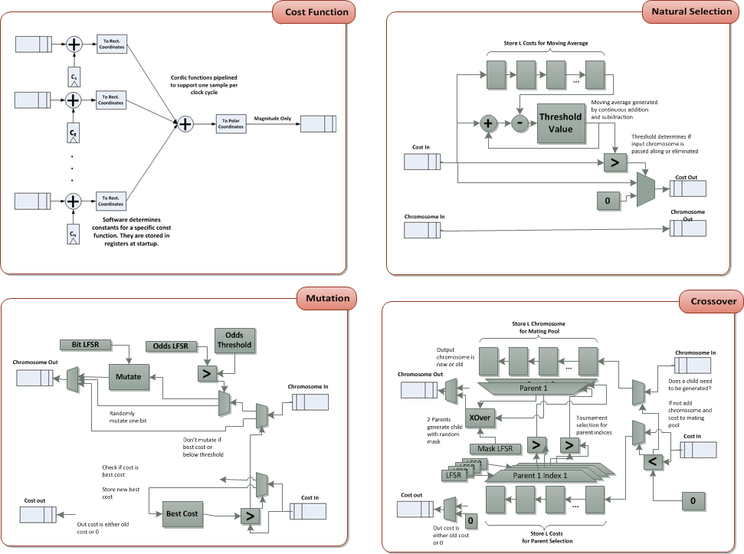
Microarchitectural Description 2
Cordic functions pipelined to accept one sample per clock cycle

Slide 14
Implementation Evaluation 2
Performance Metric | Critical Path | Throughput | FPGA Utilization** (Slice/LUT/DSP) | Place-and-Route Successful?
Sequential GA Min/max | 43 ns (Natural Selection) | 690 kGen/s* | 48%/78%/100% | NO
Sequential GA Bubblesort | 45 ns (Natural Selection) | 690 kGen/s* | 49%/76%/100% | NO
Sequential GA Kill2 | 29 ns (Natural Selection) | 690 kGen/s* | 46%/73%/100% | NO
Sequential GA FIFO1 | 39 ns (Crossover) | 690 kGen/s* | 19%/40%/100% | YES (20 MHz)
Pipeline GA | 10 ns (Cordic) | 1.72 mGen/s*** | 3%/4%/14% | YES (50 MHz)
* Assumes 20 MHz clock frequency
** Does not include SceMi interface
*** Assumes 50 MHz clock frequncy

Slide 15
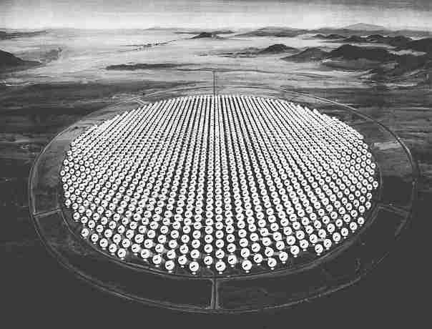
Design Exploration
Scale to models of larger arrays
PAR successful for 32 element antenna array on V5 (50 MHz)
Synthesis suggests 128 element on V7 (100 MHz)
What are the limits?
When does a new architecture make sense?
http://www.coseti.org/cyclops2.htm

Slide 16
Design Exploration
Add mutation controller
Tracks rate of change in cost function
Controls mutation parameters accordingly
More complicated antenna cost function
Multiple Cordic processors operating on single chromosome
New problem, same architecture?

Slide 17
Summary
Can hardware improve convergence rate of optimization?
3 orders of magnitude compared to Python implementation
Can flexibility be retained in hardware?
Multiple sorting algorithms explored
Discrete modules with identical interfaces
Important tuning parameters are be stored in registers
Can a hardware GA be scaled up to complicated beamforming problems?
Yes! (32 element on V5, 128 element on V7)
Can hardware be used to solve GAs in “real-time”?
Yes, for small problems, but limitations have not been explored
150 generations for 8-element array = ~41 kHz
How does the convergence scale?

