Slide 1
Power Intelligent Wearable Navigation Systems
Ishwarya Ananthabhotla & Andre Aboulian
6.375, Spring 2016

Slide 2
Time-of-Flight (ToF) Camera
Feedback
Field of View
IR Light
Obstacle
Reflection
Ground Plane

Slide 3
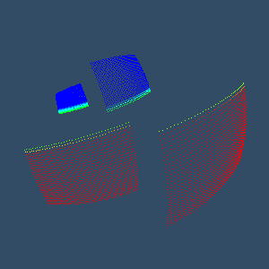
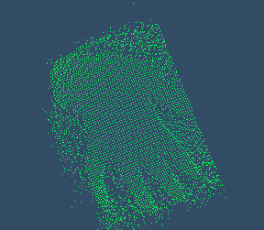
Point Cloud

Slide 4
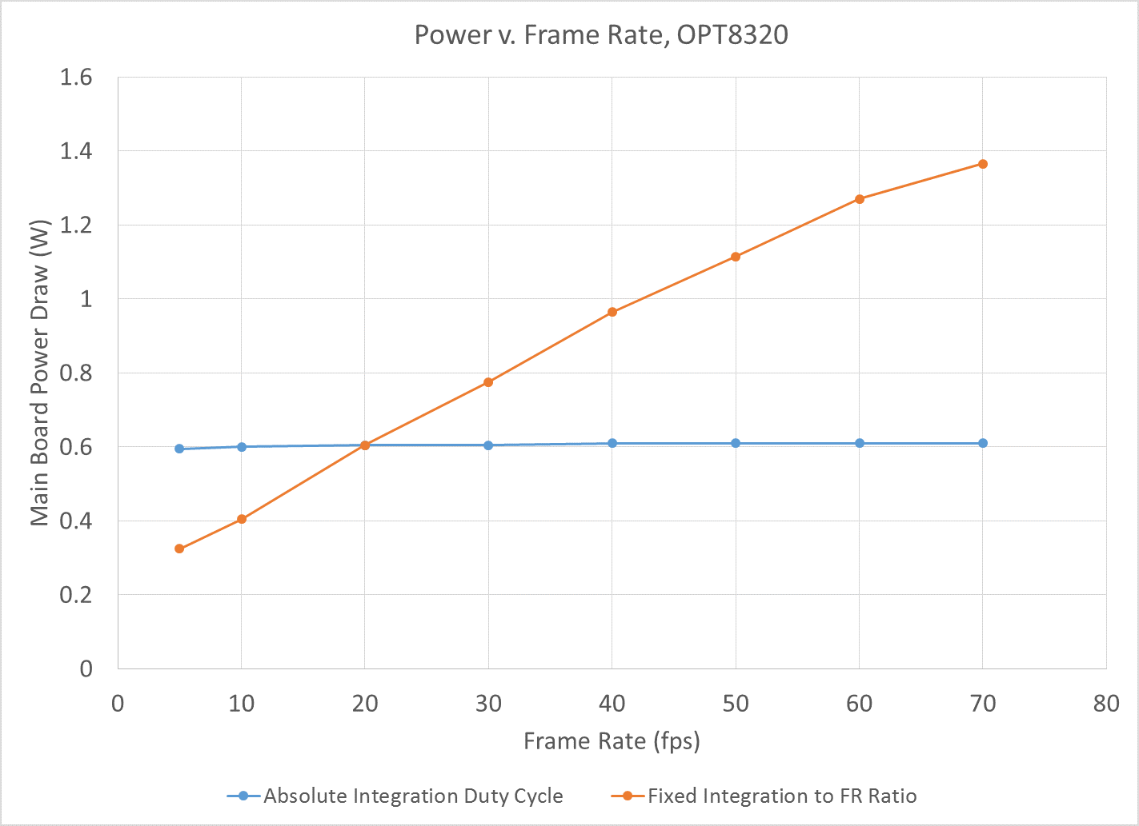
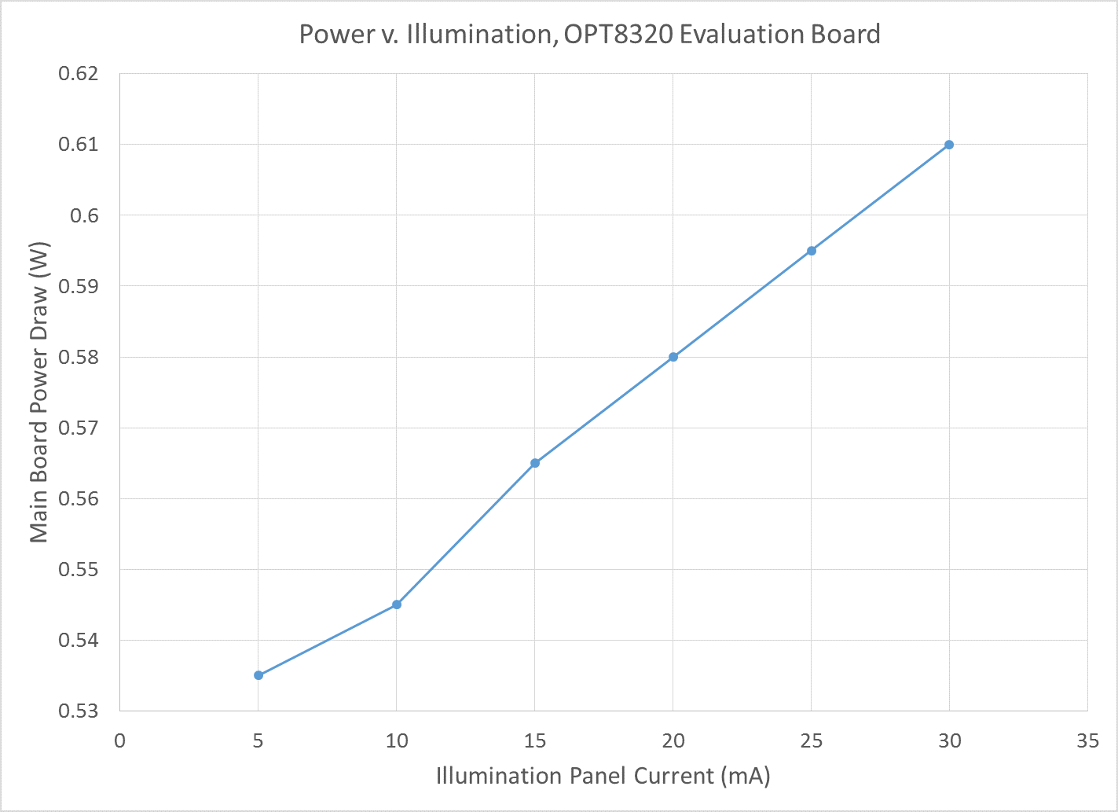
Power Scaling
↑ Frame Rate = ↑Responsiveness, ↑Power
↑ Illumination = ↑ Distance, ↑ Power

Slide 5
Problem
Dynamically scale frame rate and illumination relative to present conditions.
Maintain frame quality while consuming minimum power.

Slide 6
System Overview

Slide 7
System Overview

Slide 8
Scene Differencing

Slide 9
Testing
Unit Testing – Each module compared against simulation input/output pairs.
Integration Testing – System behavior observed under strategic inputs.

Slide 10
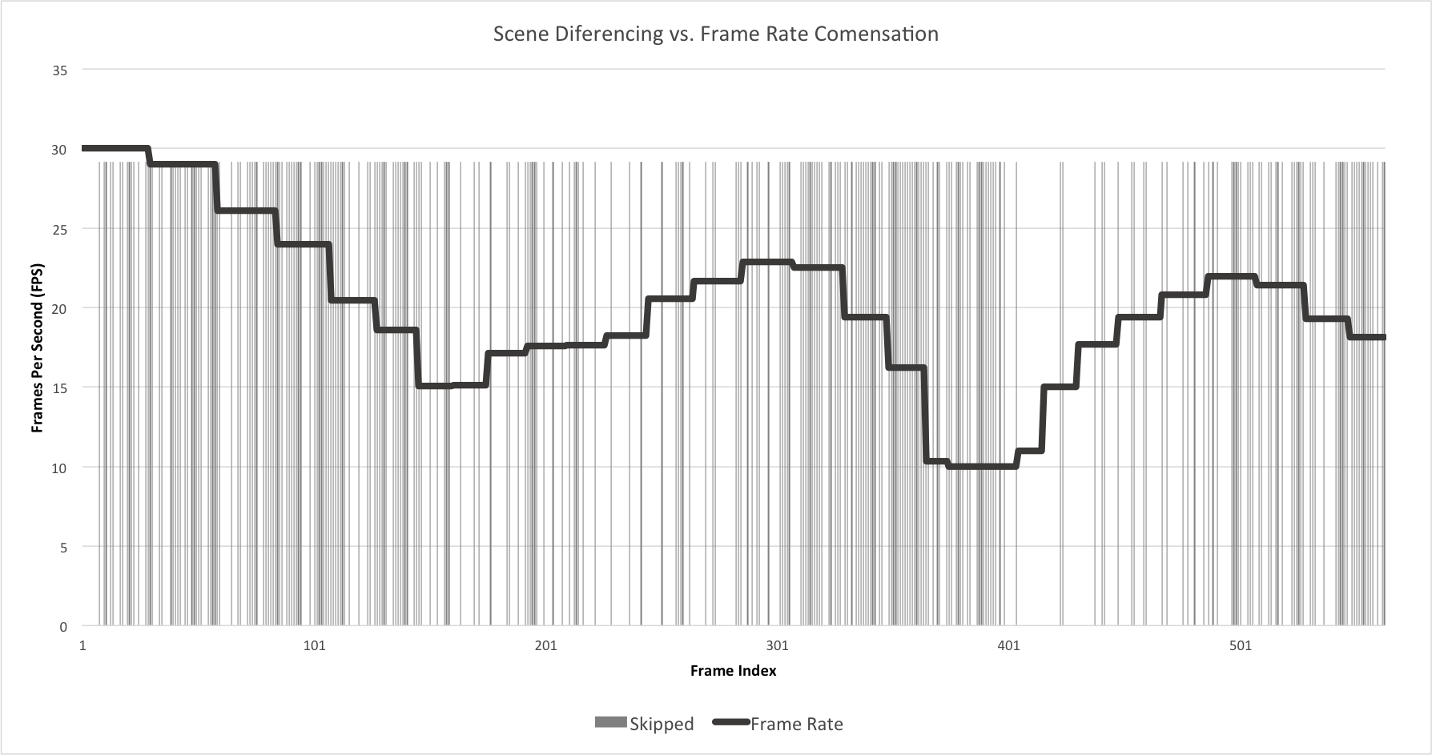
System Response

Slide 11
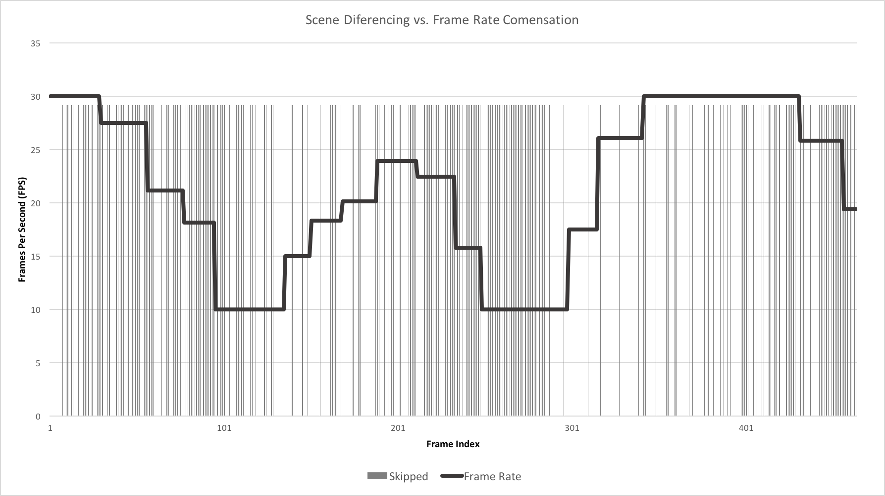
System Response

Slide 12
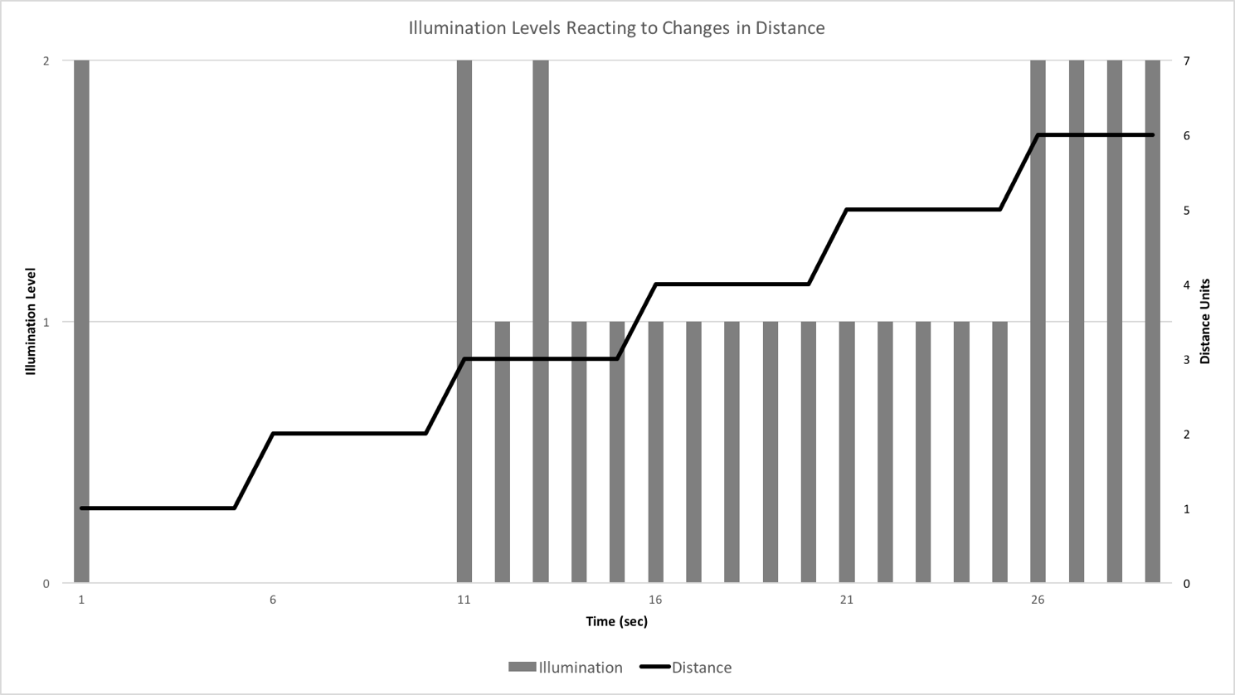
System Response

Slide 13
Surprises
FFT Size
Division operation influencing critical path
Real number arithmetic
Notes:
Super-folded FFT still too big in-system
Division crticial path length - > m
Point cloud real number math -> pre-populate in BRAM

