Slide 1
6.375 Spring 2016 Final Project
FINAL Presentation
Digital
Synthesizer
David E. Williams
Lucas L. Sanches

Slide 2
Background
SYNTH
Technology in Music
Synthesizer
Analog vs. Digital
DSP
Block
11
DSP
Block
12
DSP
Block
1n
...
DSP
Block
21
DSP
Block
22
DSP
Block
2n
...
...
...
...
DSP
Block
m1
DSP
Block
m2
DSP
Block
mn
...

Slide 3
project
Digital Synthesizer
Interesting for Music and Electrical Engineering
FPGA
Large number of DSP calculations;
Much lower cost and power consumption;
Facilitates useful real time experience for engineers;
Audio Pipeline structure already developed.

Slide 4
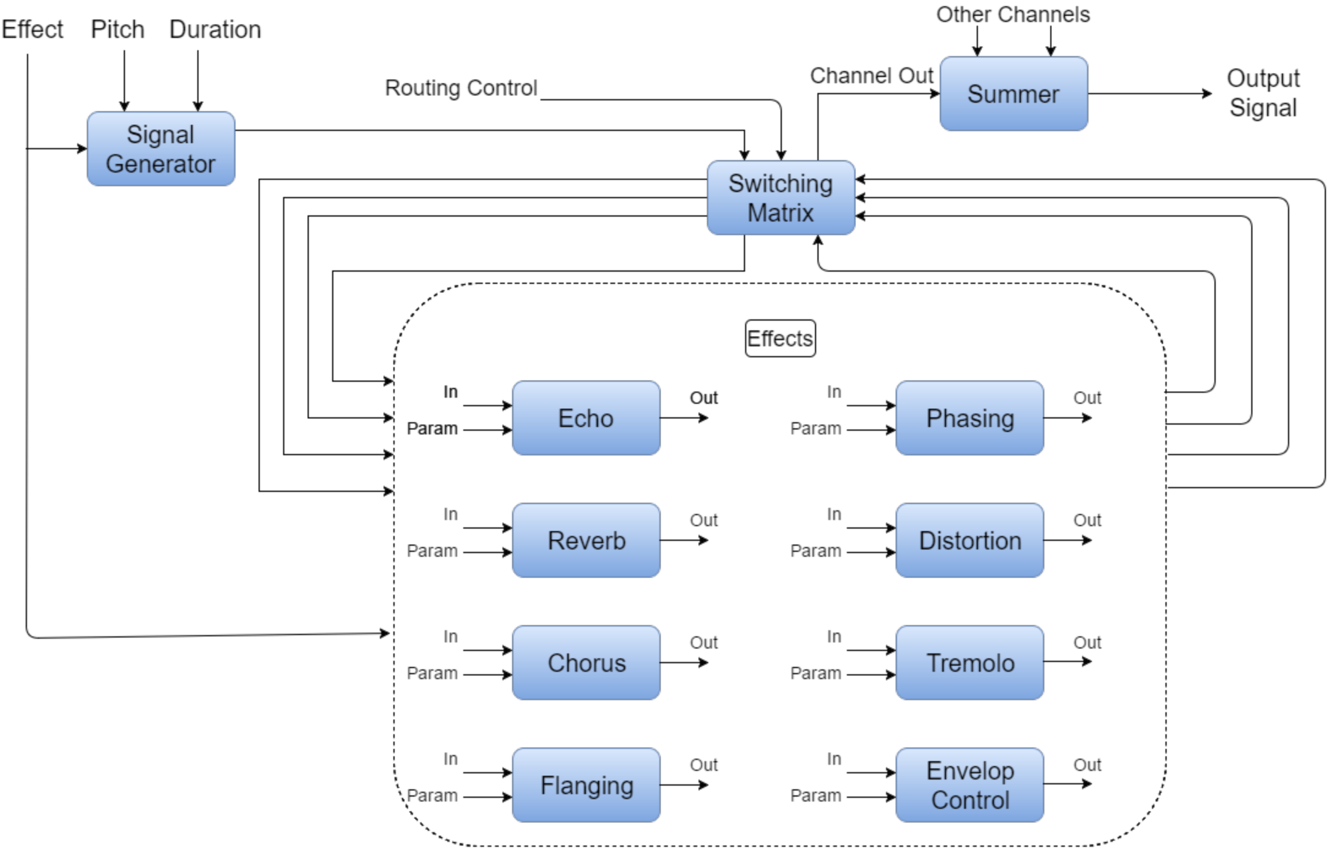
HIGH-LEVEL DESIGN
x
√
√
√
√
x
x
√
x
√
√
x

Slide 5
TEST PLAN
Effect modules tested by comparison with MATLAB generated files
Configuration matrix tested by using display statements
Signal Generator and Envelope Generator verified with Audacity

Slide 6
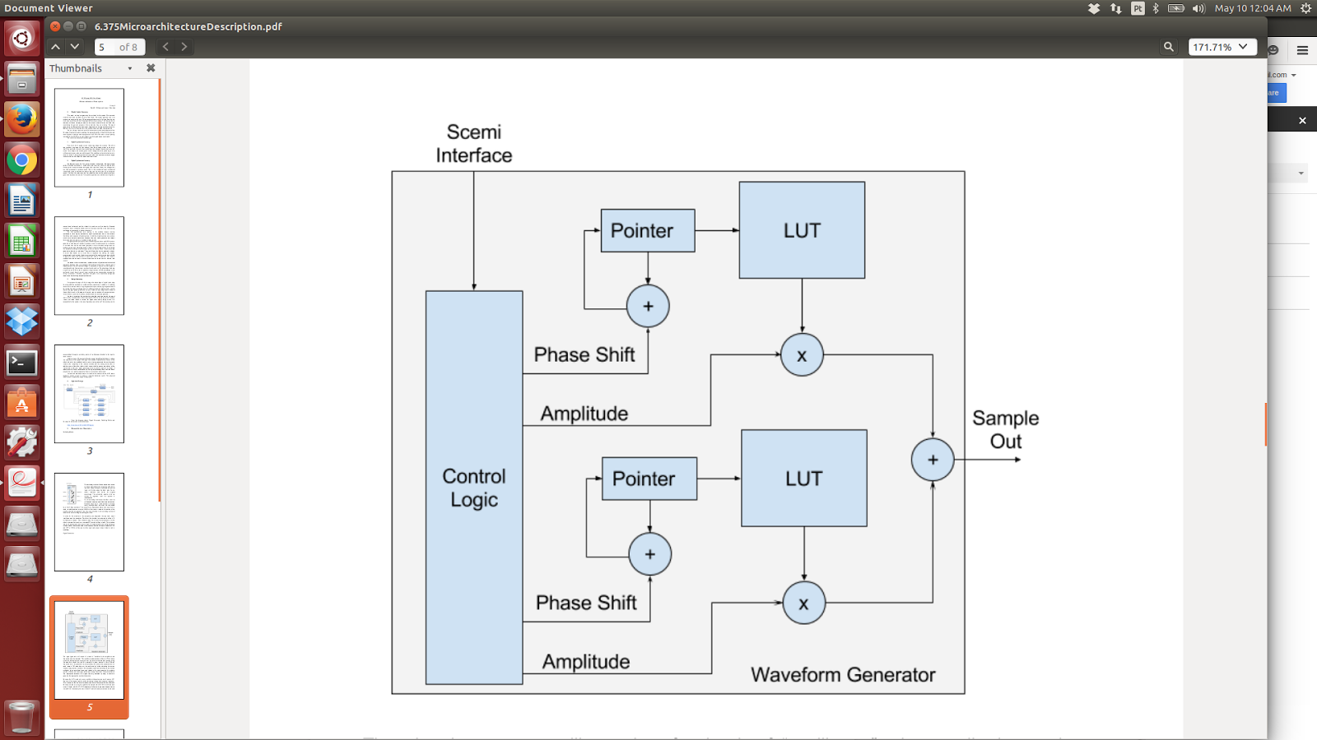
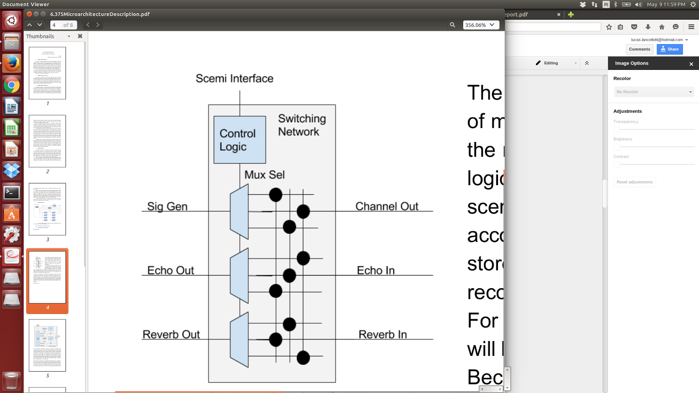
MICROARCHITECTURE
Samples for input and output of modules
Integer and Fixed Point parameters
Everything parametrized
All modules synthesized separatedly

Slide 7
IMPLEMENTATION
Splitted:
  (1) Waveform and Envelope Generators, and Switching Network
  (2) Effect blocks

Slide 8
GENERATORs + NETWORK IMPLEMENTATION
Waveform Generator: Bank of oscillators reading data from a LUT
Envelope Generator: State-machine with configurable slopes
Switching Network: Each module has an input MUX and FIFO connected to the output of every other module
  N² connections, managable with 5 modules
  Modules can be bypassed

Slide 9
EFFECTS IMPLEMENTATION
x
First attempt: mathematical functions on hardware
After: effects based on delayed samples and feedback
For Distortion, lookup table with inverse tangent calculations

Slide 10

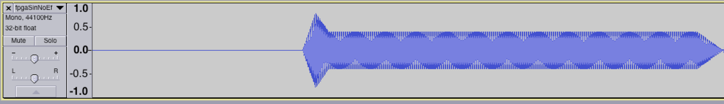
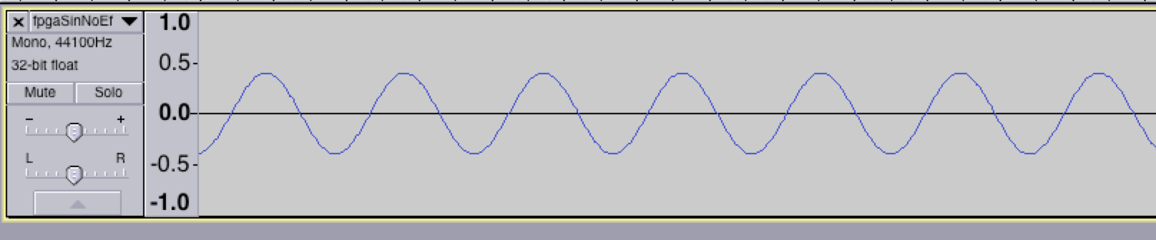
Signal Generator DEMONSTRATION
Sin Wave

Slide 11
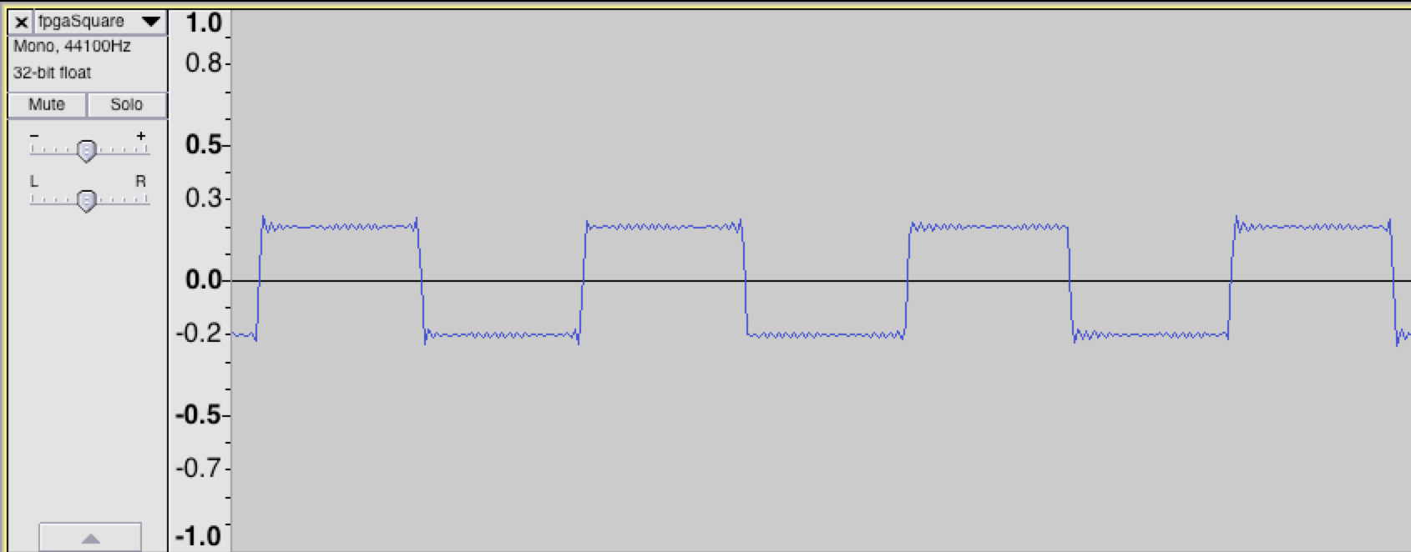
Signal Generator DEMONSTRATION
Square Wave

Slide 12
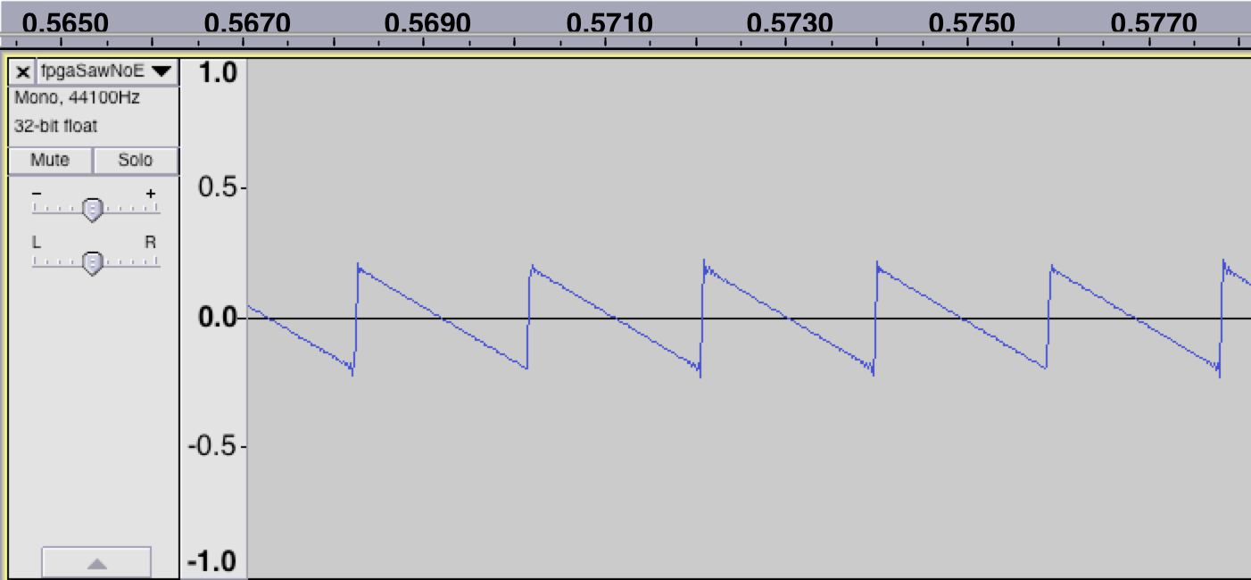
Signal Generator DEMONSTRATION
Saw-Tooth Wave

Slide 13
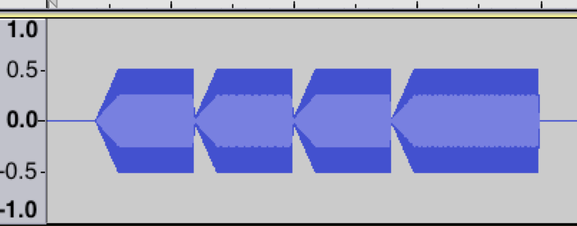
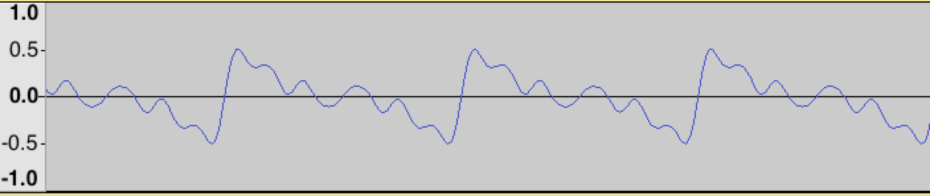
Signal Generator DEMONSTRATION
“Organ” Wave

Slide 14
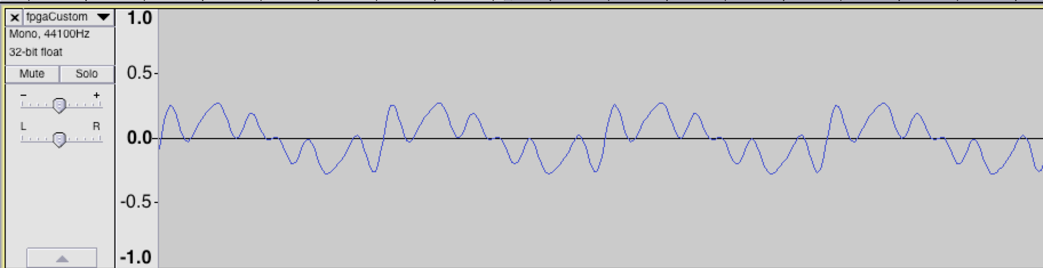
Signal Generator DEMONSTRATION
Custom Wave

Slide 15
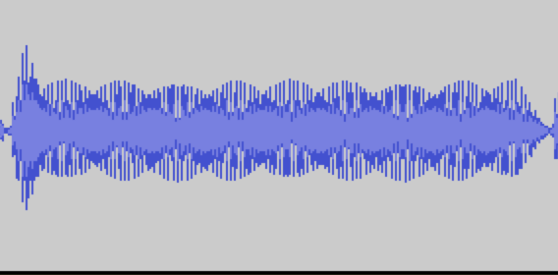
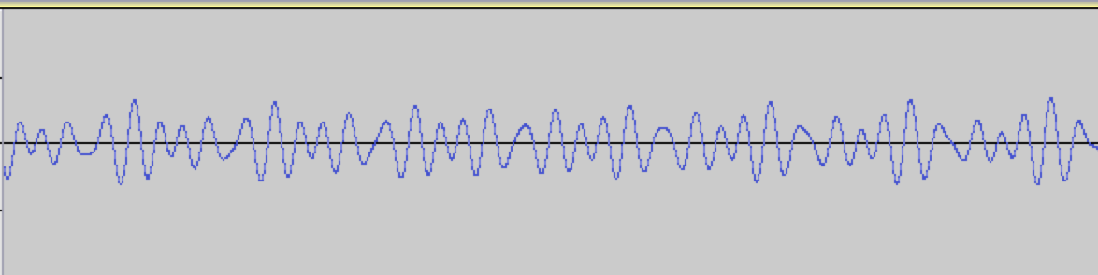
Signal Generator DEMONSTRATION
Major Sin Chord

Slide 16

Effects DEMONSTRATION
Echo – 300 ms of delay and 40% of feedback
Echo – 500 ms of delay and 70% of feedback
Flanging – 30% of feedback
Flanging – 60% of feedback
Tremolo – 200 ms of variation and 30% of addition
Tremolo – 400 ms of variation and 60% of addition
Distortion – Gain 2
Distortion – Gain 8

Slide 17
SYSTEM DEMONSTRATION
Options:
  Attack Time: 0.01, Decay Time: 0.18, Sustain Level: 0, Release Time: 0.01
  Module Order: Tremolo -> Echo, -> Output (code: 41566 )
  Instrument: “Rectified” (code: 4)
  Delay Time: 0.3 Seconds
  Tremolo Time: 0.05 Seconds

Slide 18
Final COMMENTS
√
x
Primary goals accomplished
Proof of concept
FPGA
Fun to experiment with
Sce-Mi interfaces issues
BRAM difficulties
Signal-Noise Relation
√
OVERALL: Good experience!
!
Special Thanks to Professor, Teaching Assistant, and Mentor

Slide 19
Thank you!
Questions?
Comments?

