Slide 1
6.375 Tutorial 3
Scheduling, Sce-Mi & FPGA Tools
Ming Liu

Slide 2
Overview
Scheduling Example
Synthesis Boundaries
Sce-Mi
FPGA Architecture/Tools
Timing Analysis

Slide 3
Scheduling Recap
1. Intra-rule: What makes a legal rule?
No double write
No combinational cycles
2. Inter-rule: When can rules fire in the same cycle?
Parallel execution of rules appears as if rules executed in sequential one-rule-at-a-time order

Slide 4
Packet Switching
Switch
UCLA
MIT
USC
Harvard
Demo
Notes:
Show code on csgml. Which rules can fire together?
Compile and show schedule

Slide 5
Synthesis Boundary
By default BSV compiles your design into a single flat Verilog module
All methods/rules in-lined
Use synthesis pragma to generate separate modules (.v files)
(*synthesize*)
module mkMultiplier (Multiplier);

Slide 6
Synthesis Boundary
Benefits:
Faster compile times. Modules are reused
Modularization at the circuit level
Better for synthesis and reporting
Drawbacks:
Polymorphic modules not supported
More conservative guard lifting

Slide 7
Synthesis Boundary Handling Polymorphism
Verilog does not support polymorphic interfaces
Wrap polymorphic modules with specific instantiations
FFT#(N, ComplexData) fft <- mkFFT()
(* synthesize *)
module mkSynthesizableFFT(FFT#(N, ComplexData));
FFT#(N, ComplexData) fft <- mkFFT();
return fft;
endmodule

Slide 8
Synthesis Boundary Guard Logic (Example)
Synthesis boundaries simplifies guard logic
Lifted guard without synthesis boundary:
(x && aQ.notFull) || (!x && bQ.notFull)
Lifted guard with synthesis boundary:
aQ.notFull && bQ.notFull
method Action doAction( Bool x );
if( x ) begin
aQ.enq(a);
end else begin
bQ.enq(b);
end
endmethod

Slide 9
Sce-Mi

Slide 10
Sce-Mi Standard Co-Emulation Modeling Interface
A software/hardware communication framework
Host Processor
FPGA
SceMiLayer
User SW
DUT
(AP)
SceMi Library
SceMi Xactors
PCIe Driver
PCIe
PCIe Endpoint

Slide 11
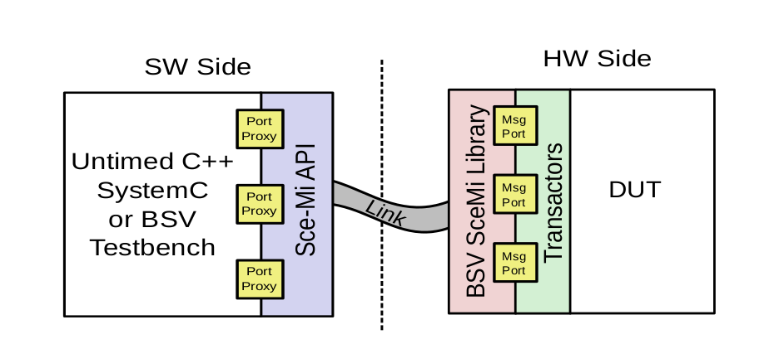
Sce-Mi Abstraction
Ports and proxies form a FIFO abstraction over a link
TCP (simulation)
or PCIe (HW)

Slide 12
Sce-Mi Example: Calculator
ServerXactor
Testbench
Calculator
(DUT)
Link

Slide 13
Sce-Mi: Hardware Calculator DUT
typedef Bit#(32) Value;
typedef enum { ADD, SUB, MUL} Operation deriving (Bits, Eq);
typedef union tagged {
void Clear;
struct {
Operation op;
Value val;
} Operate;
} Command deriving (Bits, Eq);
typedef Server#(Command, Value) Calculator;
module mkCalculator (Calculator);
…
endmodule
Server interface:
Put commands
Get results

Slide 14
Sce-Mi: Hardware SceMiLayer
(* synthesize *)
module [Module] mkDutWrapper (Calculator);
Calculator calc <- mkCalculator();
return calc;
endmodule
module [SceMiModule] mkSceMiLayer();
SceMiClockConfiguration conf = defaultValue;
SceMiClockPortIfc clk_port <- mkSceMiClockPort(conf);
Calculator dut <- buildDut(mkDutWrapper, clk_port);
Empty calcxactor <- mkServerXactor(dut, clk_port);
Empty shutdown <- mkShutdownXactor();
endmodule
Wrap DUT in synthesis boundary
Instantiate the DUT
Create a Server transactor on the Calculator dut interface
Note: DutWrapper in Lab 4 is slightly more complex (discussed later)

Slide 15
Sce-Mi: Software
#include "bsv_scemi.h“
#include "SceMiHeaders.h“
int main(int argc, char* argv[]){
//Initialize scemi …
InportProxyT<Command> inport ("", "scemi_calcxactor_req_inport", sceMi);
// Initialize the SceMi outport
OutportQueueT<Value> outport ("",
"scemi_calcxactor_resp_outport", sceMi);
Auto-generated classes based on your BSV types
SceMi auto-generates the Command class
Name of port is found in “scemi.params” file
Type of port

Slide 16
Sce-Mi: Software Sending/Receiving
Command cmd;
cmd.the_tag = Command::tag_Operate; cmd.m_Operate.m_val = 100; cmd.m_Operate.m_op = Operation(Operation::e_ADD)
inport.sendMessage(cmd);
std::cout << outport.getMessage() << std::endl;;
Construct the cmd
Send the cmd to hardware (blocking)
Get results!

Slide 17
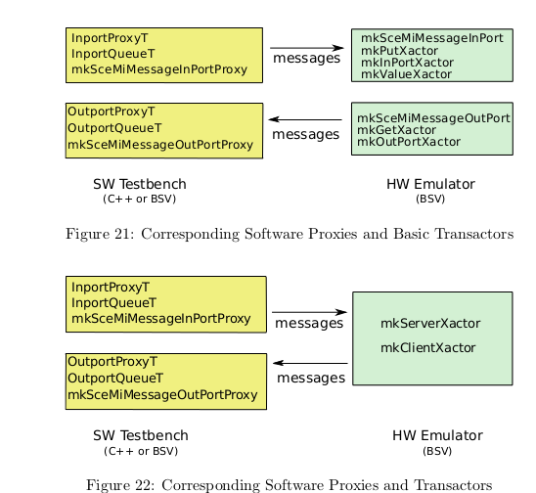
Sce-Mi: Transactors
Many transactor available. See documentation

Slide 18
Sce-Mi: Build Process
SceMi has its own build tool: build
Lab 4: project.bld
Always simulate first:
Wrap DUT in SceMiLayer in hardware
Run build: “build –v”
This creates scemi.params and C++ headers
Write/update your software C++ code
Re-run “build –v”

Slide 19
Sce-Mi: Simulation
SceMi simulation is done over TCP sockets
“build –v” will generate two binaries
bsim_dut: simulated hardware
tb: the host software
Run both binaries. They will communicate with each other.

Slide 20
Sce-Mi: Building Hardware
Run Build:
vivado_setup build –v”
Runs synthesis tool (for a long time) to create FPGA bitfile
Compiles software tb
Log into a server with FPGA attached
programfpga <path_to_bitfile>
Run software
runtb ./tb 2.0
Demo
Notes:
Show calculator SceMi simulation demo

Slide 21
Clocks and Resets in BSV
All BSV modules have implicit clock and reset interfaces
Compiled Verilog files will have these ports
Modules can also have additional clocks/resets as parameters
Can specify clocks/reset explicitly
module mkDut(DutIfc); //One default clk/rst
//Two clks, one default rst
module mkDut2Clk#(Clock clk_usr)(DutIfc);
DutIfc dut <- mkDut(clocked_by clk, reset_by rst);
DutIfc dut <- mkDut2Clk(clk_usr, clocked_by clk, reset_by rst);

Slide 22
SceMi Clocks
SceMi transactors run at 50MHz
But our DUT runs faster in a different clock domain
Thus need clock domain crossing primitives at the DUT interface
Synchronization FIFOs/Registers
Bluespec provides these
//Scemi clock to user clock (dut) sync fifo
SyncFIFOIfc#(Sample) toApSyncQ <- mkSyncFIFOFromCC(2, clk_usr);
//User clock to Scemi clock sync fifo
SyncFIFOIfc#(Sample) fromApSyncQ <- mkSyncFIFOToCC(2, clk_usr, rst_usr);

Slide 23
Running Design on FPGA

Slide 24
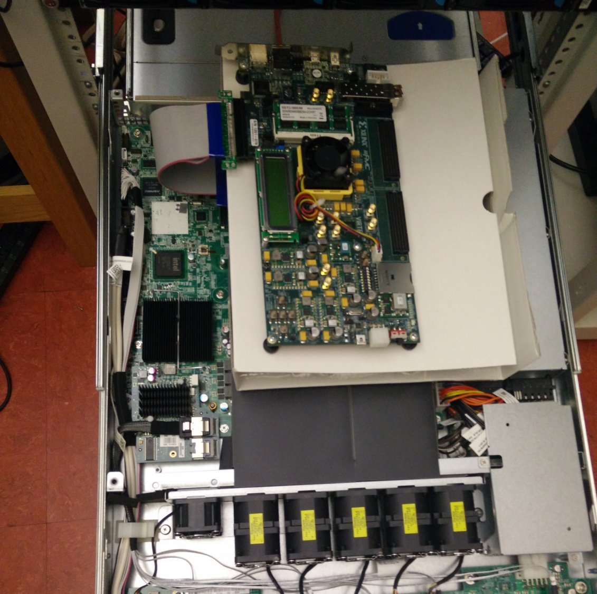
FPGA Hardware Setup
PCIe
Xilinx VC707
(Virtex 7) Development Board

Slide 25
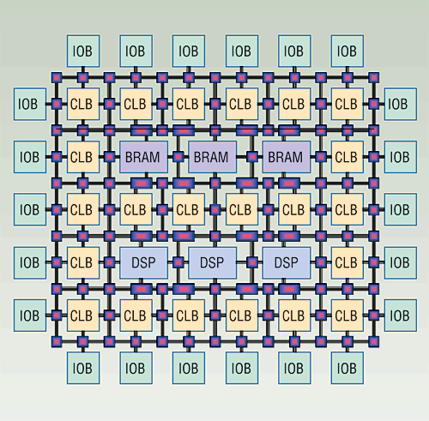
FPGA Architecture Brief
CLB: configurable logic block
Routing switches
BRAMs (~1-8MB total)
DSP
IOB: I/O buffers
Hard IPs: PCIe, DRAM
Clocking network

Slide 26
Tool Flow for FPGA
SceMi build file invokes all tools
BSV
Bluespec Compiler
Xilinx Vivado
C++/SceMi
Verilog
Synthesis
Constraints (.xdc)
Map
g++
Place and Route
Software TB Binary
Bit File

Slide 27
Reading Timing Reports
Focus on Max Delay Path (setup)
Slack: Timing margin
Location: Physical location of the slice
Delay Type: which resource in the slice the path goes through
FDRE: register, LUT: look up table, CARRY4: carry chain
Net: routing delay
Incr (ns): Additional delay added
Path (ns): Total delay
Demo
Notes:
Show failed 75MHz design on lightning; Open Vivado
~/6.375_test/mingliu/audio/scemi/fpga/xilinx_1_75mhz_fail/mkBridge/mkBridge.runs/impl_1

Slide 28
Debugging Timing Errors
Search for “VIOLATED” in the timing report
Look at which module the error is from
Source and destination
What logic is generally on the path
Remember that you are looking at one particular path – when there are timing failures on one path, there are typically many paths failing in the same way
TNS Failing Endpoints tells you exactly how many
Resolve long combinational paths by pipelining/folding your design

Slide 29
Examples of Long Paths
Multipliers/adders generally expensive
Can be cheap for constants
Proportional to width
rule doMult;
outR <= a * b;
endrule
Reg#(Bit#(32)) a <- mkReg(0); //value set dynamically
Reg#(Bit#(32)) b <- mkReg(0); //value set dynamically
method setInputs (Bit#(32) a, Bit#(32) b) …
Reg#(Bit#(4)) a <- mkReg(0);
Reg#(Bit#(4)) b <- mkReg(0);
Bit#(32) a = 2;
Reg#(Bit#(32)) b <- mkReg(0);

Slide 30
Examples of Long Paths
Vector#(N, Reg#(Bit#(32))
outVectR <- replicateM(mkReg(0))
rule doSel;
outR[sel] <= ..
endrule
Reg#(Bit#(TLog#(N))) sel <- mkReg(0); //dynamically set
Dynamic selection creates muxes
Many input muxes creates long comb paths

Slide 31
Examples of Long Paths
rule doPipe;
for (Integer sel=0; sel< n; sel=sel+1) begin
outFIFO[sel].enq( inpFIFO[sel].first );
inpFIFO[sel].deq;
end
endrule
Likely OK
for (Integer sel=0; sel< n; sel=sel+1) begin
rule doPipe;
outOneFIFO.enq( inpFIFO[sel].first );
inpFIFO[sel].deq;
endrule
end
Many conflicting rules -> large mux

Slide 32
A Few Notes
Please don’t program the FPGA until design meets timing
Send me an email if having issues with FPGA
Servers with FPGAs attached:
bdbm[12-14].csail.mit.edu
Do not use these for long compiles
Additional servers for compiling
bdbm[10-11].csail.mit.edu
Sharing
Use “w” and “top” to check who is using machine
Only one person can use the FPGA at a time
Change TCP port in project.bld in sim
Start early! Synthesis takes >30 minutes.

Slide 33
Lab 4 Code

