Slide 1
Fixed-Function Configurable Graphics Pipeline
Thomas Watson

Slide 2
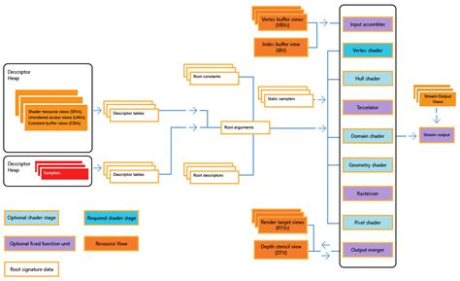
How do computers draw?

Slide 3
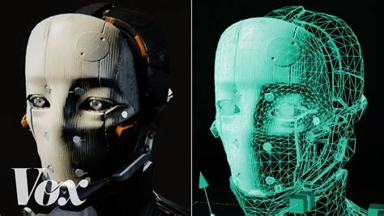

Slide 4
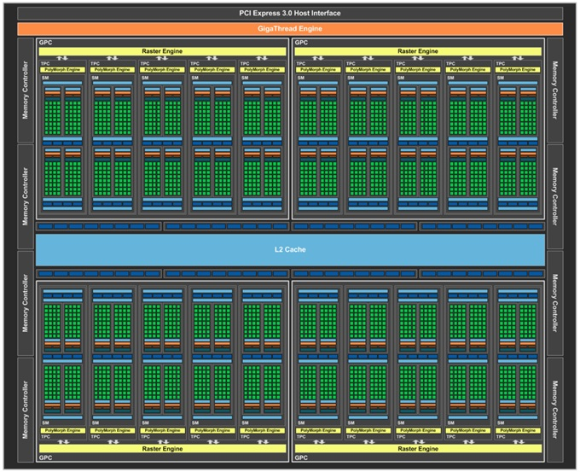

Slide 6
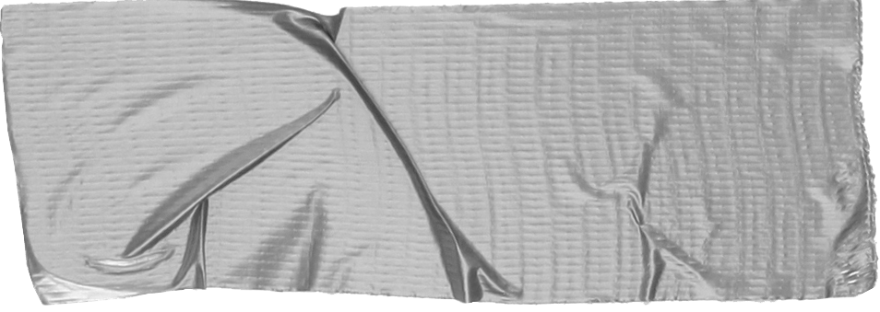
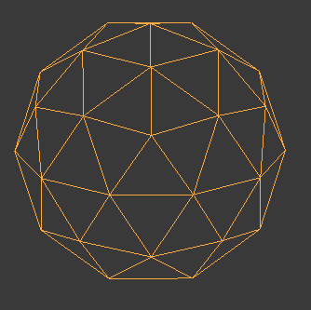
Idea: Triangles
Input Stream like AudioProcessor
Transformation RotLocScale with DSP48
Rasterization Point -> Line -> Triangles -> Lighting?
Frame buffer
None -> ???
Output
Stream pixels to host

Slide 7
So you want hardware? Show me your algorithm first

Slide 8
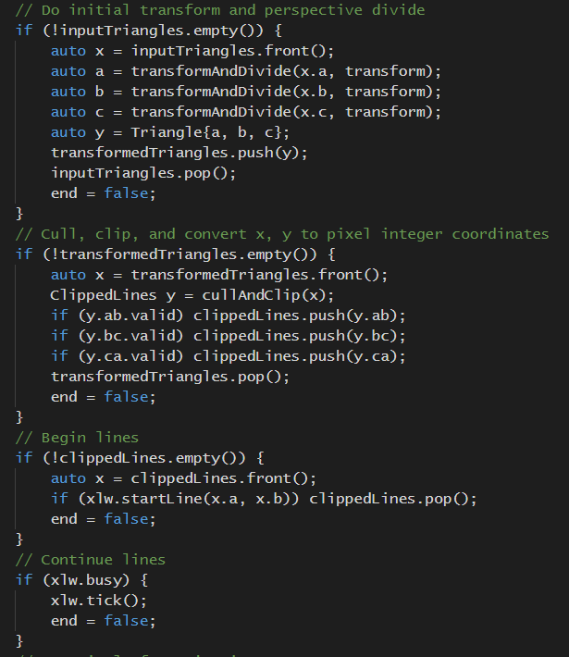
C++ implementation of each stage
Mock pipeline - beginning to think in terms of hardware as soon as possible.
Structs can be like wires
Standard library has FIFOs
Iteration and debugging much faster in software

Slide 9
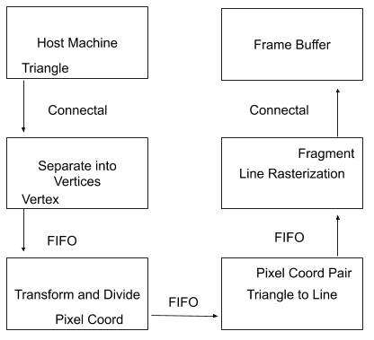
Pipeline Overview

Slide 10
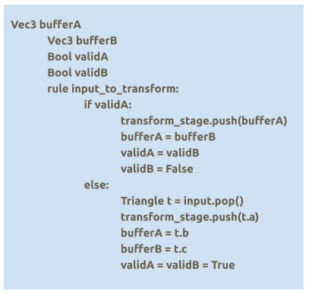
Triangle -> 3 vertices, one at a time

Slide 11
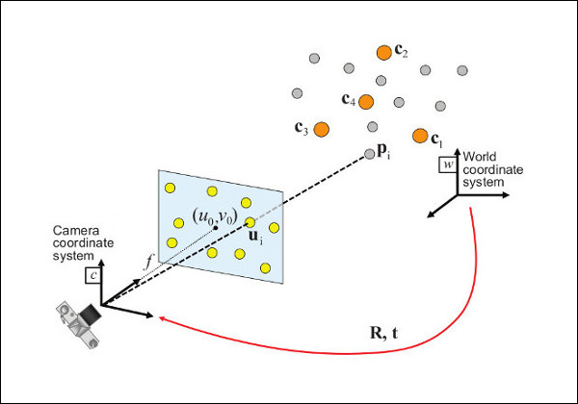

Slide 12
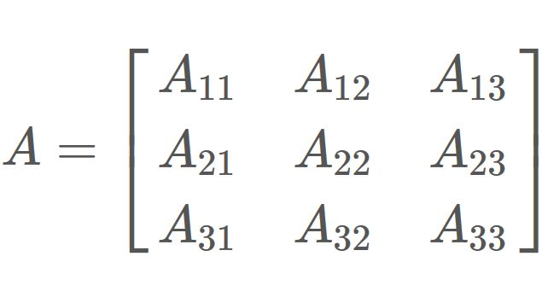
x
y
z
x
y
z
X
+

Slide 13
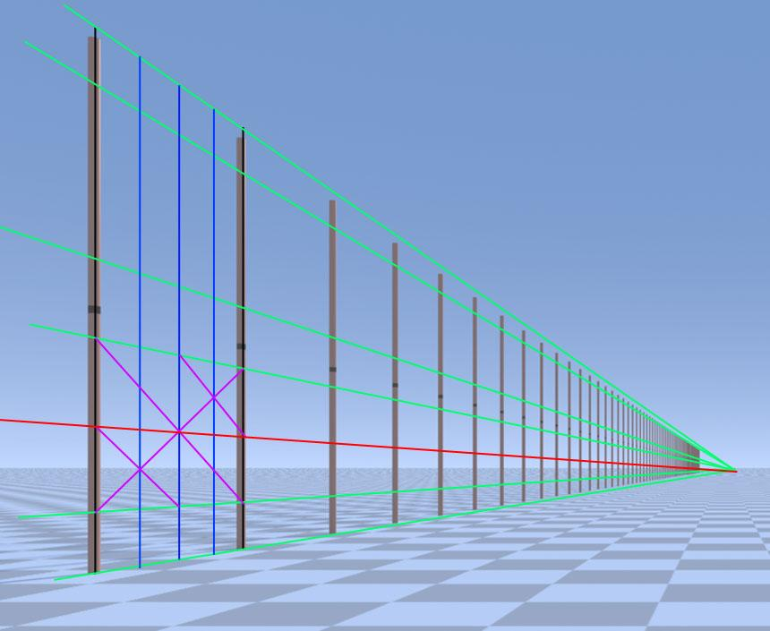
Finally, divide by z

Slide 14
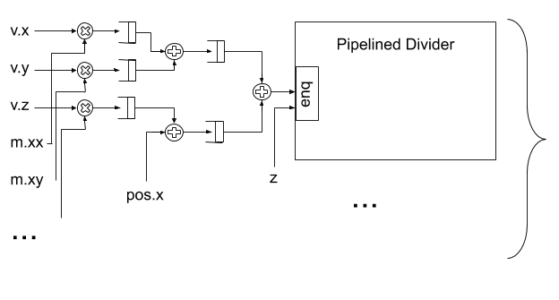

Slide 17
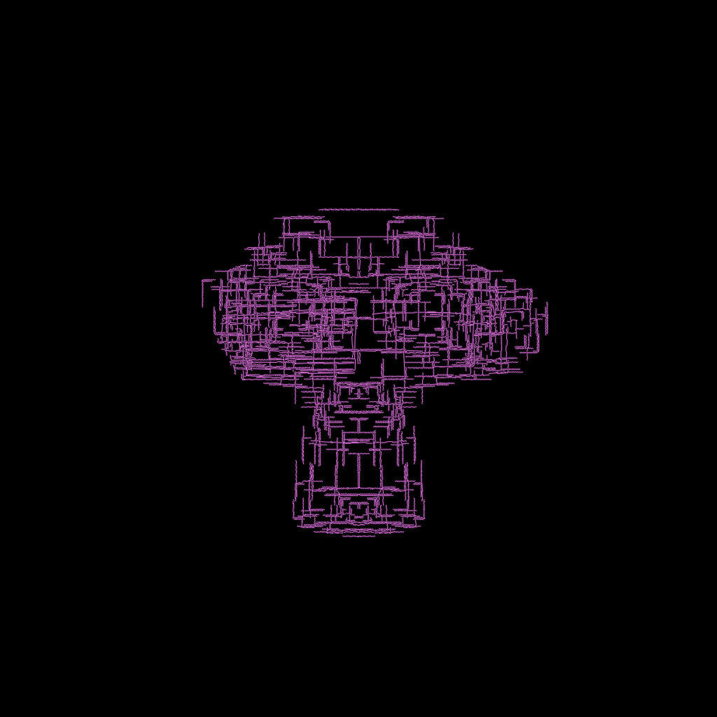

Slide 18
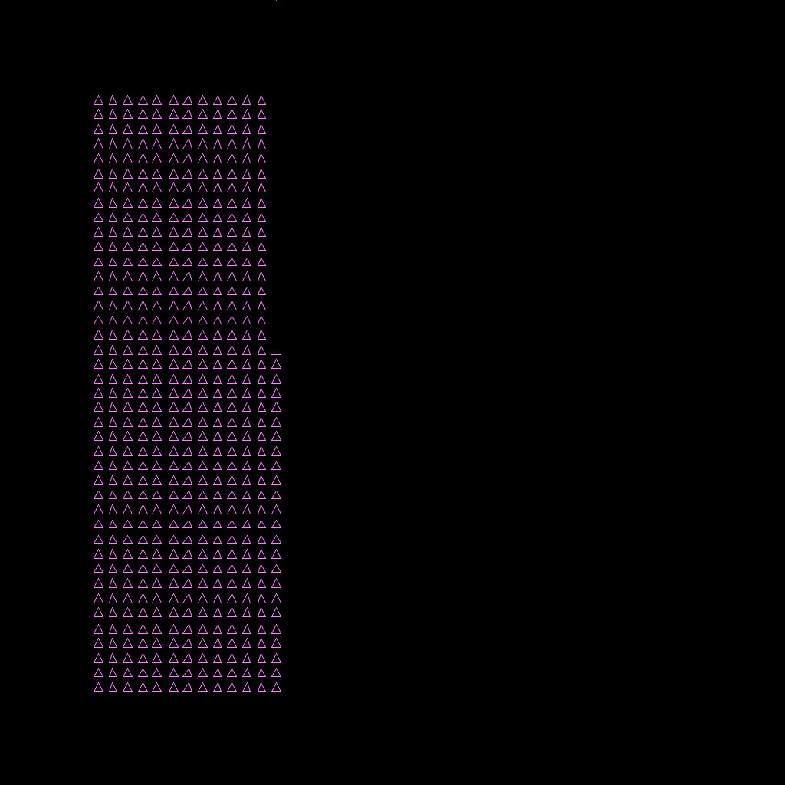

Slide 19
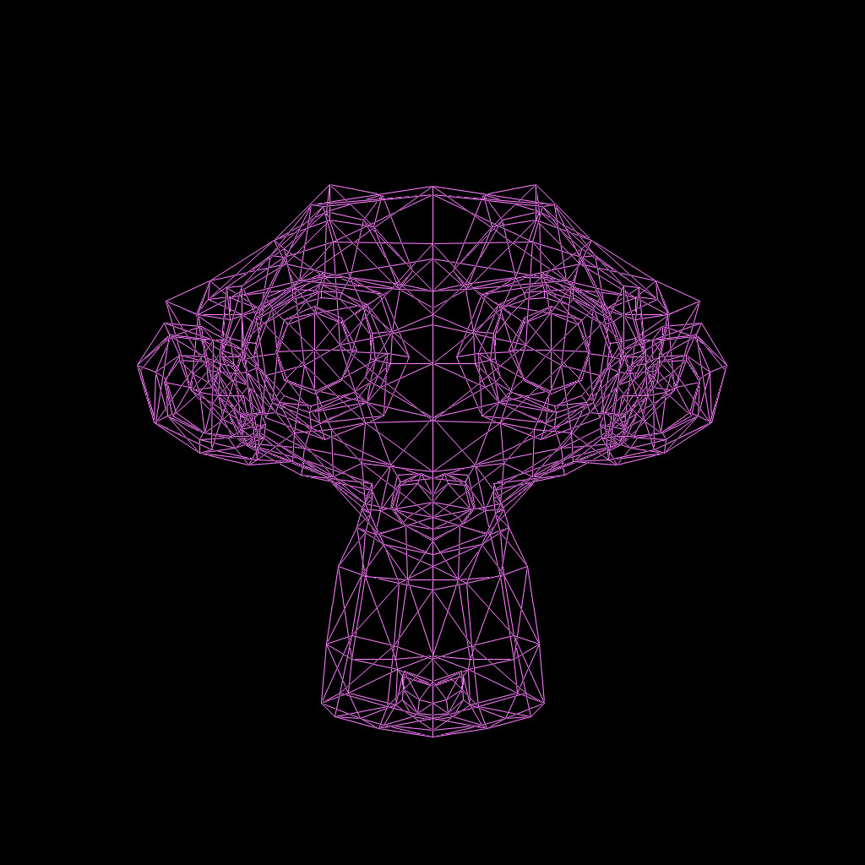

Slide 20
mkConnectalTop | 7828(2.58%) | 7828(2.58%) | 0(0.00%) | 0(0.00%) | 10132(1.67%) | 0(0.00%) | 0(0.00%) | 10(0.36%) |
under 13 ns
66 MHz at least

Slide 21
3. Notes
Multiplication
XiaoLin Wu's algorithm

Slide 22
Multiplication came for free...if we ask nicely
Worked when output of multiplication went directly to register

Slide 23
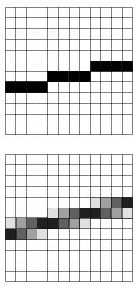
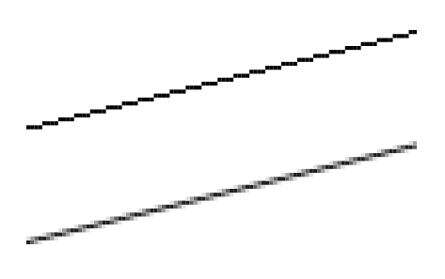
Xiaolin Wu
It's just drawing lines?

