Slide 1
6.823 SPring15 Quiz 2 Review (L09-L14)
TA: Po-An Tsai, Hsin-Jung Yang

Slide 2
Lecture 9-14 are all about ILP
Instruction-level parallelism (ILP)
Execute as many instructions as possible at the same time to maximize throughput and hide long latency by memory/ALU
Why this is not easy?
Dependencies between instructions

Slide 3
Dependency
Data dependency
RAW WAR WAW
Control dependency
Branch jump
Structural dependency
Only one ALU

Slide 4
Ways to Solve Dependency
For false dependency
Indirection
For true dependency
Stall
Bypass
Speculate => best if you speculate mostly correctly

Slide 5
Ways to Solve Dependency
Data dependency
RAW WAR WAW
=> Scoreboard (L9) ROB, Register renaming (L10), Store queue(L13)
Control dependency
Branch jump
=> Branch prediction (L11)
Structural dependency
Only one ALU
=> Superscalar (L9)

Slide 6
Speculation
We speculate a lot!
Branch
No exceptions
Addresses for load/store are not the same
How to manage old and new values?
Greedy/lazy (L12)

Slide 7
Mis-speculation
Recovery according to your policy(L12)
Snapshot
Rollback

Slide 8
Hide Long Latency
A cache miss takes 100 cycles
A divide takes 20 cycles
Execute following instructions, but hold them until those long-latency instruction finish.
Use Little’s law to calculate how many instruction in flight

Slide 9
Hide Long Latency
A cache miss takes 100 cycles
A divide takes 20 cycles
Switch to another independent thread until they finish (L14)
Use Little’s law to calculate how many threads needed

Slide 10
Example OoO Pipeline

Slide 11
Branch Prediction

Slide 12
Branch Prediction
Speculate what the next instruction is
Static
1 bit predictor
2 bit predictor
Global history (a history register and lots of predictor)
Local history (many history registers and lots of predictor)
Combined local and global history

Slide 13
Branch Prediction
Data management

Slide 14
Branch Target Buffer
Store the next PC of branch/jmp instructions seen last time
Get address earlier than predictor

Slide 15
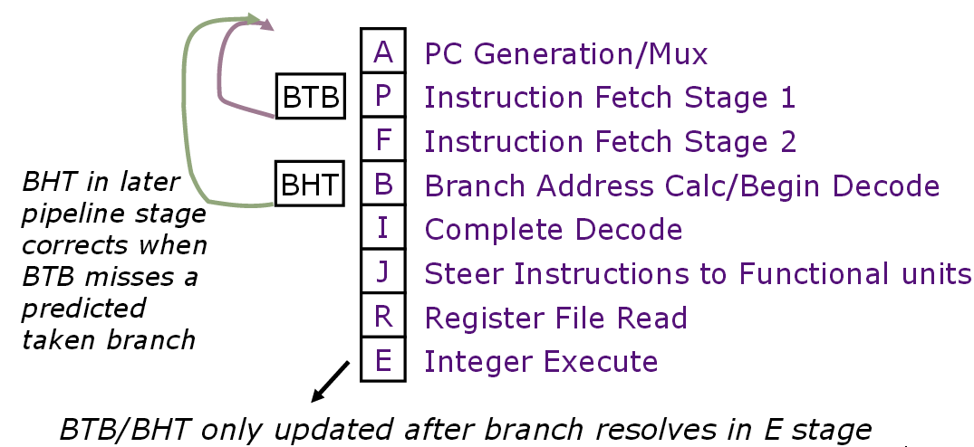
Combine BTB and Predictor(BHT)

Slide 16
Out-of-Order Execution
In-order Fetch/Decode
Out-of-order Execute
In-order Commit
When can we execute an instruction out-of-order?
Need to consider data dependency
(register dependency, memory dependency)

Slide 17
Data Dependency
Register Dependency
Data-dependence
r₃ ← (r₁) op (r₂) Read-after-Write
r₅ ← (r₃) op (r₄) (RAW) hazard
Anti-dependence
r₃ ← (r₁) op (r₂) Write-after-Read
r₁ ← (r₄) op (r₅) (WAR) hazard
Output-dependence
r₃ ← (r₁) op (r₂) Write-after-Write
r₃ ← (r₆) op (r₇) (WAW) hazard

Slide 18
Data Dependency
Register Dependency
Data-dependence
r₃ ← (r₁) op (r₂) Read-after-Write
r₅ ← (r₃) op (r₄) (RAW) hazard
Anti-dependence
r₃ ← (r₁) op (r₂) Write-after-Read
r₁ ← (r₄) op (r₅) (WAR) hazard
Handled by register naming
Output-dependence
r₃ ← (r₁) op (r₂) Write-after-Write
r₃ ← (r₆) op (r₇) (WAW) hazard
Handled by register naming

Slide 19
Data Dependency
Memory Dependency
When is the load dependent on the store?
When (r2 + 4) == (r4 + 8)
Do we know this issue when the instruction is decoded? No
st r1, 4(r2)
ld r3, 8(r4)

Slide 20
Data Dependency
Memory Dependency
Solution:
(1) Stall: can execute load before store only if the addresses are known to be different
(2) Address speculation: guess r2+4 != r4+8 and execute load before store
st r1, 4(r2)
ld r3, 8(r4)
Speculative Load Buffer

Slide 21
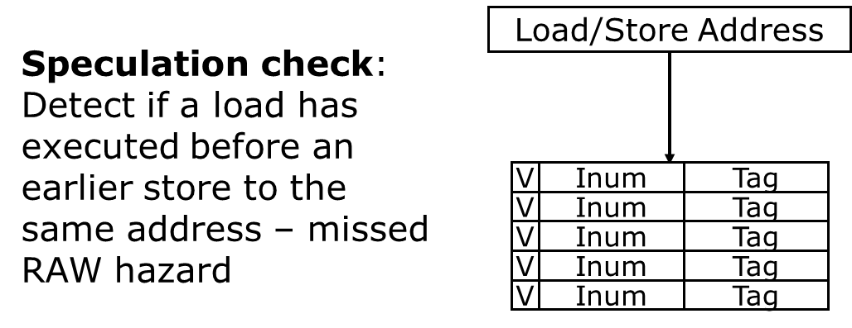
Data Dependency
Speculative Load Buffer
On load execute: mark entry valid, instruction number and tag On load commit: clear valid bit
On load abort: clear valid bit
On store execute: if tag matches and the instruction is younger than the store -> Abort!

Slide 22
Speculative Data Management
When do we do speculation?
Branch prediction
Assume no exceptions/interrupts
Assume no memory dependency
…
How do we manage speculative data?
Greedy (or Eager) Update
Update the value in place
Maintain a log of old values to use for recovery
Lazy Update
Buffer the new value and leave the old value in place
Replace the old value only at ‘commit’ time

Slide 23
Speculative Data Management
Type of speculative data
Branch prediction
history registers, prediction counters (see P.13)
Register values
Lazy update: store new values in the ROB and update registers during commit
Hybrid: store both new and old values in the unified physical register file
Store values to memory
Laze update: store new values in the speculative store buffer and write to non-speculative store buffer/cache/memory during commit

Slide 24
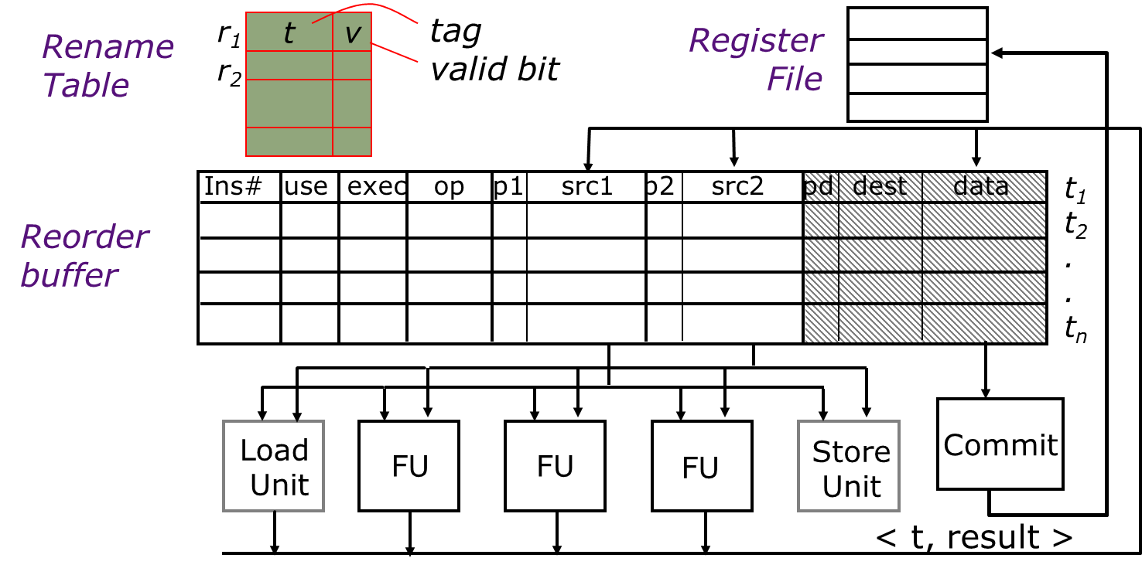
Speculative Data Management
Register Value Management
Approach 1: store new values in the ROB and update registers during commit
Space Inefficient

Slide 25
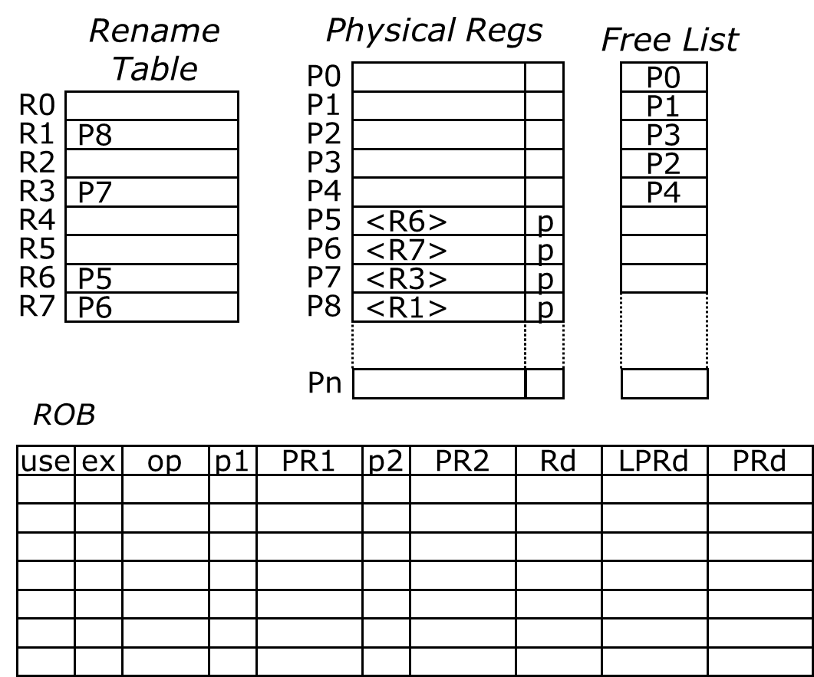
Speculative Data Management
Register Value Management
Approach 2: keep all data values in a physical register file
Reorder buffer contains only tags

Slide 26
Out-of-Order Execution
Pre-Issue Check:
The ROB is checked for available slots
The free list is checked for free rename registers (if necessary)
For store instructions, the non-speculative store buffer is checked for available slots

Slide 27
Out-of-Order Execution
ROB Insert:
The instruction is inserted into the ROB only if all the checks in the previous cycle (Pre-Issue check) pass
The destination register is renamed

Slide 28
Out-of-Order Execution
Rename Table
Physical Regs
Free List
P0
P0
R0
P1
P1
R1
P0
P2
ld r1, 0(r3)
add r3, r1, #4
sub r6, r7, r6
add r3, r3, r6
ld r6, 0(r1)
P8
P3
R2
P3
P2
R3
P7
P4
P4
R4
P5
<R6>
p
R5
P6
<R7>
p
R6
P5
P7
<R3>
p
R7
P6
P8
<R1>
p
Pn
ROB
use
ex
op
p1
PR1
p2
PR2
Rd
LPRd
PRd
x ld r1
P8
P0
p
P7

Slide 29
Out-of-Order Execution
Rename Table
Physical Regs
Free List
P0
P0
R0
P1
P1
R1
P0
P2
ld r1, 0(r3)
add r3, r1, #4
sub r6, r7, r6
add r3, r3, r6
ld r6, 0(r1)
P8
P3
R2
P3
P2
R3
P1
P2
P4
P7
P4
R4
P5
<R6>
p
R5
P6
<R7>
p
R6
P3
P4
P7
P5
<R3>
p
R7
P6
P8
<R1>
p
Pn
ROB
Ready to execute
use
ex
op
p1
PR1
p2
PR2
Rd
LPRd
PRd
x ld p P7 r1 P0
P8
x add P0 r3 P1
P7
x sub p P6 p P5 r6 P3
P5
x add P1 P3 r3 P2
P1
x ld P0 r6 P4
P3

Slide 30
Out-of-Order Execution
Reg File Read:
Operand values are read from the unified physical register file
Execute:
Integer and floating point operations are sent to the appropriate functional units
Stores enter the speculative store buffer
Loads read from the store buffer or cache/memory

Slide 31
Out-of-Order Execution
Reg File Write:
The output from the functional units/memory is written into the unified register file and the ROB is notified.

Slide 32
Out-of-Order Execution
Rename Table
Physical Regs
Free List
P0
<R1>
p
P0
R0
P1
P1
R1
P0
P2
ld r1, 0(r3)
add r3, r1, #4
sub r6, r7, r6
add r3, r3, r6
ld r6, 0(r1)
P8
P3
R2
P3
P2
R3
P1
P2
P4
P7
P4
R4
P5
<R6>
p
R5
P6
<R7>
p
R6
P3
P4
P7
P5
<R3>
p
R7
P6
P8
<R1>
p
Pn
ROB
use
ex
op
p1
PR1
p2
PR2
Rd
LPRd
PRd
Execute
x ld p P7 r1 P0
x ld p P7 r1 P0
x
P8
p
x add P0 r3 P1
P7
x sub p P6 p P5 r6 P3
P5
x add P1 P3 r3 P2
P1
p
x ld P0 r6 P4
P3

Slide 33
Out-of-Order Execution
Commit:
Instructions are committed in-order
Free the previously mapped physical register
Data is written to cache/memory/non-speculative store buffer when a store is committed
The ROB entry is freed after commit

Slide 34
Out-of-Order Execution
Rename Table
Physical Regs
Free List
P0
<R1>
p
P0
R0
P1
P1
R1
P0
P2
ld r1, 0(r3)
add r3, r1, #4
sub r6, r7, r6
add r3, r3, r6
ld r6, 0(r1)
P8
P3
R2
P3
P2
R3
P1
P2
P4
P7
P4
R4
P5
<R6>
p
P8
R5
P6
<R7>
p
R6
P3
P4
P7
P5
<R3>
p
R7
P6
P8
<R1>
p
Pn
ROB
use
ex
op
p1
PR1
p2
PR2
Rd
LPRd
PRd
Commit
x ld p P7 r1 P0
x ld p P7 r1 P0
x
P8
p
x add P0 r3 P1
P7
x sub p P6 p P5 r6 P3
P5
x add P1 P3 r3 P2
P1
p
x ld P0 r6 P4
P3

Slide 35
Multithreading

Slide 36
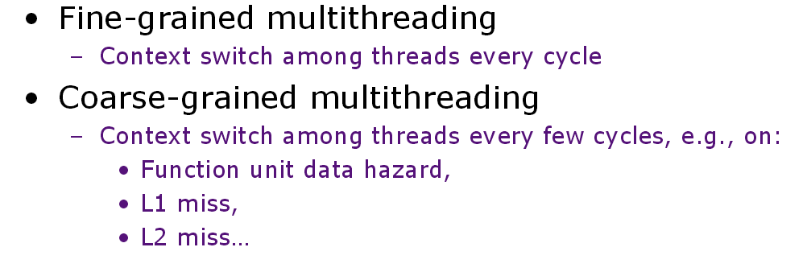
Scheduling Policy

Slide 37
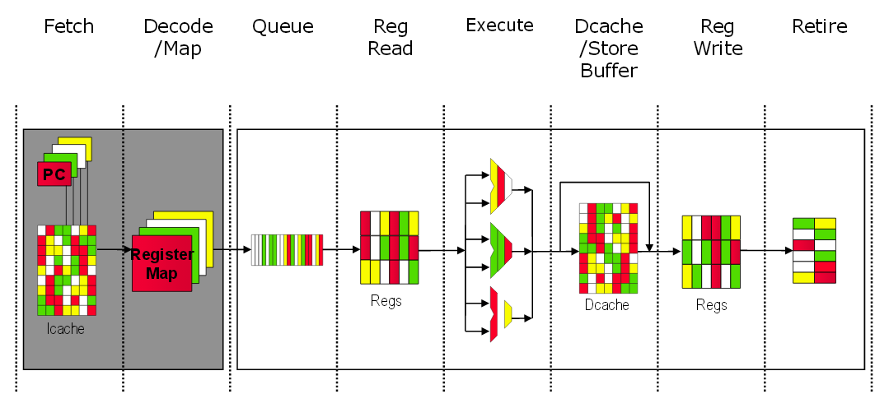
Simultaneous Multithreading (SMT)
Share OOO structures between threads

Slide 38
The end
Good luck!! ☺

