Slide 1
NoC
Po-An Tsai
6.823S15 Recitation

Slide 2
NoC
Network-on-chip is about how elements (cores, cache banks, memory controller, I/O controller etc.) communicate with each other
Important when you have a large system

Slide 3
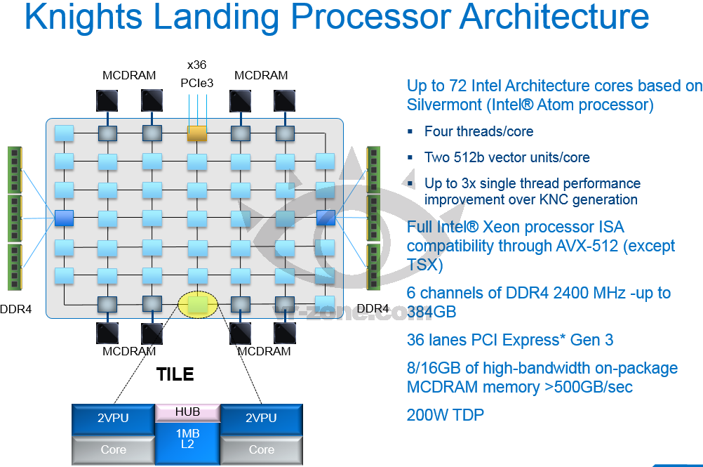
http://www.extremetech.com/wp-content/uploads/2013/11/KNL13.png

Slide 4
Topology
How different nodes connect to each other
Ring
Mesh/Torus
Tree
Important properties
Diameter
Avg. distance
Bisection bandwidth
Links (overhead)

Slide 5
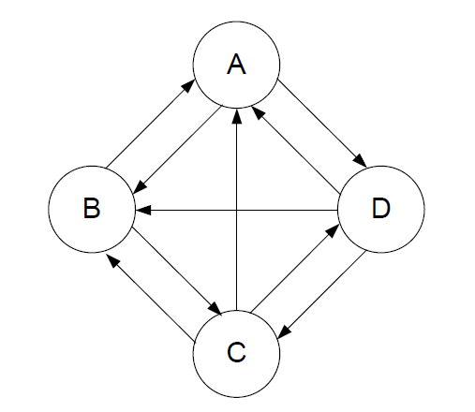
Topology
Problem 8.2
Diameter?
2
Average Hop Count?
(AB+AC+AD+BA+BC+BD+CA+CB+CD+DA+DB+DC)/12 = 7/6
Bisection Bandwidth?
4 if all links bi-directional

Slide 6
Flow control
How messages are forwarded from src to dst
Buffered/ Bufferless
Wormhole is the most common one
but there is head-of-line blocking problem

Slide 7
Head-of-line Blocking in Street Network
Congested
Waiting for the left turn…
We want to go straight!!
This is why we have such lanes as “straight only” or “left turn only”
7
Notes:
7

Slide 8
Congestion & HoL Blocking
Head-of-Line (HoL) Blocking
1
A
B

Slide 9
Congestion & HoL Blocking
Head-of-Line (HoL) Blocking
1
A
B
C
D
2
Solution: Virtual Channels

Slide 10
Congestion & HoL Blocking
Head-of-Line (HoL) Blocking
1
A
B
C
D
2
Solution: Virtual Channels

Slide 11
Routing
What is the path between src and dst
Use mesh as example here
Choose a path so that the message can arrive faster
Choose a path to ensure no deadlock/livelock

Slide 12
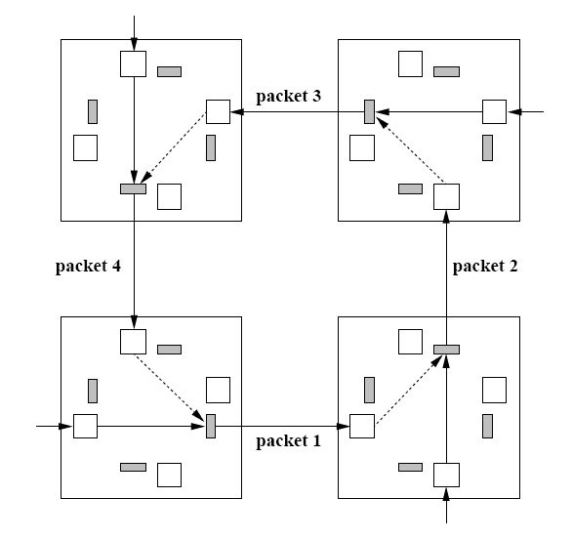
Routing: Deadlock

Slide 13
Turn Model
The eight possible turns and cycles in a 2D mesh
Only four turns are allowed in the XY routing algorithm

Slide 14
Turn Model
1
2
AND
3
4

Slide 15
Turn Model
1
2
West-First
AND
3
4

Slide 16
Turn Model
1
2
West-First
AND
3
4

Slide 17
Turn Model
1
2
West-First
AND
3
4
North-Last

Slide 18
Turn Model
1
2
West-First
AND
3
4
North-Last
Negative-First

Slide 19
Channel dependency graph (CDG)
Problem 8.2

Slide 20
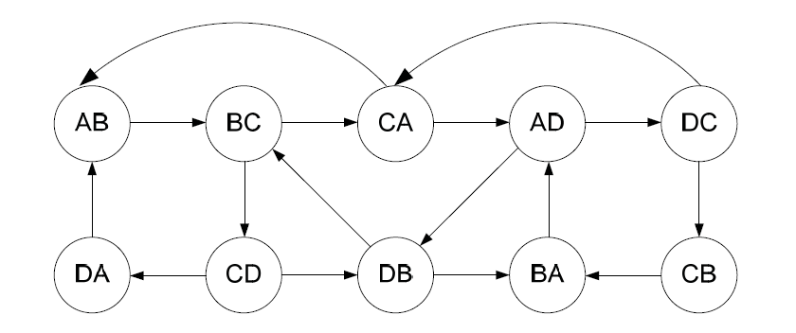
8.2.B: CDG
Deadlock free?
No

Slide 21
8.2.C: Minimal Routing
X
X
X
X
X
X
X
X
X
X
X
X
Deadlock free?
Yes

Slide 22
Dimension-Order Routing (DOR)
Approaches in one dimension first, then in the other
D_{A}
Bandwidth No path diversity
Latency Minimal routing
Deadlock Prevention Deadlock-free with 1 VC
D_{B}
S_{A}
S_{B}
DOR (XY)

Slide 23
Valiant
Uses one random intermediate node per each packet
I_{B}
D_{A}
Bandwidth Wide path diversity
Latency Poor latency
Deadlock Prevention Deadlock-free with >= 2 VCs - each phase should use different VCs
I_{A}
D_{B}
S_{A}
S_{B}
Valiant (XY/YX)

Slide 24
n-phase ROMM
n-1 random intermediate node(s) only in MBR (Minimum Bounding Rectangle)
D_{A}
Bandwidth More path diversity than DOR Limited by the value of n
Latency Minimal routing
Deadlock Prevention Deadlock-free with >= n VCs - each phase should use different VCs
D_{A}
I_{B}
I_{B}
D_{B}
D_{B}
S_{A}
S_{A}
I_{A}
I_{A}
S_{B}
S_{B}
2-phase ROMM (XY/YX)

Slide 25
Routing and Performance
D_{A}
S_{A}
S_{B}
DOR
Valiant
ROMM
O1TURN
Depend on traffic patterns
In general, path diversity helps lower congestions due to load balancing.

Slide 26
The end
Next time:
Router architecture
Cache coherence

