Slide 1
6.5930/1 Hardware Architectures for Deep Learning Dataflow for DNN Accelerator Architectures (Part 1)
March 11, 2024
Joel Emer and Vivienne Sze Massachusetts Institute of Technology Electrical Engineering & Computer Science

Slide 2
CONV Layer OS Loop Nest
int i[C,H,W]; # Input activations
int f[M,C,R,S]; # Filter weights
int o[M,P,Q]; # Output activations
for p in [0, P):
for q in [0, Q):
for r in [0, R):
for s in [0, S):
parallel-for c in [0, C):
parallel-for m in [0, M):
o[m,p,q] += i[c,p+r,q+s]*f[m,c,r,s]

Slide 3
Output Stationary - Movie

Slide 4
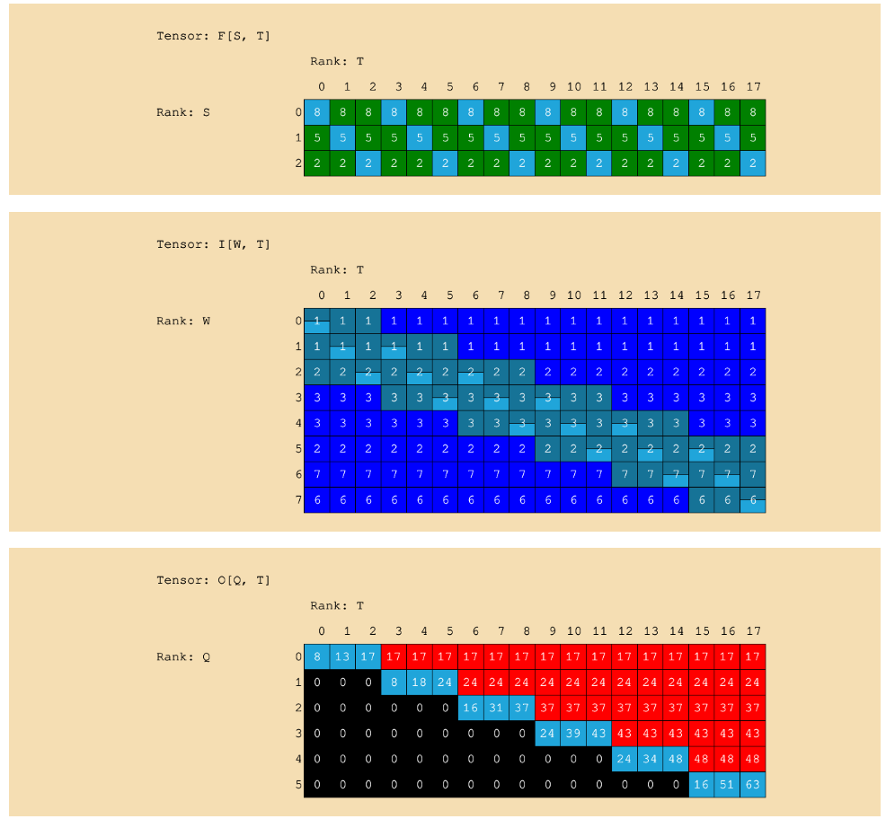
Output Stationary – Spacetime View

