Slide 1
6.5930/1
Hardware Architectures for Deep Learning
Sparse Matrix Multiplication
Accelerator Architecture
April 10, 2024
Joel Emer and Vivienne Sze
Massachusetts Institute of Technology
Electrical Engineering & Computer Science
Notes:
Applying the techniques from previous lectures to understand sparse architectures for matrix multiplication….

Slide 2

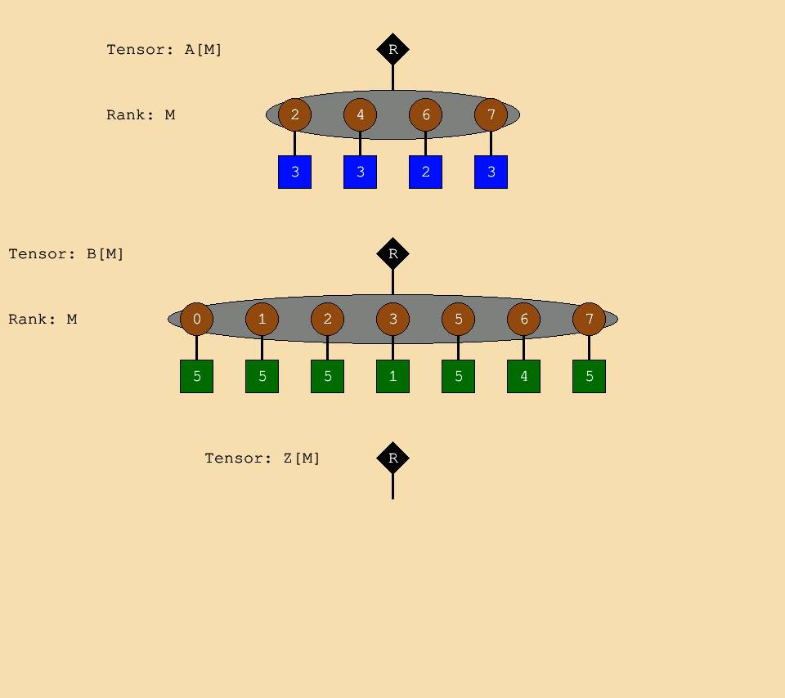
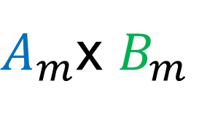
Intersection
$A_{m}$x $B_{m}$
for (m, (a_val, b_val)) in a & b:
…
Notes:
Does intersection require complex hardware? (options: yes, no, representation dependent, hard to tell)
What representations would be good? (options: uncompressed, RLE, bit mask of non-zeros, coordinate/payload, none of the above)
How this is accomplished in hardware is an interesting topic.
From coordinate representations as bit masks to “galloping” serial intersection.
Also interesting when operands are in different formats, e.g. one uncompressed and one compressed
As you read a paper they may be contributing an intersection approach…

Slide 3
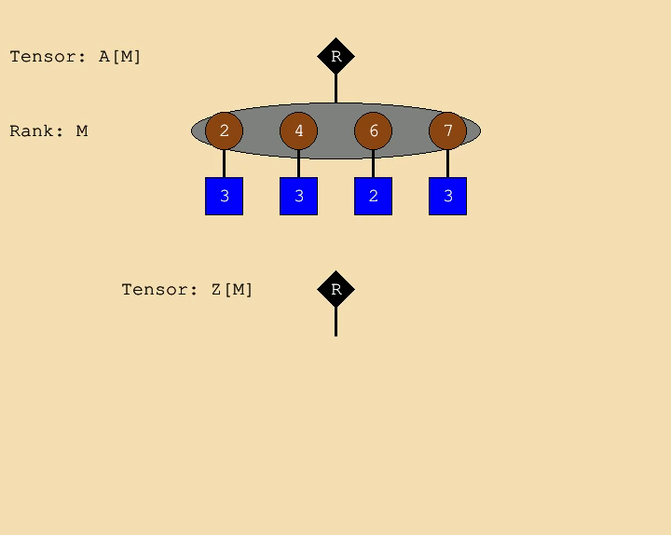

Populate
for m, (z_ref, a_val) in z << a:
z_ref <<= a_val
$$Z_{m}=A_{m}$$
Notes:
Like intersection populate creates a tuple as a payload.
But populate returns a reference to as one element of the payload tuple.
That means if the tuple already has a value you get a reference to that value that can be updated, e.g., through reduction.
How this is accomplished in hardware is another interesting topic.
Can be very hard inserting into a partially populated fiber. Especially in software, but there are more options in hardware.

Slide 4
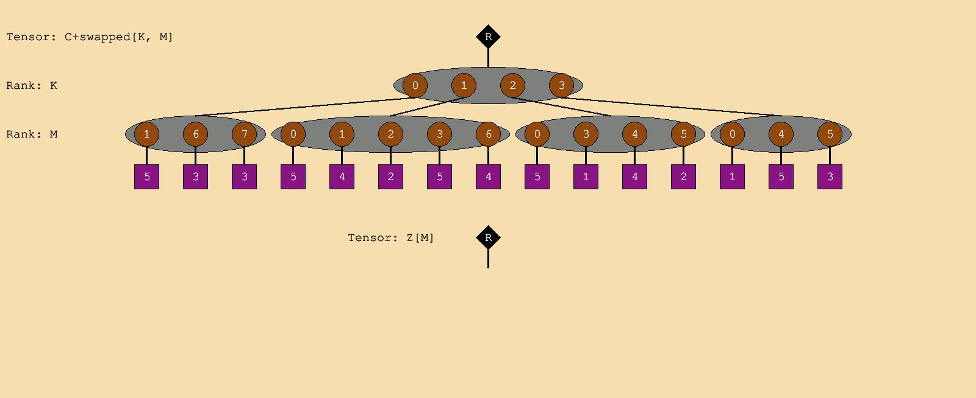

Populate+Reduce
for k, c_m in c:
for m, (z_ref, c_val) in z_m << c_m:
z_ref += c_val
$$Z_{m}=C_{k,m}$$
Notes:
Every more challenging hardware…

Slide 5
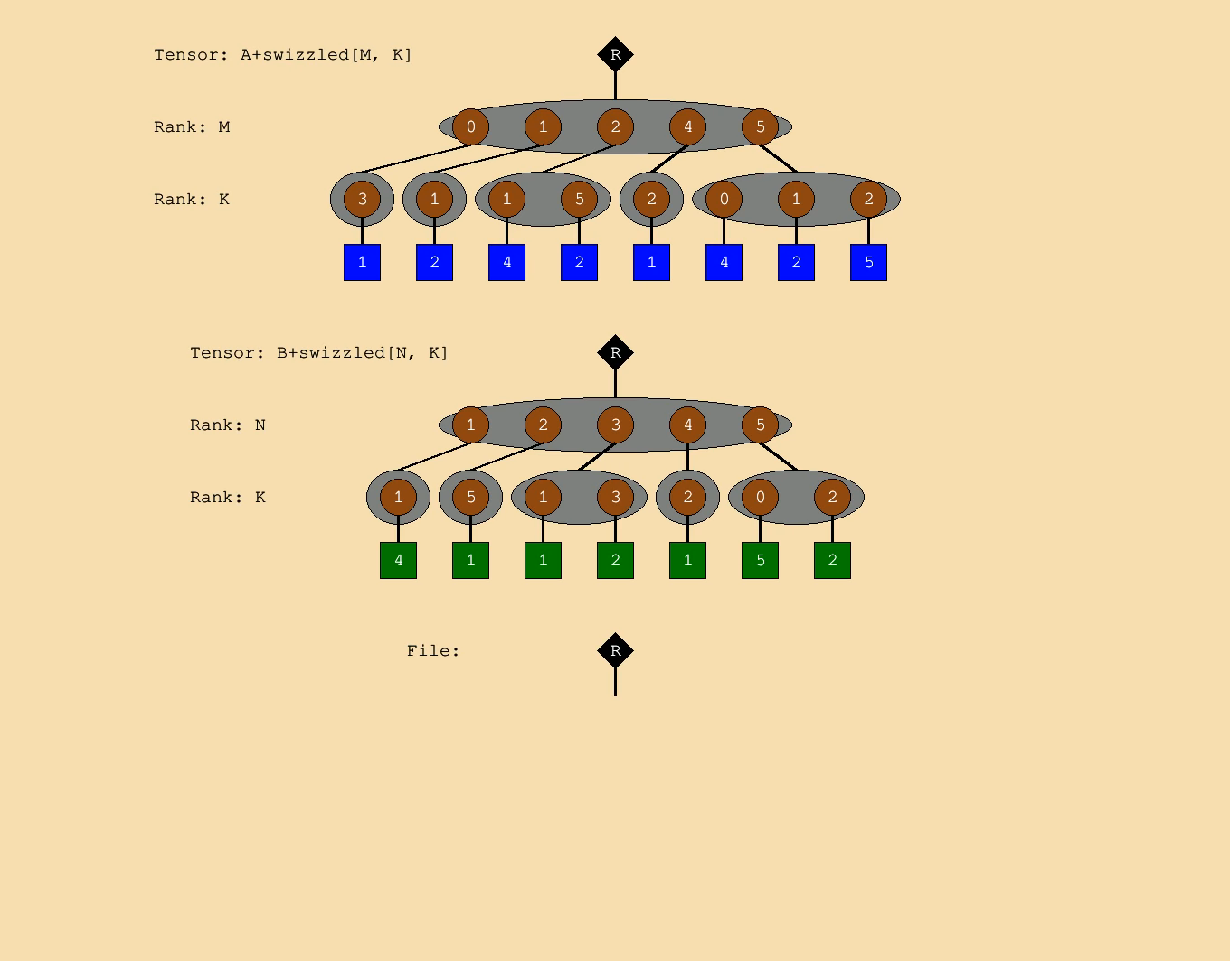
Output Stationary - Animation
Notes:
Note the long traversal of B…
What can we do to avoid the storage overflow – tiling
But in dense/uncompressed data we relied on position==coordinate….

Slide 6
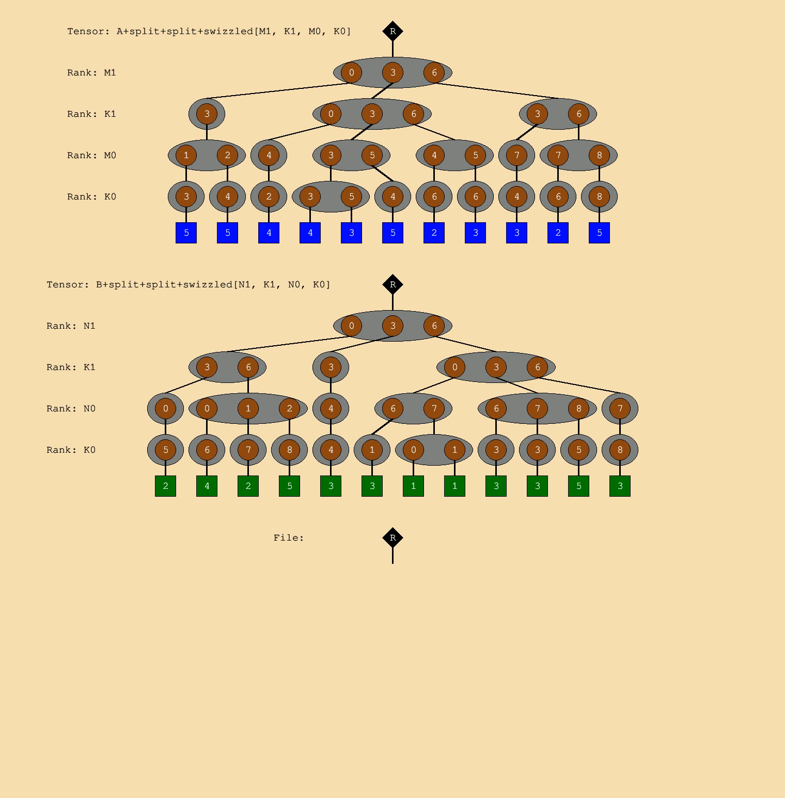
Two-level ExTensor Animation
Notes:
Tile corresponds to top two coordinates
One traversal through the A tiles
Multiple traversals through the B tiles
Output tiles created successively
Note output tile 0,0 is never created.
Traversals in A and B stay within a tile and then move to another tile.

Slide 7
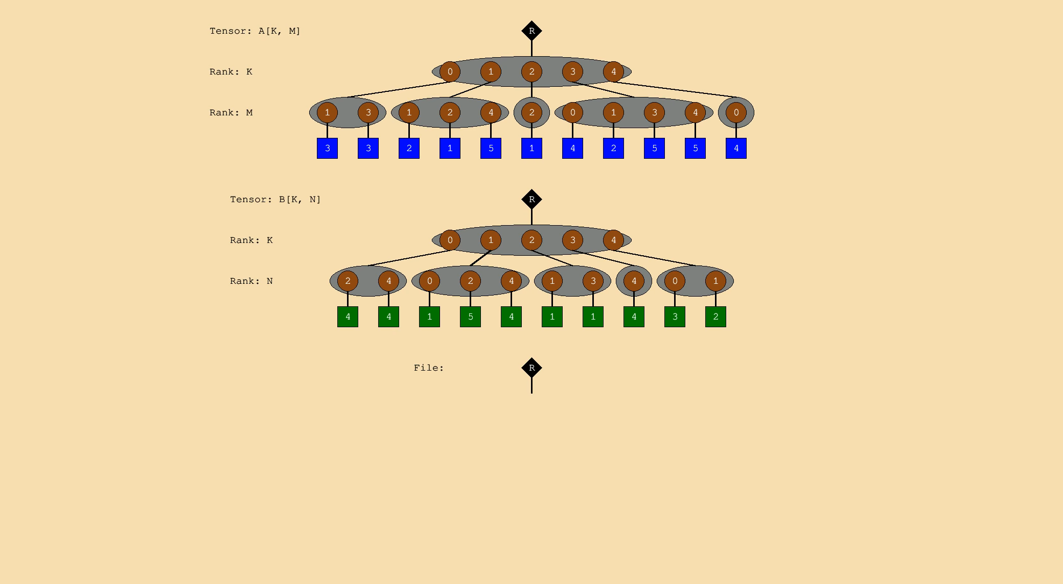
OuterSPACE – Step 1
Notes:
Concordant traversal of B with multicast use of B_n elements in a step
Concordant traversal of A with parallel access to A_m fiber
Works on one output K matrix at a time
Parallel append traversal of Z matrix

Slide 8
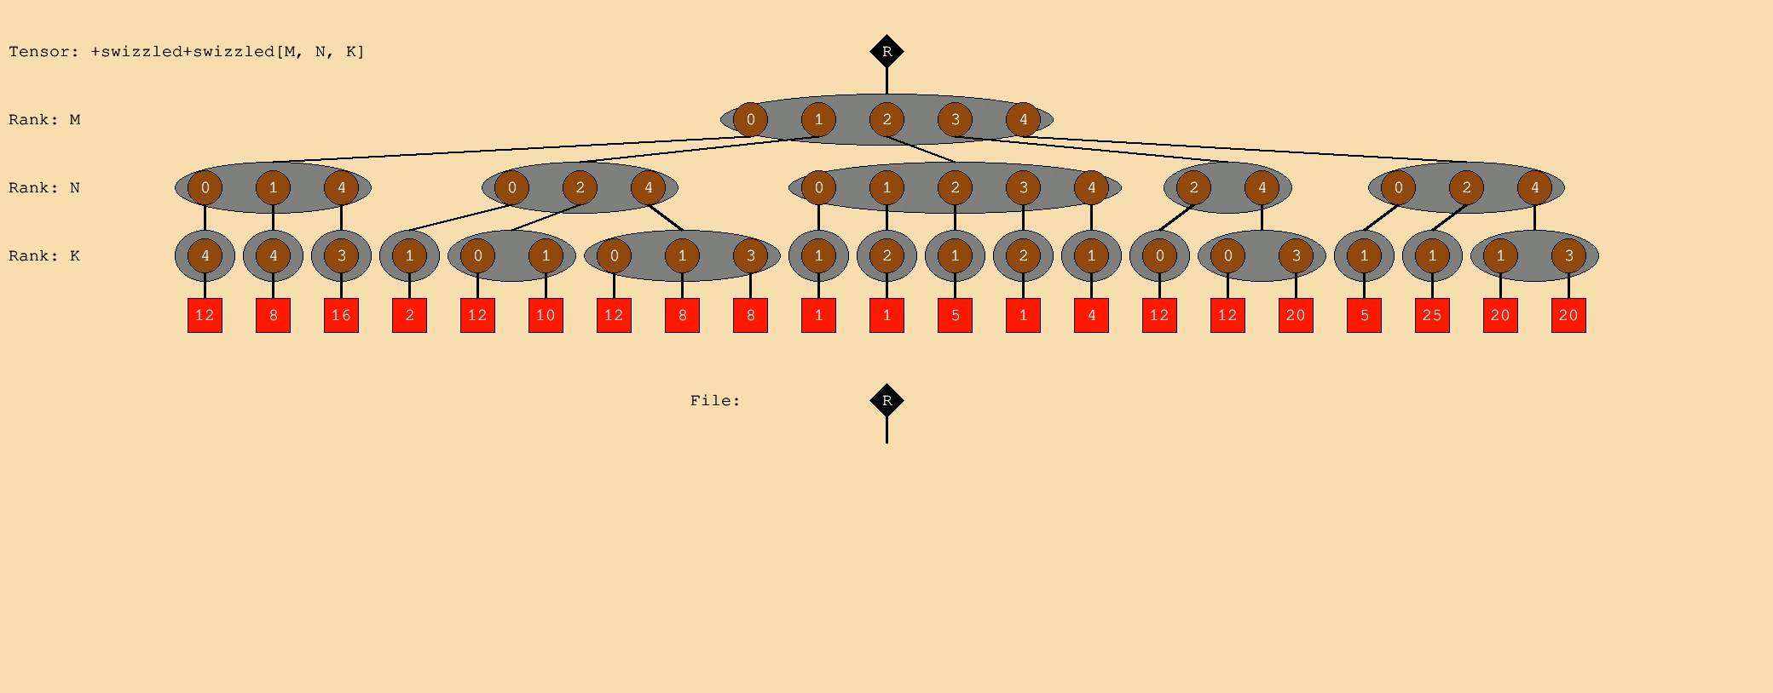
OuterSPACE – Step 2

Slide 9
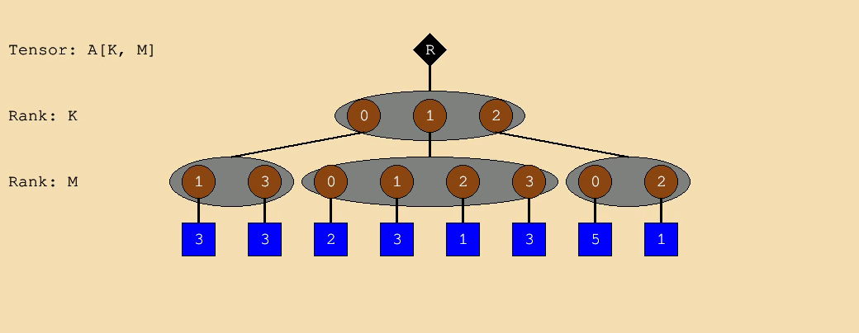
Discordant Traversal - Fibertree
Traversal order (slowest to fastest): M,K

Slide 10
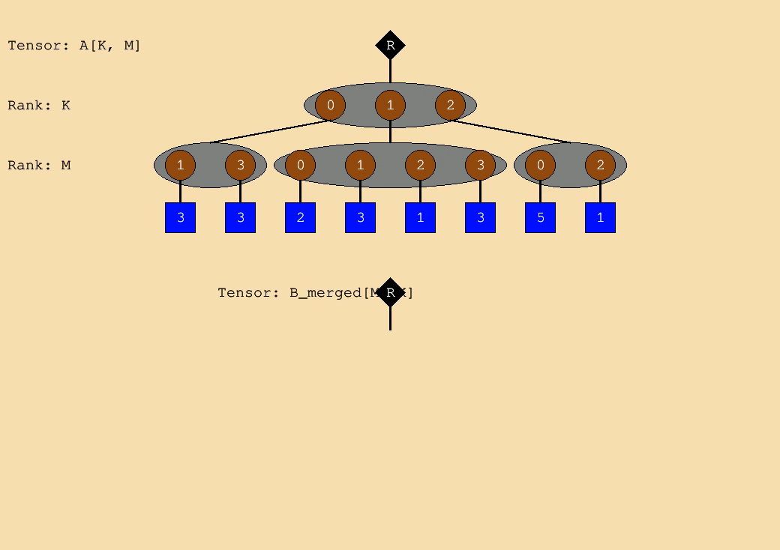
Rank Swizzle/Merger
Take lowest untaken coordinate in input M-fibers and
place into result at location with coordinates reversed

Slide 11
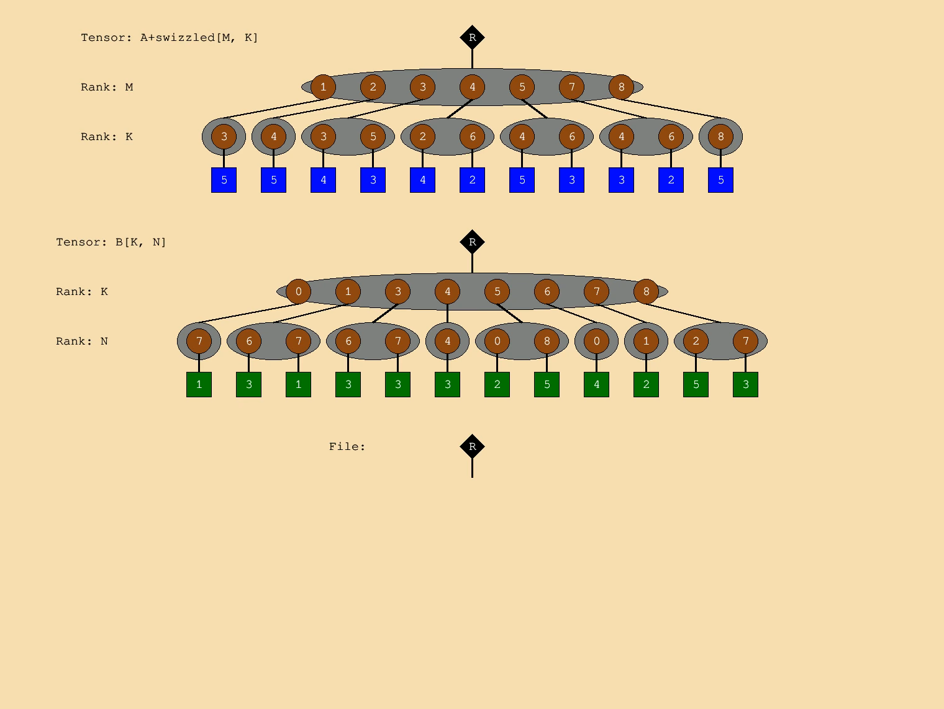

Gamma - Step 1
$$T_{m,k,n}={right(A}_{m,k},B_{k,n})$$
Traversal (s to f): M, K, N
Parallel K, M*
*Not modelled
Notes:
Single traversal of M
Note that same B_n filbers are fetched multiple times.
For each specific M, the processing is parallel across K to force a specific order of creation of T
That allows for merging of T in next step
Illustrate creation of rank swapped T be looking at sequence of creation of T[3,{3,5},*]

Slide 12
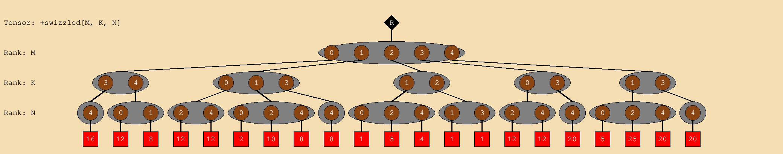
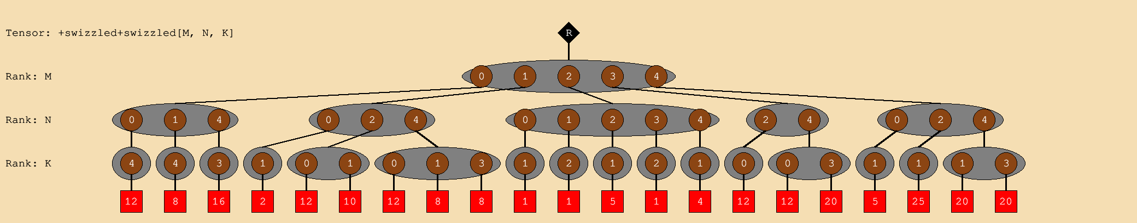
Gamma - Rank Swizzled T
T[M,K,N]
T’[M,N,K]
Since elements of each K fiber in T[M,K,N] are processed in parallel and elements in
N fibers are created concordantly, the head elements needed for the swizzle are available!

Slide 13
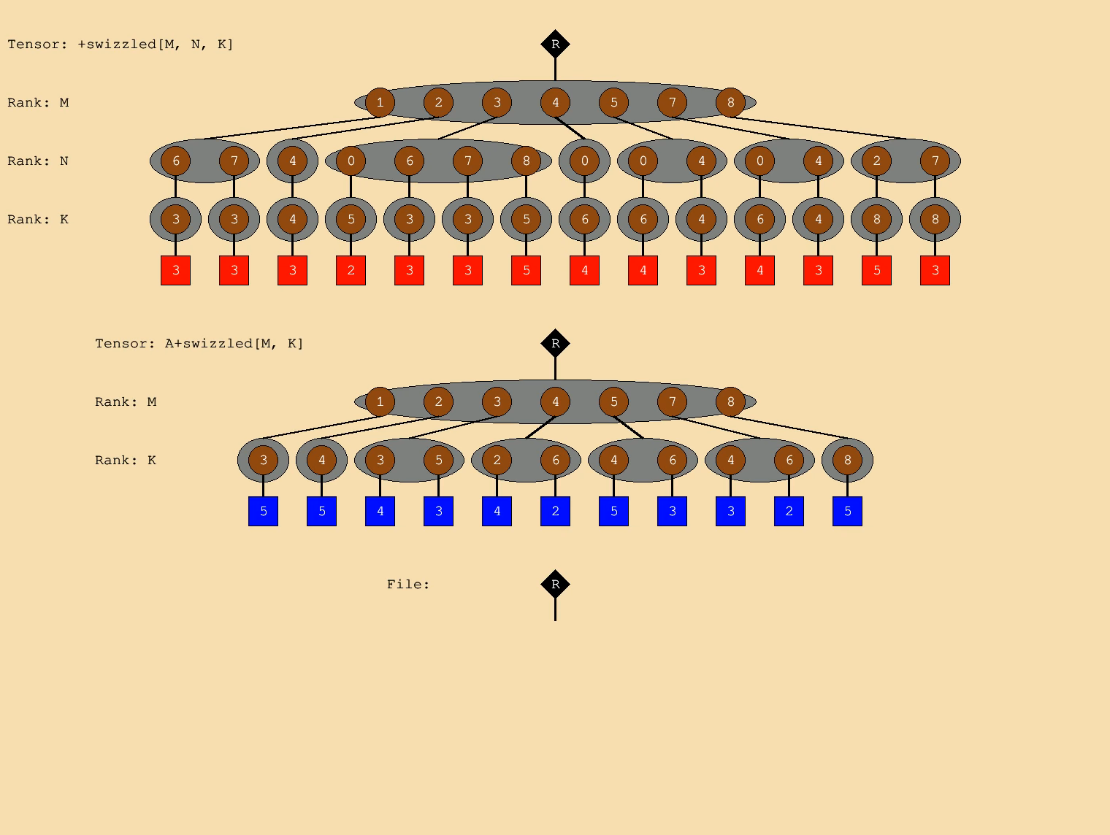

Gamma – Step 2
$$Z_{m,n}=T_{m,n,k}× A_{k,m}$$
Traversal (s to f): M, N, K
Parallel M*
*Not modelled
Notes:
Note concordant in T that means it can be created in pipeline and consumed immediately without all being held.
Note how K-fibers of A are re-read repeatedly.

