Slide 1
Constructive Computer Architecture
Tutorial 3:
Debugging SMIPS
Andy Wright
6.S195 TA

Slide 2
Introduction
In lab 4, you will be making modifications to an existing, functional, SMIPS processor
How do you know if your processor is working?
You will run an existing suite of C and assembly software test benches on your processor
What could go wrong?
Software and Hardware
How will you debug this?
Print statements!

Slide 3
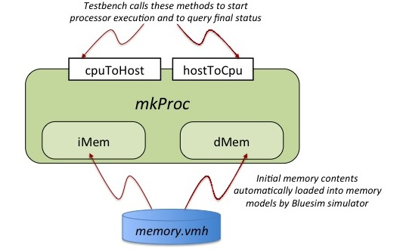
SMIPS Cpu Interface

Slide 4
SMIPS Cpu Interface
Hardware Problems
Software
Problems

Slide 5
Running SMIPS Test Benches - Success
$ ./smips –x –b 1cyc.bsv –c all -r
…
Compiling programs/src/assembly/smipsv2_addu.S
Running smipsv2_addu.S on 1cyc.bsv
PASSED
…
Compiling programs/src/vvadd
Running vvadd on 1cyc.bsv
Cycles = 3018
Insts = 3018
PASSED
…

Slide 6
SMIPS’s Coprocessor
The coprocessor is what enables these software tests
Reg 10 (read): Number of clock cycles passed
Reg 11 (read): Number of instructions executed
Reg 18 (write): Printing an integer
Reg 19 (write): Printing a character
Reg 21 (write): Finished executing (data is return code)

Slide 7
Test Benches
Test Benches can be written in assembly or in C
Assembly examples:
smipsv1_simple.s
smipsv2_addu.s
C example:
vvadd

Slide 8
Running SMIPS Test Benches - Failure
$ ./smips –x –b 1cyc.bsv –c all -r
…
Compiling programs/src/assembly/smipsv1_lw.S
Running smipsv2_addu.S on 1cyc.bsv
FAILED 1
…
Compiling programs/src/vvadd
Running vvadd on 1cyc.bsv
Executing unsupported instruction at pc: 00000004.
Exiting
…
We need more feedback from the processor!

Slide 9
Test Bench Setup
mkTestBench
Start
mkProc
hostToCpu
Run
cpuToHost
Where does feedback from the processor come from in this system?

Slide 10
Printing from the COP
mkTestBench
Start
mkProc
hostToCpu
Run
cpuToHost
Cycles = 2052
Insts = 1026
PASSED
FAILED 5
These messages are written to stderr.

Slide 11
Printing from Bluespec: Error
mkTestBench
Start
mkProc
hostToCpu
Run
cpuToHost
$fwrite(stderr, “Executing unsupported instruction at pc: %x. Exiting\n”, pc );
This message is written to stderr.

Slide 12
Printing from Bluespec: Message
mkTestBench
Start
mkProc
hostToCpu
Run
cpuToHost
$display(“pc: %h inst: (%h) expanded: “, pc, inst, showInst(inst));
This message is written to stdout every clock cycle.

Slide 13
Output streams
Stderr
Piped to stdout in the smips test script
Contains statements printed by software and error messages
Sdtout
Piped to build/<program_name>/simOut
Contains debug messages about the processor status

Slide 14
Debugging
To debug problems, look at simOut
To debug further, you can add more $display(…) statements
…
Cycle 3057 ---------------------------------
pc: 00001098 inst: (03e00008) expanded: jr ‘h1f
Cycle 3058 ---------------------------------
pc: 00000004 inst: (aaaaaaaa) expanded: nop

