Slide 1
Constructive Computer Architecture
Tutorial 4:
SMIPS on FPGA
Andy Wright
6.S195 TA

Slide 2
Introduction
Field programmable gate arrays (FPGAs) are chips filled with fine grained configurable hardware
  Can think of it as logic gates that you can connect together
They are a prototyping tool in ASIC design flow
They are the end-target for many designs
  Low volume custom hardware
They are also very useful for simulation
Later labs will use FPGA tools to compile Bluespec code for an FPGA

Slide 3
BSV Design Flow
BSV source
Bluespec Compiler
Verilog RTL
Bluespec Simulator
Cycle
Accurate
Xilinx ISE
Simulator
Xilinx XST
Synthesis
VCD output
Power Analysis
Gates

Slide 4
Original Test Bench Setup
mkTestBench
Start
mkProc
hostToCpu
Run
cpuToHost
- This setup isn’t suited to test a design on an FPGA.
- None of the output from the test can be seen by the user since all $… commands are ignored during FPGA synthesis

Slide 5
SceMi Infrastructure
mkBridge
SceMi
mkProc
SceMi
Magic
specialized SceMi interface to outside world
hostToCpu
cpuToHost
- The SceMi infrastructure sets up a way to access interface methods of a DUT through a common connection to the outside world

Slide 6
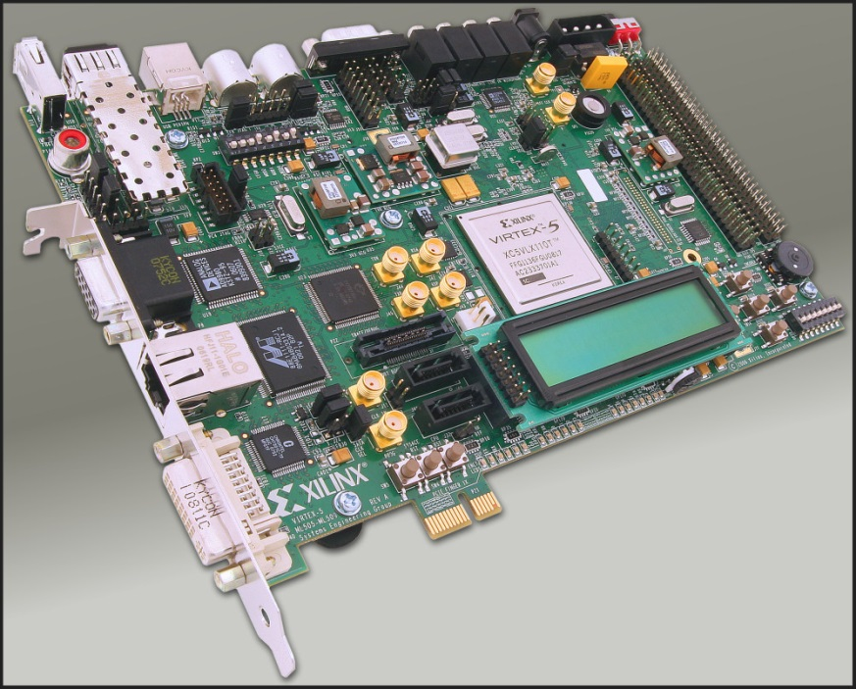
Sample Scemi Interfaces
TCP – for bsim simulations of scemi connection
XUPV5
Image of XUPV5 from Xilinx Inc.
http://www.xilinx.com/univ/xupv5-lx110t.htm

Slide 7
Scemi using TCP
Host Computer
Testbench written in C++
Bluespec DUT simulation in BSIM
TCP

Slide 8
Scemi using XUPV5
Host Computer
XUPV5
Testbench written in C++
Bluespec DUT on FPGA
FPGA
PCIE
Same testbench from the TCP example

Slide 9
TCP vs XUPV5
TCP
  + Can see output from $… commands
  + Don’t have to wait for FPGA compilation
  - Not testing hardware
XUPV5
  + Actually running Bluespec code on FPGA
  - More things can go wrong
  - Harder to Debug
  + Faster simulation!
  Filter:
  SMIPS: 867329 cycles
  CPU sim: ~10 seconds
  FPGA: ~25 ms

Slide 10
Debugging on FPGA
You can’t see the effects of:
  $display
    Used to give basic debug information from processor in simulation
  $fwrite
    Used to give essential output from the simulation
  $finish
    Used to stop the processor early on error
All output seen by the user must pass through the SceMi Interface
  The current setup only allows for print statements from SMIPS programs and PASSED/FAILED output
  An improved interface could give more feedback

Slide 11
Old Processor Interface
interface Proc;
method ActionValue#(...) cpuToHost;
method Action hostToCpu(Addr startpc);
endinterface

Slide 12
Old C++ Test Bench
Look at Run.cpp
Look at function that prints to stderr from cpuToHost

Slide 13
Interface Improvements
GDB Inspired
  More program flow control:
    start, step, stop
    read PC, write PC
  Read processor state:
    Read registers, read memory
  Read profiling stats
    cycle count, instruction count

Slide 14
Debug Processor Interface
interface ProcDebug;
method ActionValue#(...) cpuToHost;
method Action start(Bool ignore);
method Action step(Data steps);
method Action stop(Bool ignore);
method Addr read_pc;
method Action write_pc(Addr d);
method Action req_read_rfile(Bit#(5) r);
method ActionValue#(Data) resp_read_rfile();
method ActionValue#(Data) read_mem32(Addr addr);
method Addr read_cycle;
method Addr read_inst;
endinterface

Slide 15
New 1cyc.bsv
Look at 1cyc.bsv
Also includes modified coprocessor

Slide 16
New SceMiLayer.bsv
Look at SceMiLayer.bsv

Slide 17
New C++ Test Bench
Look at Run-debug.cpp
Look at the new functions included for debugging

Slide 18
Output from C++ Test Bench
Look at output.txt

Slide 19
SMIPS Debugger Program
Give user interactive control over processor on FPGA
  User can type start, step <n>, stop, and other similar commands
  They can also choose to get the entire processor state when the processor is stopped
  This is still a work in progress

Slide 20
Adding breakpoints to SMIPS
The user needs to be able to specify a PC to stop at
  New interface method to write breakpoint to processor
The processor needs to be able to store breakpoints
  The processor needs a breakpoint register
The processor needs to stop when that PC has been reached
  Coprocessor needs to monitor PC and change processor state accordingly

Slide 21
SceMi simulation bugs?
Look at bugs.txt
Cycle count and instruction count don’t match for print and filter when running 1cyc.bsv
This is not a bug, the coprocessor fifo is getting filled because the C++ test bench is slower at dequeuing from the fifo than the BSV test bench. The filled coprocessor fifo is forcing the processor to stall.

Slide 22
Conclusion
FPGA simulation is harder, but SceMi’s interfaces make it easier.
The TCP SceMi interface allows for testing software written for FPGA simulation without using the FPGA.
More advanced debugging techniques can be used by adding to the processor interface.

