Slide 1
6.5930/1 Hardware Architectures for Deep Learning Dataflow for DNN Accelerator Architectures (Part 2)
March 13, 2024
Joel Emer and Vivienne Sze Massachusetts Institute of Technology Electrical Engineering & Computer Science

Slide 2
1-D Convolution
Weights
Inputs
Outputs
*
=
S
W
Q = W-ceil(S/2)†
int i[W]; # Input activations
int f[S]; # Filter weights
int o[Q]; # Output activations
for s in [0, S):
for q in [0, Q):
o[q] += i[q+s]*f[s]
What dataflow is this?
Weight stationary
† Assuming: ‘valid’ style convolution

Slide 3
Weight Stationary - Animation
Notes:
Note how some combinations of input activations and weights never occur.

Slide 4
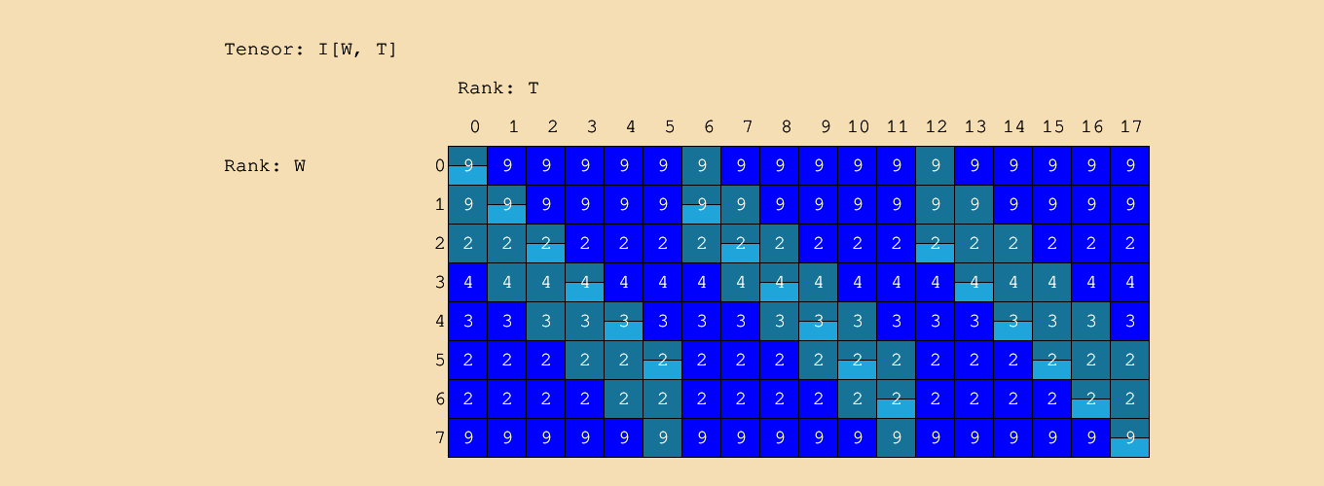
Weight Stationary - Spacetime

Slide 5
1-D Convolution Einsum + WS
Serial WS design
Einsum:
$$O_{q}=I_{q+s}× F_{s}$$
Traversal order (fastest to slowest): Q, S
WS design for parallel weights
Einsum:
$$O_{q}=I_{q+s}× F_{s}$$
Parallel Ranks:
S
Traversal order (fastest to slowest):
Q
Can you write the loop nest?
I hope so 😊

Slide 6
Parallel Weight Stationary - Animation
Notes:
Highlight color shows the PE that is doing the work.
What can you see in this behavior:
All weights used
Activations are multicast to all PEs
Multiple outputs are worked on and then they move to the next PE

Slide 7
Loop Nest: NVDLA (simplified)
M = 8; C = 3;
R = 2; S = 2
P = 2; Q = 2
int i[C,H,W]; # Input activations
int f[M,C,R,S]; # Filter weights
int o[M,P,Q]; # Output activations
for r in [0,R):
for s in [0,S):
for p in [0,P):
for q in [0,Q):
parallel-for m in [0, M):
parallel-for c in [0, C):
o[m,p,q] += i[c,p+r,q+s] * f[m,c,r,s]
How can we tell this is weight stationary?
Top loops are r and s

Slide 8
CONV-layer Einsum
$$O_{m,p,q}=I_{c,p+r,q+s}× F_{m,c,r,s}$$
Traversal order (fastest to slowest):
Q, P, S, R
Parallel Ranks:
C, M

Slide 9
NVDLA (Simplified) - Animation
M = 2
C = 2
R = 3
S = 3
H = 4
W = 8
P = 2
Q = 6
Notes:
Weights are stationary in each PE
Input activations are “multi-cast” to contribute to multiple outputs
Multiple MAC results are combined in same cycle to contribute to an output
Output is not completed in a single cycle
Note every filter weight read in a cycle contributes to exactly one output in that cycle so for a particular weight there is a position in the sliding window that has the same shape as the output.

