Slide 1
6.5930/1
Hardware Architectures for Deep Learning
Sparse Architectures – Part 2
April 8, 2024
Joel Emer and Vivienne Sze
Massachusetts Institute of Technology
Electrical Engineering & Computer Science
Notes:
Applying the techniques from previous lectures to understand sparse architectures….
Recount story of unification of Banyan and Butterfly networks…. I believe that it was Danny Hillis’ work on the “Connection Machine”

Slide 2
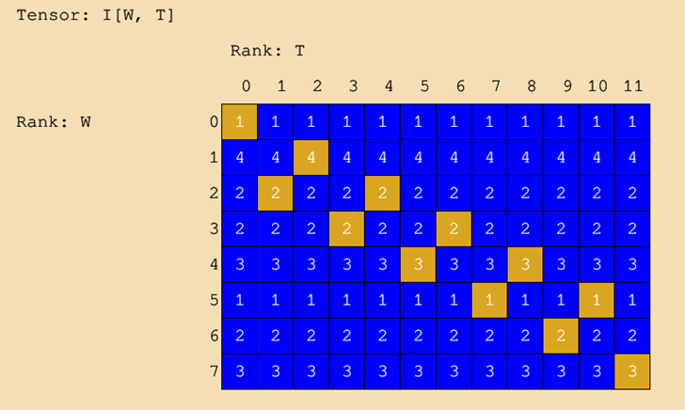
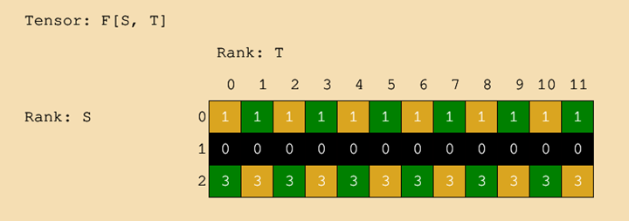
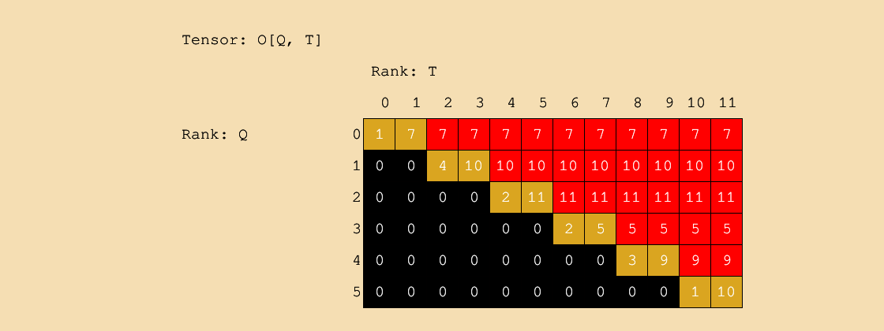
Output Stationary – Sparse Weights

Slide 3
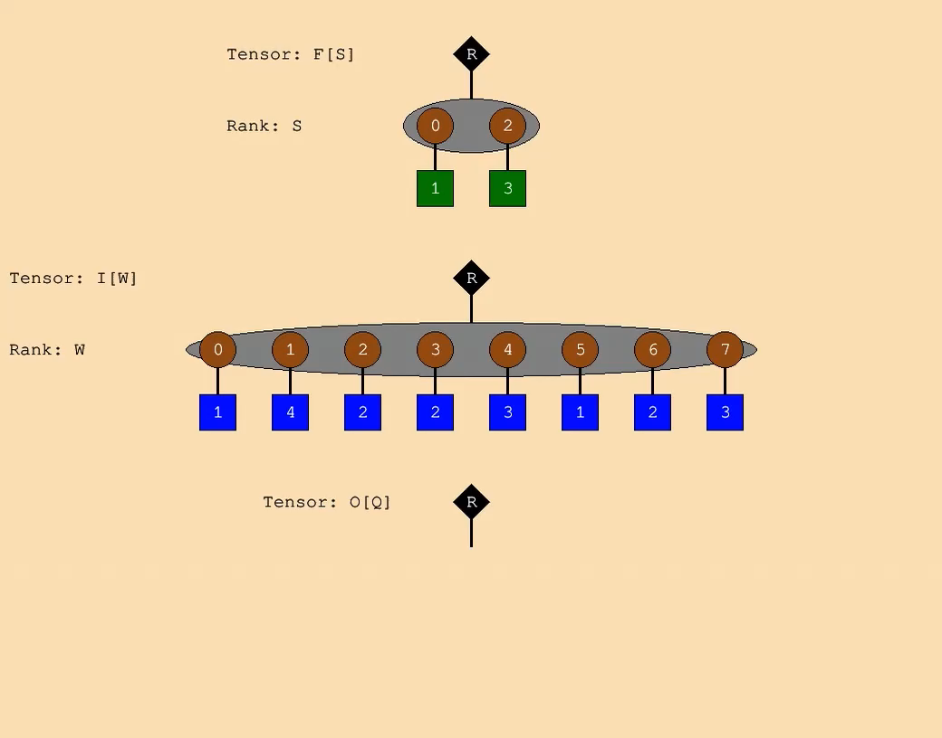
Output Stationary – Sparse Weights

Slide 4

Parallel Weight Stationary - Sparse Weights
Notes:
Update to an example with 4 weights that are actually split into groups of 2.

Slide 5
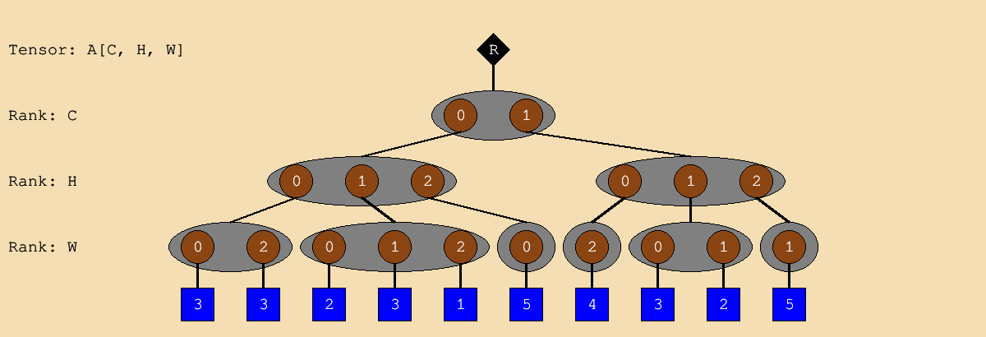
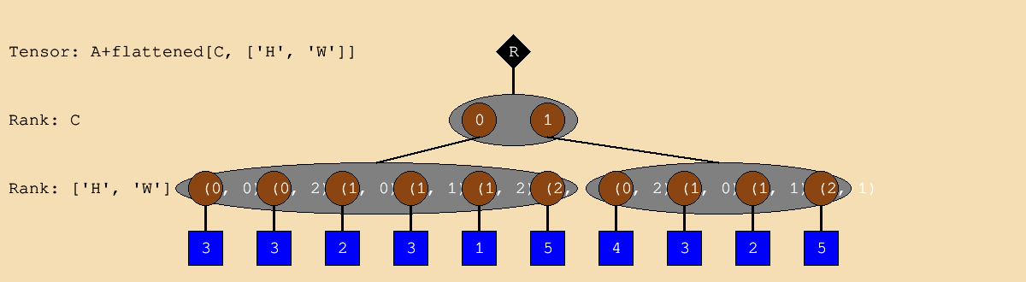
Flattening

